Slide 1
Building an Academic Web Presence
Rochelle Terman
20 March 2013

Slide 2
DAY 1 Planning and Installation

Slide 3
Game Plan
Introductions
Basic Planning: Goals and Capacities
Locating Your Site
Builders and Software
Dream Team: Dreamhost + Wordpress + Contributed Theme
Install and Away
Notes:
Take thoughts from group

Slide 4
Communication Goals
2. Basic Planning
Why do you want a web presence?
Who will be visiting your website?
What do you hope to communicate to these visitors?
What kinds of content do you imagine present?
Exercise: Share your preliminary thoughts
Notes:
Take thoughts from group

Slide 5
Capabilities
2. Basic Planning
What is your budget?
How much time are you willing to devote?
What is your coding / design / development skill level?
Exercise: Write your answers on a sheet of paper

Slide 6
Would your department profile suffice?
2. Basic Planning
Yes
No
Tenured faculty and pre-quals graduate students
No budget or time
Basic information like research interests and contact information (static content)
Early career faculty and job-seeking graduate students
Sufficient budget and time
Want to share different kinds of content, especially dynamic content

Slide 7
Locating your site
Where will your site live (hosting)
How will people get to your site (domain)

Slide 8
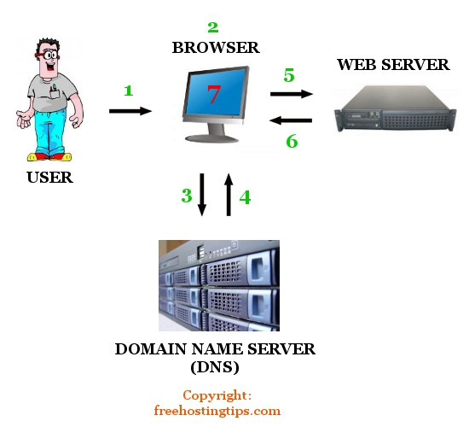
Domains v. Hosting
3. Locating Your Site
Domain
(www.berkeley.edu)
<==>
IP Address
(169.229.216.200)*
http://ip-lookup.net/domain.php

Slide 9
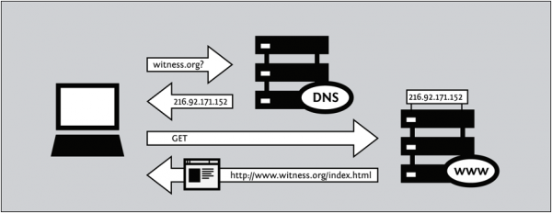
Domains v. Hosting
3. Locating Your Site

Slide 10
Where to host?
3. Locating Your Site
 | Free Service | Paid Service*
Generic Service | Google Sites**, Wordpress.com, Academia.edu | Dreamhost, GreenGeeks, Hostpapa
Berkeley Service | Open Computing Facility, Berkeley Scholars | ?
Domain | myname.wordpress.com ocf.berkeley.edu/~myname | www.myname.com, or Anything available.
Plus + | No hassle hosting, easy set-up, free | Lots of options for CMS, domain, hosting
Minus - | Constrained CMS and hosting options, ugly domain ** Can connect to a custom domain | Costs money, time, knowledge, motivation *Also paid services, e.g. Square Space, Weebly, Wix.

Slide 11
What’s the domain?
3. Locating Your Site
 | Berkeley | Personal
Domain | myname.berkeley.edu | www.myname.com
Good if… | You want to capitalize on the legitimacy of UC Berkeley | You plan on switching departments
 | You have a center on campus | You have a unique name
 | You can “point” to any host. | You want to keep it for life.
Exercise: See if your desired domain is available.

Slide 12
Builders & Software
4. Builders
 | Google Sites | Adobe Muse | CSS Templates | Wordpress | Drupal | Others for Sale (e.g. SquareSpace)
$$$ | Free | High* | Low* | Free* | Free* | High
Skill | None | Moderate (Design) | Moderate (Code) | Low (install) | Med - High | None
Static? | Static | Static | Static | Dynamic | Dynamic | Dynamic
Pretty? | Plain | Beautiful | Makeup | Beautiful | Makeup | Makeup
Power? | Weak | Weak | Weak | High | Superman | Muscle for Sale
FTP? | No | Yes | Yes | Kinda** | Yes | No
* Plus Hosting Costs
** It’s very possible to set up and maintain a WP site without ever having to use FTP.

Slide 13
What’s the cost?
4. Builders
 | Free | $5-10 / month | > $10 / month
Service / Hosting | Department Page, Google Sites, Wordpress.com, Berkeley Scholars | Dreamhost + Open Source CMS (Drupal, Wordpress) | Weebly, Wix, Square Space, Wix
Domain | Generic | Custom | Custom
Pluses + | Free, Easy | Cheap, Flexible | Easy, Pretty
Minuses - | Ugly, Inflexible | Difficult | Expensive, Inflexible

Slide 14
My Proposed Solution
5. Dreamteam
Dreamhost:
Cheap
Good customer service
One-click installs
Flexible
Free custom domain:
Wordpress
Free
Easy
Intuitive UI
Dynamic
Free Theme:
Free!
Flexible
Customizable
Premium Theme
$15-40
Beautiful
Time Saver

Slide 15
Try it out
5. Dreamteam
Exercise: make an account on wordpress.com
Why isn’t this good enough? (hint: http://www.wpbeginner.com/beginners-guide/what-are-the-limitations-of-wordpress-com/ )
Exercise (advanced): install locally using a MAMP stack: http://codex.wordpress.org/Installing_WordPress#Installing_WordPress_on_your_own_Computer
Like Bitnami: http://bitnami.com/stack/wordpress

Slide 16
Dreamhost
6. Dreamteam
Step 1: Make an account on www.dreamhost.com
Check out those deals! (there are often good promotions)
Alt: bluehost, etc (http://wordpress.org/hosting )

Slide 17
Dreamhost
6. Dreamteam
Step 2: Set up a domain
Domains usually come free with a hosting plan
To transfer a domain, you’ll have to pay about $10-20 (http://wiki.dreamhost.com/Transfer_your_domain_registration_to_us ) unlock it, and transfer
To use an outside domain on a dreamhost-hosted site, you have to “point” it to dreamhost (http://wiki.dreamhost.com/Configure_hosting_on_a_non-DreamHost_domain )

Slide 18
Dreamhost
6. Install
Step 3: Pick a hosting plan
Don’t worry about the bells and whistles, i.e. virtual dedicated servers, ssh, etc.
It’s cheaper to get 2-3 years at a time, but that’s up to you
Don’t believe me? Check out a comparison: http://www.artofblog.com/wordpress-hosting/

Slide 19
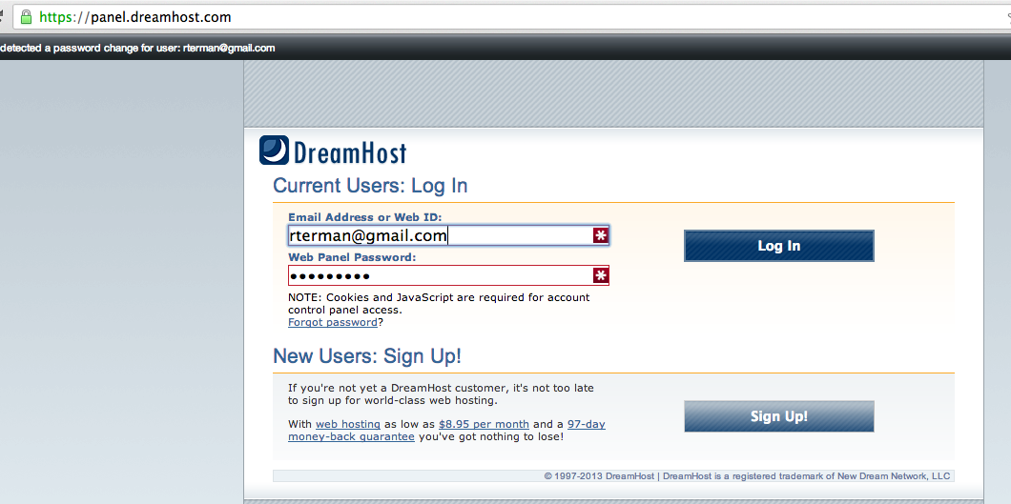
Dreamhost
6. Install
Step 4: Login in Panel

Slide 20
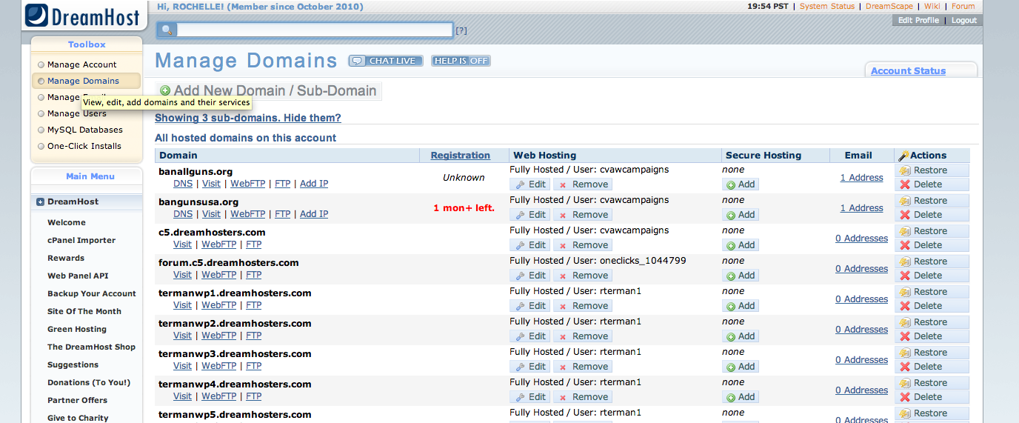
Dreamhost
6. Install
Step 5: “Manage Domains” → “Add Domain”
Make sure your domain is fully hosted.

Slide 21
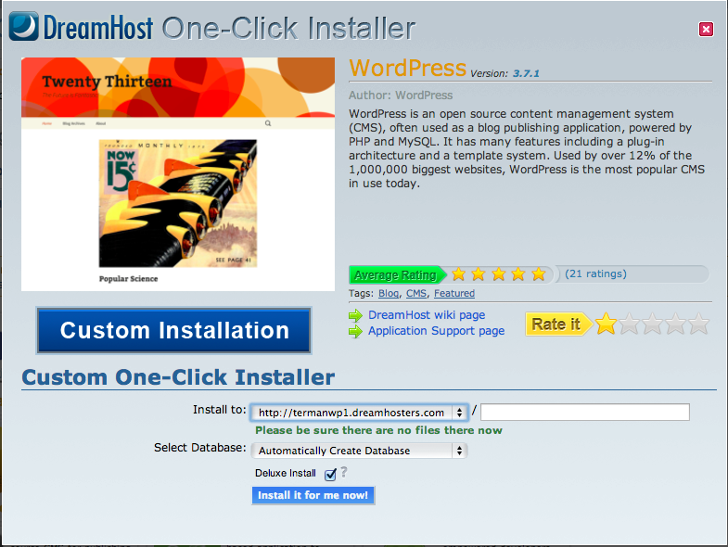
Dreamhost
6. Install
Step 6: One-Click Install Wordpress!
Hint: Find the one-click install in the “toolbox” menu on the upper left.
Hint: Install to: Your domain. Select Database: Automatically Create Database. Deluxe Install? Check!

Slide 22
Dreamhost
2. Navigation and Design
6. Install
Step 7: Wait.
You’ll get an email when the install is finished with a link to your new site.
Once you get the email, travel over to your new site, finish the install form, and you’re ready to go!

Slide 23
DAY 2 Building Your Site

Slide 24
Game Plan
Content Architecture and Communications Planning
Navigation and Design
Intro to Wordpress
Customize, Extend, and Away
Resources, Questions and Discussion
Notes:
Take thoughts from group

Slide 25
Communication Goals
1. Content Architecture
Why do you want a web presence?
Who will be visiting your website?
What do you hope to communicate to these visitors?
What kinds of content do you imagine present?
Exercise: Share your preliminary thoughts
Notes:
Take thoughts from group

Slide 26
Communication Goals
1. Content Architecture
This website will be dedicated to X, Y, and Z,
and cover the topics of A, B, and C. The audience will
be __________ ________________ _______. I will be adding
posts every _____________ about ________ _______ ______________.
I am doing this because _____________ _____________ __________________.
Exercise: Write your paragraph
Notes:
Take thoughts from group

Slide 27
Content Architecture
1. Content Architecture
Common
Less Common
Personal
Biography
Research activities
Teaching activities
CV
Contact info
Data
Image galleries
Links to academic resources
Transcripts or videos of lectures
Travel photos
Hobbies
Non-academic links
Blogs**

Slide 28
Rule of Thumb
1. Content Architecture
The earlier you are in your career, the more conservative you should be.
This applies as well for content tone and design.
Exercise: To blog or not to blog?

Slide 29
Things to think about
1. Content Architecture
Dynamic or Static?
How often will you update your site?
What will the site map look like?
What kinds of media will you use (photos, videos, files?)
Exercise: Sketch out a site map.

Slide 30
Navigation
1. Navigation and Design
Refers to how visitors move around the site
Primary menu (usually horizontal but sometimes vertical) that organizes the site’s content
Expect that people will spend on average about 30 seconds on your site – make your menus simple and intuitive

Slide 31
Navigation
2. Navigation and Design
Limited depth: 3 clicks rule
Less than 5-6 menu items
Content split into big blocks (About Me, Research, Teaching, Resources)
Items Brief and Standard
Submenus or headings for more specific information (Current Publications, Past Courses).
Simple and easy to read – stands out
Exercise: Design your primary menu on a sheet of paper

Slide 32
Design
2. Navigation and Design
Notes:
Be consistent: format all graphic elements, fonts, sizes, and colors consistently. For instance, the main navigation menu should be in the same place on all pages.
Use simple typography: There should be no more than 2 different fonts on your website. Use readable, web-safe fonts such as Verdana or Helvetica, 12 or 14 pt sizes, and use italics or bold sparingly and consistently.
Limit use of color: Choose a white or neutral background, a black or charcoal font color and a limited (1-2) accent colors for your menus and links.
Design like it’s a billboard, not a newspaper: Empty (negative) space is your friend. Make sure each page is 25-50% blank. Write short paragraphs and use bullet-points to break up content and make for a more aesthetically pleasing page.
Limit the amount of details such as lines, graphics, and frames. They tend to clutter the page.

Slide 33
Design
2. Navigation and Design
Be consistent
Use simple typography:
No more than 2 different fonts
Use readable, web-safe fonts such as Verdana or Helvetica
12 or 14 pt sizes
use italics or bold sparingly and consistently.
Limit use of color:
white or neutral background
a black or charcoal font color
limited (1-2) accent colors for your menus and links.
Design like it’s a billboard, not a newspaper
Limit the amount of details such as lines, graphics, and frames
Notes:
Be consistent: format all graphic elements, fonts, sizes, and colors consistently. For instance, the main navigation menu should be in the same place on all pages.
Use simple typography: There should be no more than 2 different fonts on your website. Use readable, web-safe fonts such as Verdana or Helvetica, 12 or 14 pt sizes, and use italics or bold sparingly and consistently.
Limit use of color: Choose a white or neutral background, a black or charcoal font color and a limited (1-2) accent colors for your menus and links.
Design like it’s a billboard, not a newspaper: Empty (negative) space is your friend. Make sure each page is 25-50% blank. Write short paragraphs and use bullet-points to break up content and make for a more aesthetically pleasing page.
Limit the amount of details such as lines, graphics, and frames. They tend to clutter the page.

Slide 34
Design
2. Navigation and Design
Exercise: Find your favorite theme on wordpress.org

Slide 35
What is Wordpress?
3. Intro Wordpress
http://codex.wordpress.org/FAQ_About_WordPress
http://codex.wordpress.org/WordPress
Open Source and Free
LAMP: Linux, Apache, MySQL, PHP
Focus on aesthetic and usability
Fast and powerful
Great community, documentation
Remember: If you don’t know, Google it!

Slide 36
First Glance
3. Intro Wordpress
http://codex.wordpress.org/First_Steps_With_WordPress
Check out your site
Test Drive: Header, Menu, Content, Widgets, Footer
Metadata and Comments
Content Types: Posts v. Pages
Categories v. Tags
Exercise: Write a post. Any post.
Remember: If you don’t know, Google it!

Slide 37
Admin Test Drive
3. Intro Wordpress
http://codex.wordpress.org/First_Steps_With_WordPress#Test_Drive_the_WordPress_Administration_Screens
Check out your Dashboard + Admin pages
Click around the various menu items – this is the only way to learn!
Exercise: Change your site title and tagline
Remember: If you don’t know, Google it!

Slide 38
Pages
3. Intro Wordpress
http://codex.wordpress.org/First_Steps_With_WordPress#What_Information_Do_You_Want_to_Share
Pages, similar to posts, are most commonly used to present unchanging information such as About Us, Contact Us, Sign Up for Our Mailing List, and other static information.
Exercise: Add an “About Me” Page
Remember: If you don’t know, Google it!

Slide 39
Wysi-what?
3. Intro Wordpress
http://codex.wordpress.org/Writing_Posts and
http://en.support.wordpress.com/visual-editor/
You don't have to use HTML when writing your posts. WordPress will automatically add it to your site using the WYSIWYG (What You See Is What You Get).
This menu allows you make things bold, italics, lists, headers, links etc.
Exercise: Add some HTML to that “About Me” Page
Remember: If you don’t know, Google it!

Slide 40
A Pretty Face
3. Intro Wordpress
http://codex.wordpress.org/Using_Images and http://codex.wordpress.org/Wrapping_Text_Around_Images and
http://www.wpbeginner.com/beginners-guide/how-to-crop-rotate-scale-and-flip-images-in-wordpress/
There are usually two ways to add images to your posts/pages:
Directly in the post using the wysiwyg (see links above)
Attached to the post in the “featured image” field** : http://en.support.wordpress.com/featured-images/
** This depends on the theme
Exercise: Add some an image to your “About Me” Page
Remember: If you don’t know, Google it!

Slide 41
PDFs Galore
3. Intro Wordpress
http://bakermarketingservices.com/2012/12/add-a-pdf-download-link-to-your-wordpress-website/ and
http://en.support.wordpress.com/uploading-documents/
Use the media upload button to add pdfs, docs, and any other document you want
See detailed instructions in the links above
Exercise: Add a link to your CV in your “About Me” Page
Remember: If you don’t know, Google it!

Slide 42
Pages v. Posts
3. Intro Wordpress
http://en.support.wordpress.com/post-vs-page/ and
http://www.wpbeginner.com/beginners-guide/what-is-the-difference-between-posts-vs-pages-in-wordpress/
By default…
Posts are timely vs. Pages are timeless.
Posts are social vs. Pages are NOT.
Posts can be categorized vs. Pages are hierarchical.
Posts are included in RSS feed vs. Pages are not.
Pages have custom template feature vs. Posts do not.
Exercise: Decide whether you want to structure your site using pages, posts, or both.
Remember: If you don’t know, Google it!

Slide 43
Posts
3. Intro Wordpress
http://www.wpbeginner.com/beginners-guide/how-to-add-a-new-post-in-wordpress-and-utilize-all-the-features/
Posts have things like…
Categories
Tags
Excerpts
Featured Images
Exercise: Find the post you made
Remember: If you don’t know, Google it!

Slide 44
Organize your content
3. Intro Wordpress
http://en.support.wordpress.com/posts/categories-vs-tags/ and
http://www.wpbeginner.com/beginners-guide/categories-vs-tags-seo-best-practices-which-one-is-better/ and
http://www.wpbeginner.com/beginners-guide/how-to-add-categories-and-subcategories-to-wordpress/
Go to Dashboard→ Posts → Categories
Add categories corresponding to your content architecture
Add tags for more specific topics across categories
Exercise: Add categories like “Research” or “Teaching” or anything you want
Remember: If you don’t know, Google it!

Slide 45
Customize the Look
4. Customize and Away!
http://codex.wordpress.org/Using_Themes
Go to Dashboard→Appearance
Themes decide the look and feel of the site
“Manage Themes” to activate a pre-installed theme
“Install Theme” to add a new theme
Select free theme from interface
Upload a premium theme
“Theme Options” to decide things like colors and fonts, if your theme offers such options
Exercise: Change your theme and see what happens
Remember: If you don’t know, Google it!

Slide 46
Menus
4. Customize and Away!
http://codex.wordpress.org/WordPress_Menu_User_Guide
Go to Dashboard→ Appearance → Menus
Menus: Main Navigation and any other menu you want
Menu regions and some options are decided by theme
Exercise: Add your primary menu. Remember: Static v. Dynamic Content
Remember: If you don’t know, Google it!

Slide 47
Widget-ize
4. Customize and Away!
http://codex.wordpress.org/WordPress_Widgets
Go to Dashboard→Appearance→Widgets
Add content and features to your Sidebars.
Default Widgets: post categories, tag clouds, navigation, search, etc.
Plugins will often add their own widgets.
“Sidebars” or regions depend on the theme.
Drag ‘n’ Drop your widgets
Exercise: Add some widgets to the sidebar
Remember: If you don’t know, Google it!

Slide 48
Extend and Away
4. Customize and Away!
http://www.wpbeginner.com/beginners-guide/step-by-step-guide-to-install-a-wordpress-plugin-for-beginners/
Go to Admin → Plugins
Plugins add broad features of your site. If you want it, there’s probably a plugin for it
Exercise: Add the Jetpack and Codex plugins
Remember: If you don’t know, Google it!

Slide 49
Shortcode Magic
4. Customize and Away!
http://codex.wordpress.org/Shortcode
Shortcodes = WordPress-specific code that lets you do nifty things with very little effort.
Can embed things like galleries, videos, contact forms, lists of posts, etc in posts and pages (and even widgets)
Some shortcodes come default, but most are available via Plugins
Exercise: Find a plugin that offers some kind of shortcode
Remember: If you don’t know, Google it!

Slide 50
Shortcode Magic
4. Customize and Away!
http://codex.wordpress.org/Shortcode
Shortcodes usually have attributes
[gallery id="123" size="medium"]
How do you get an id for a post, image or page? (hint: it’s in the url)
Lots of themes have shortcodes that comes with them
Especially premium themes: http://www.elegantthemes.com/features/shortcodes.html
Exercise: Add a gallery using shortcode: http://codex.wordpress.org/Gallery_Shortcode
Remember: If you don’t know, Google it!

Slide 51
Get Help
5. Help and Resources
http://codex.wordpress.org/First_Steps_With_WordPress
Wordpress documentation codex
Blogs, screencasts, third party websites
Forums
Me!
Exercise: Find out how to disable comments on both your current content and future content
Remember: If you don’t know, Google it!

