Slide 1
Lifecycle of a Text Analysis Project
https://github.com/rochelleterman/worlds-women
Rochelle Terman
Social Computing Working Group
Feb 27, 2015

Slide 2
Lifecycle
Frame research question
Acquire text data
Preprocess
Analyze
Visualize + Interpret

Slide 3
Text as Data
Language is the medium for politics and political conflict
Social scientists have always used texts
There are costs to large-scale text analysis
Computers can lower these costs

Slide 4
My research question
How does American media represent women abroad?
How do these representations vary across time and space?
What are some others?

Slide 5
4 principles of ATA
All Quantitative Models of Language Are Wrong—But Some Are Useful
Quantitative methods for text amplify resources and augment humans.
There is no globally best method for automated text analysis.
Validate, Validate, Validate.
~ Grimmer & Stewart, 2013

Slide 6
An overview of process
Credit: Grimmer & Stewart, 2013

Slide 7
An overview of methods
Credit: Laura Nelson

Slide 8
Methods covered today
Sentiment analysis
Word separating analysis
Structural topic modeling

Slide 9
2. Acquire
Goal: machine readable text
plain text (.txt) file.
UTF-8, ASCII
Metadata if possible

Slide 10
Sources
Online databases, e.g. LexisNexis (batch downloads)
Websites (scraping, Mechanical Turk)
Archives (high- quality scanner and Optical Character Recognition software)

Slide 11
LexisNexis: Download
Can only download > 500 articles at a time
Search strategy:
Terms: ((SUBJECT(women)) and Date(geq(10/01/2014) and leq(12/31/2014))
Source: The New York Times
Download:
Format: Text
Document View: Full w/ Indexing
Document Range: Current Category (if subsetting)

Slide 12
LexisNexis: Parse
Download
Merge
> cat *.TXT > all.txt3
3. Parse into csv format using Neal Caren’s python script.
> python split_ln.py all.txt

Slide 13
LexisNexis: Metadata
Get Year (from date)
Get Country (from LexisNexis geography)
Get Region (from Country)
Subset to only non-US counries

Slide 14
LexisNexis: Metadata
Date → Year
total$DATE <- as.character(total$DATE)
total$YEAR <- substr(total$DATE, nchar(total$DATE)-2, nchar(total$DATE))
total$YEAR <- as.integer(total$YEAR)

Slide 15
LexisNexis: Metadata
Geography → Region
NIGERIA (99%); UNITED STATES (98%); SOMALIA (92%); SOUTH AFRICA (79%); AFRICA (79%); UGANDA (79%);

Slide 16
LexisNexis: Metadata
Geography → Region
NIGERIA (99%); UNITED STATES (98%); SOMALIA (92%); SOUTH AFRICA (79%); AFRICA (79%); UGANDA (79%);

Slide 17
LexisNexis: Metadata
To the R script!
clean-and-categorize.R
Input: all-raw.csv
Output: women-all.csv, women-foreign.csv
descriptive.R

Slide 18
Descriptive Plots

Slide 19
3. Pre-process
Tokenize (1-gram, 2-gram, etc.)
Remove stop words
Remove punctuation
Stemming and lemmatization
Named Entity Removal**

Slide 20
Document-Term Matrix
 | ambit | poverti | peopl | full
Document1 | 4 | 2 | 0 | 0
Document2 | 1 | 3 | 7 | 0
Document3 | 2 | 0 | 0 | 0
Document4 | 9 | 1 | 4 | 0
Document5 | 0 | 0 | 0 | 6
Notes:
After you do this, produce a document-term matrix. Rows are documents, columns are terms, and the cells are the frequency of each term per document. From here, you can do a number of calculations.

Slide 21
3. Pre-process
To the ipython notebook!
Preprocess.ipynb
Output: women-processed.csv, dtm-python.csv

Slide 22
4. Analyze
Sentiment Analysis: Where are women represented most postivitely? Negatively?
Word Separating Analysis: How do regions differ in framing of coverage?
Structural Topic Models: How does region affect substance of coverage?

Slide 23
Sentiment Analysis
A dictionary method to measure affect
Affective Norms for English Words (ANEW)
On a scale of 1-9 how happy does this word make you
Happy : triumphant (8.82)/paradise (8.72)/ love (8.72)
Neutral: street (5.22)/ paper (5.20)/ engine (5.20)
Unhappy : cancer (1.5)/funeral (1.39)/ rape (1.25) /suicide (1.25)
Can use weights or counts

Slide 24
Sentiment Analysis

Slide 25
Sentiment Analysis
To the R script!
sentiments.R
Input: women-processed.csv
Output: Results/sentiments-bar.jpeg

Slide 26
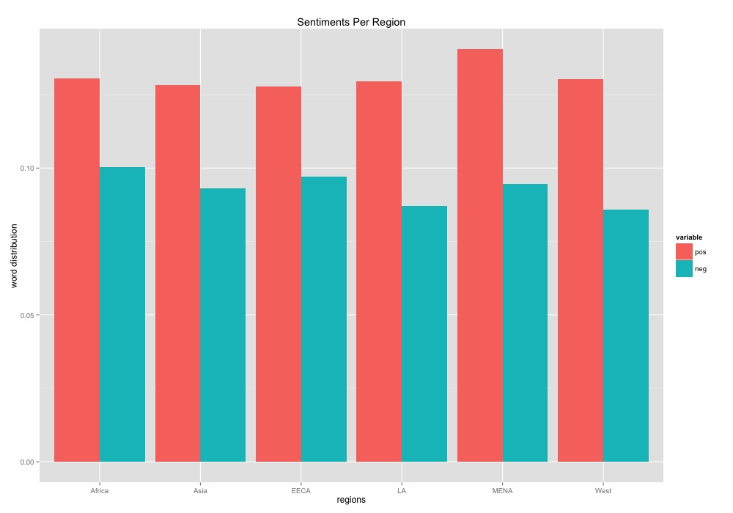
Sentiment Plots

Slide 27
Discriminating Word Analysis
Identify features (words) that discriminate between groups to learn features that are indicative of some group
Ex: partisan words, ideological words, etc
Many methods: difference in proportions, standard log odds, log odds ratio, standard mean difference, td-idf, independent linear discriminant etc.

Slide 28
Discriminating Word Analysis
To the R script!
distinctive-words.R
Input: Data/dtm-python.csv
Output: Results/distinctive-words/*

Slide 29
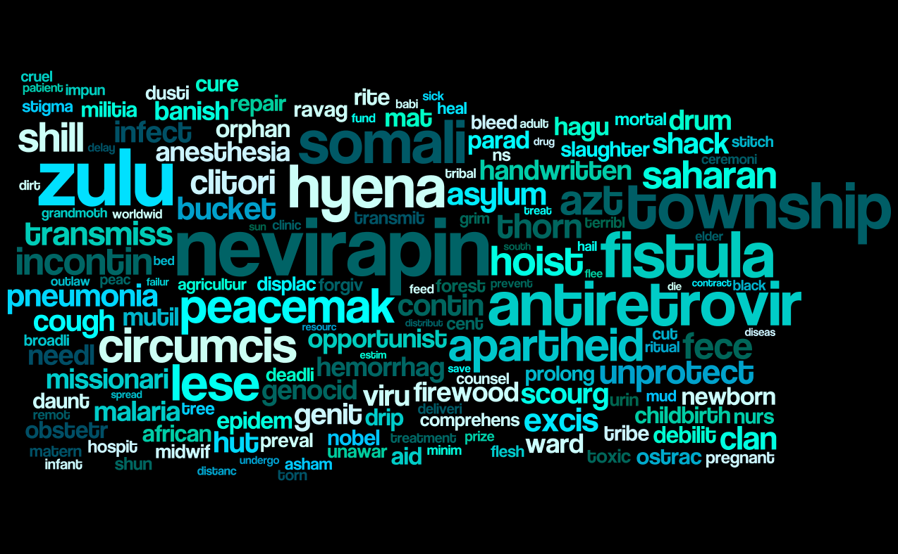
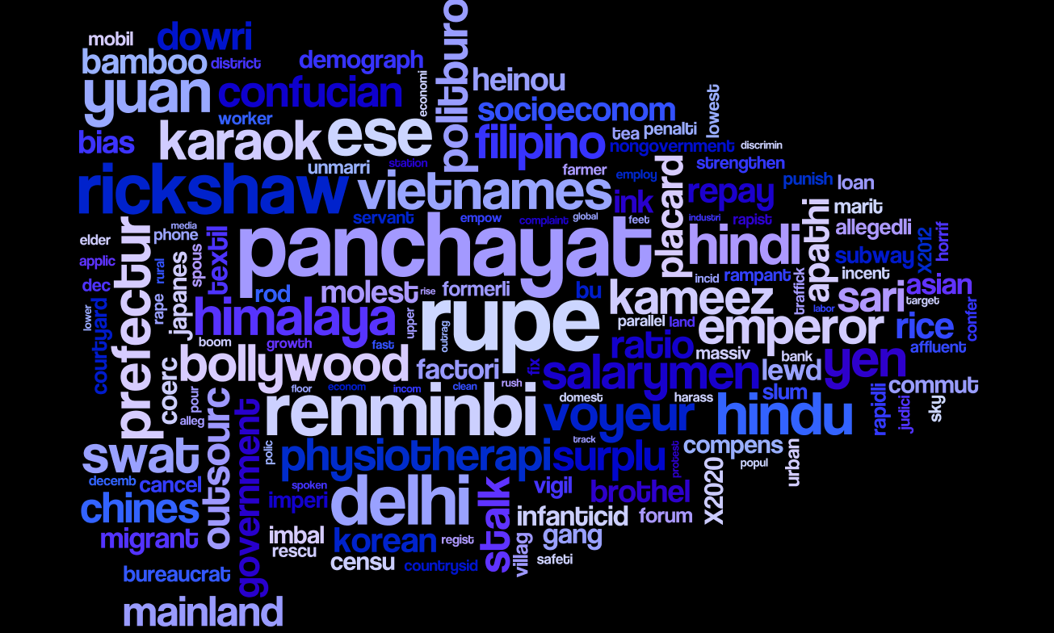
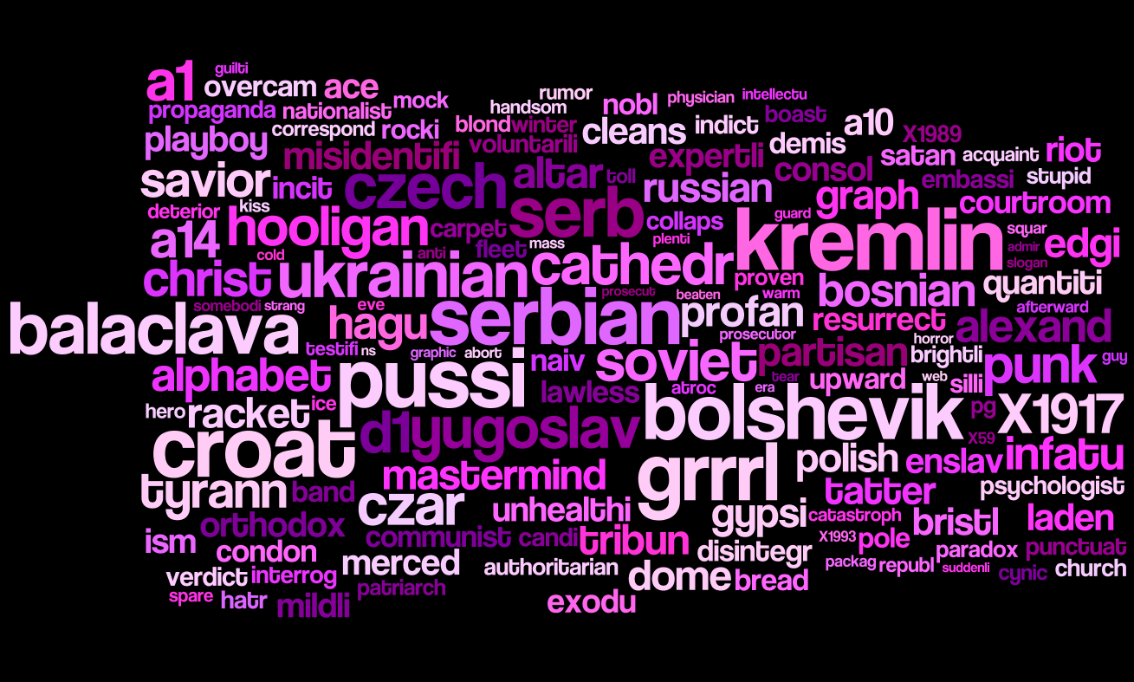
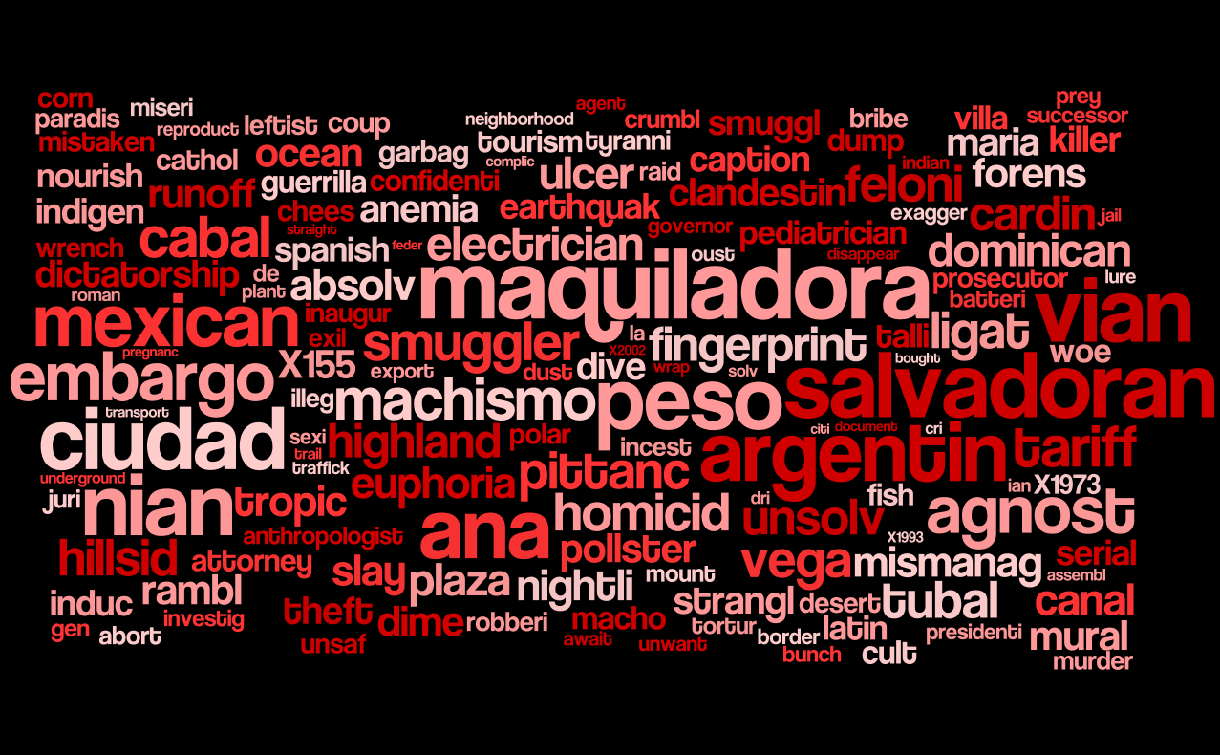
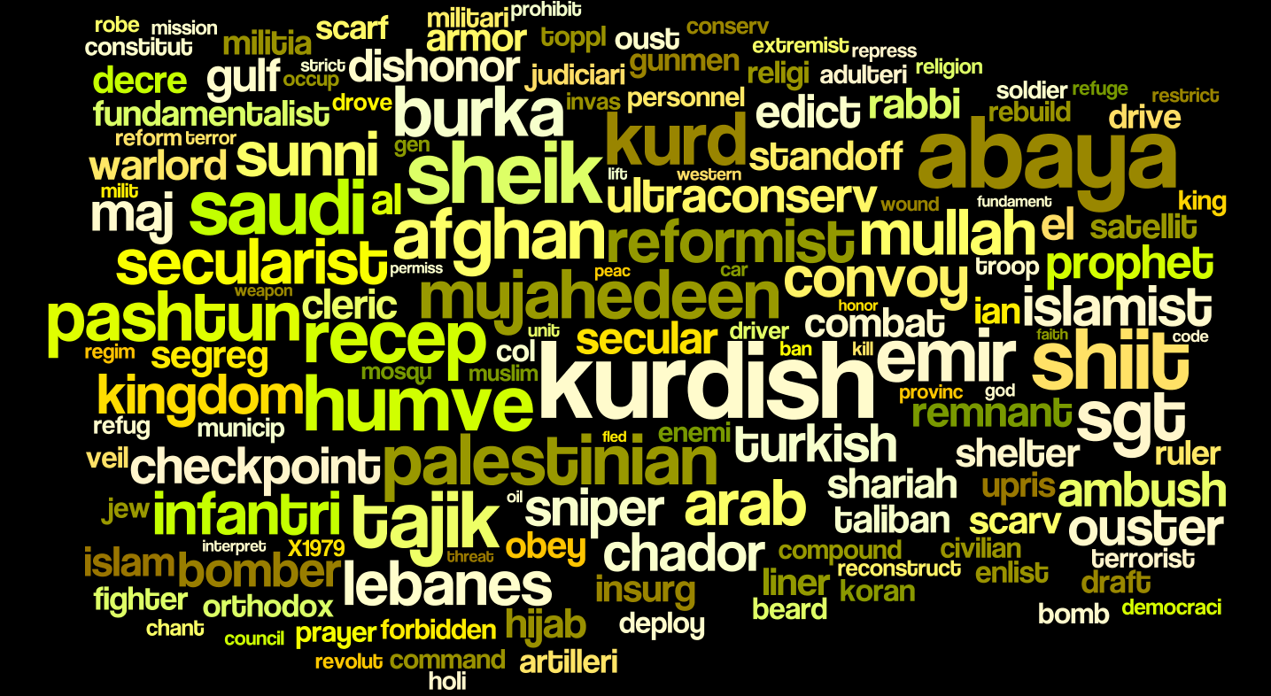
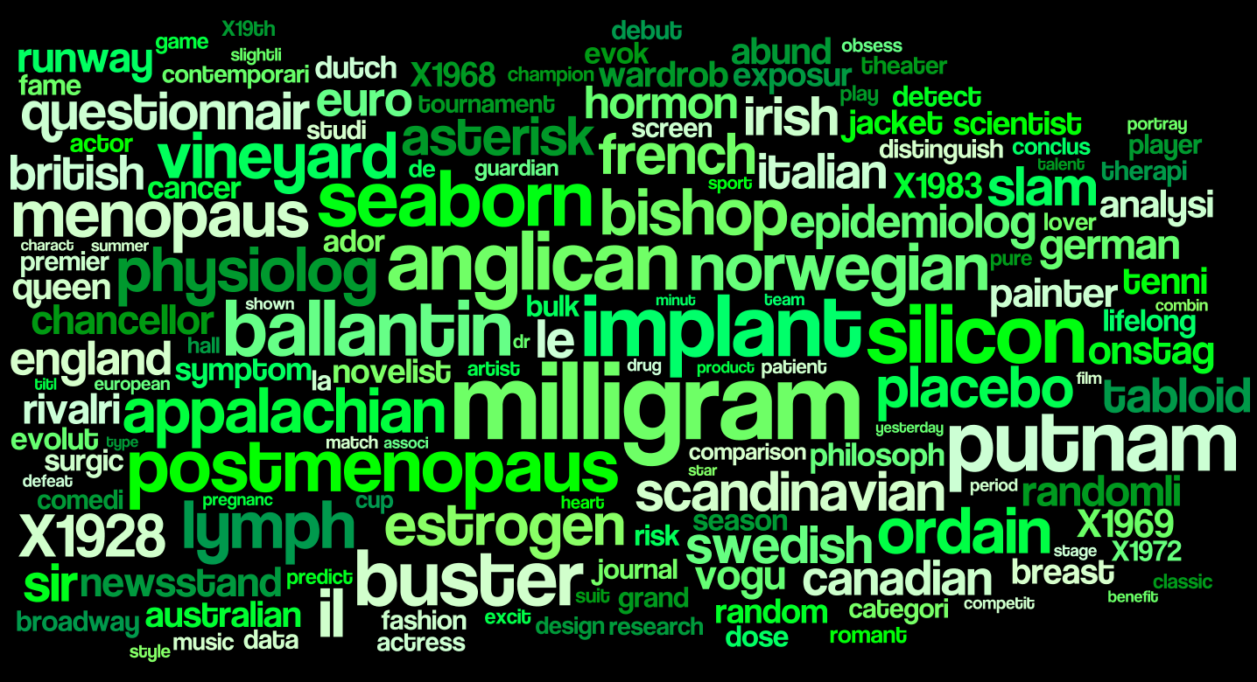
Visualizing word scores with Wordle

Slide 30
Topic Modeling - LDA
Unsupervised
Mixed-membership
Simple and extendible

Slide 31
Topic Modeling

Slide 32
Topic Modeling
Each topic is a distribution over ALL words.
Topic1 | topic1_weight | Topic2 | topic2_weight | Topic3 | topic3_weight
gene | 0.5 | genetic | 0.4 | dna | 0.7
dna | 0.3 | dna | 0.2 | genetic | 0.2
genetic | 0.2 | gene | 0.2 | gene | 0.1
Sum | 1.0 |  | 1.0 |  | 1.0
Each document is a distribution over ALL topics.
Doc1 | doc1_weight | Doc2 | doc2_weight | Doc3 | doc3_weight
Topic1 | 0.6 | Topic2 | 0.8 | Topic3 | 0.5
Topic2 | 0.3 | Topic3 | 0.1 | Topic1 | 0.3
Topic3 | 0.1 | Topic1 | 0.1 | Topic2 | 0.2
Sum | 1.0 |  | 1.0 |  | 1.0
Notes:
Out of a document-term matrix you give a topic modeling algorithm the number of topics you want to find, and it give you two things:
-A distribution of each topic over all of the words (every topic contains every word, at different weights)
-A distribution of each document over all of the topics (every document “contains” every topic, at different weights)
You can then look at how the topic weights per document change over time, or if they're different per category of interest.
Again, you choose the number of topics, and it starts from a random distribution of topics. If either is bad, your output will be bad.
LDA is extremely sensitive to word choice. In model I ran it picked up a “car maintenance” topic. This is not because car maintenance was an important topic, self defense was probably more important. But because LDA is sensitive to word choice, unique words will more likely be grouped into a clear topic. Words for car maintenance are not typically used in everyday langauge. If I didn't know anything about the text I would have missed the self-defense topic, and though car maintenance was quite important. It's so important to validate your findings with topic modeling, and use some other method to do so.

Slide 33
Right number of topics?
Depends on task at hand
Coarse: broad comparisons, lose distinctions
Granular: specific insights, lose broader picture

Slide 34
Topic Modeling
It does
It does not
Allow categories to arise inductively
Find latent categories
Find patterns across text
Handle large and diverse corpora
Find key differences between categories
Find the “one” best way to categorize text
Capture the categories you want
Tell you who does what to whom
Magically reveal meaning

Slide 35
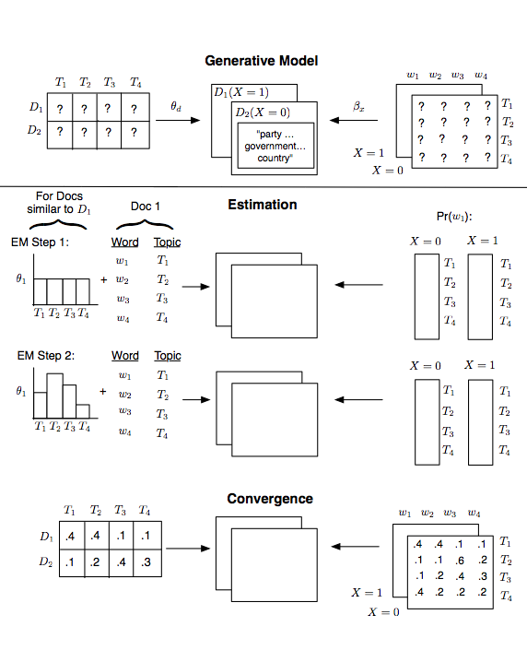
Structural Topic Model

Slide 36
Structural Topic Model
Examines how document attention, topic content varies over time, across authors, or with general set of covariates.
Can use prevalence and content covariates.
Prevalence ~ (Region + Year)

Slide 37
Validation
Semantic Validity: All categories are coherent and meaningful
Convergent Construct Validity: Measures concur with existing
measures in critical details.
Discriminant Construct Validity: Measures differ from existing measures in productive ways.
Predictive Measure: Measures from the model corresponds to external events in expected ways.
Hypothesis Validity: Measures generated from the model can be used to test substantive hypotheses.
Must use a variety of validations.
None of these validations are performed using a canned statistic
All: require substantive knowledge on areas (and what we expect!)

Slide 38
Structural Topic Model
To the R script!
stm.R
Input: Data/women-processed.csv
Output: Results/stm/*

Slide 39
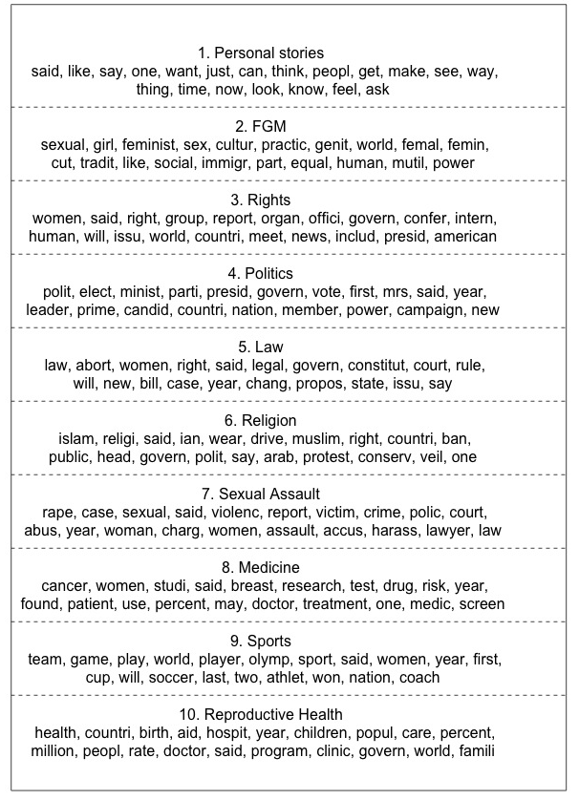
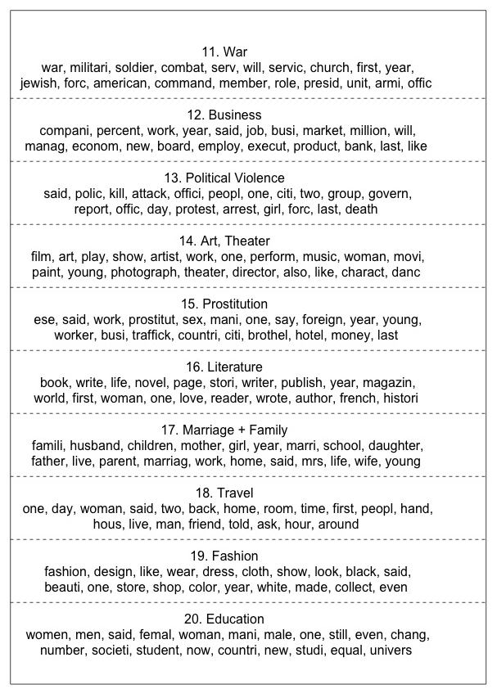
Topics

Slide 40
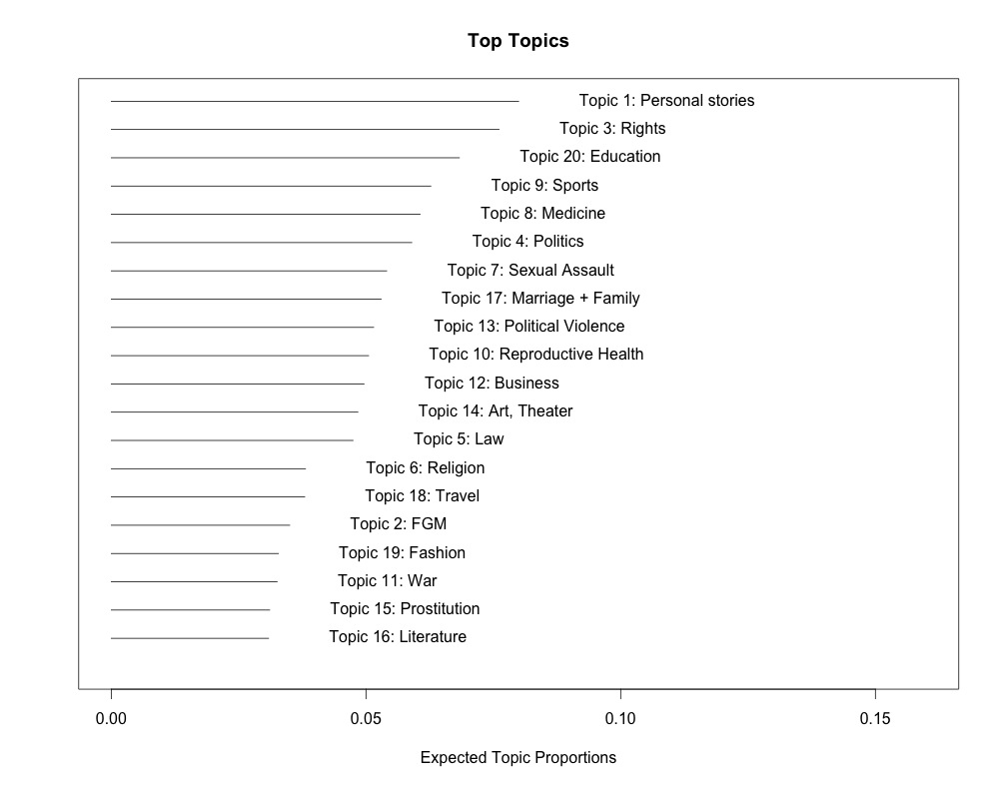

Slide 41
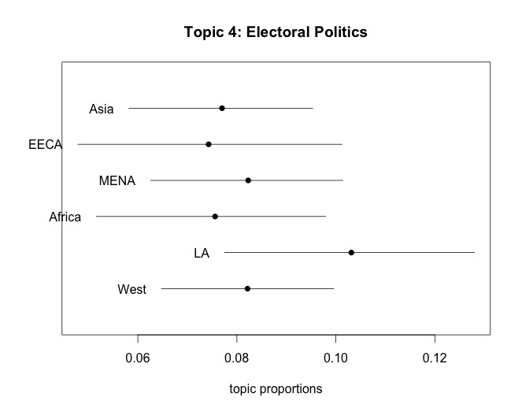
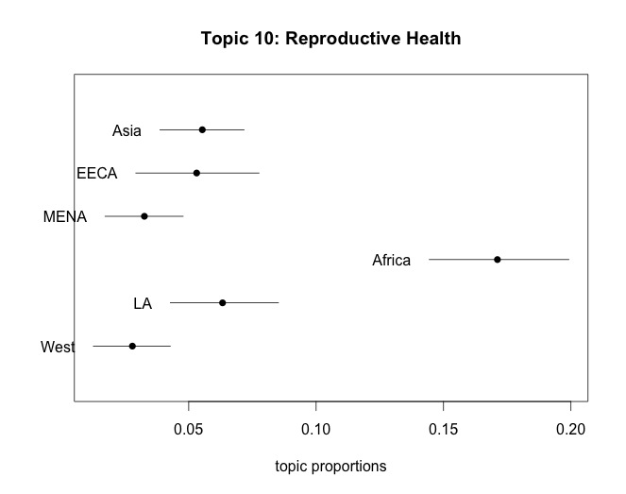
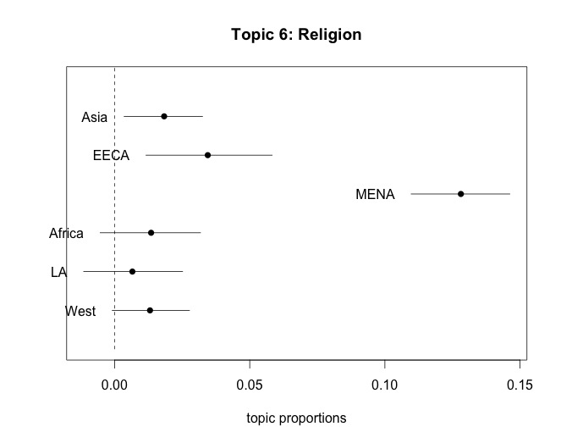
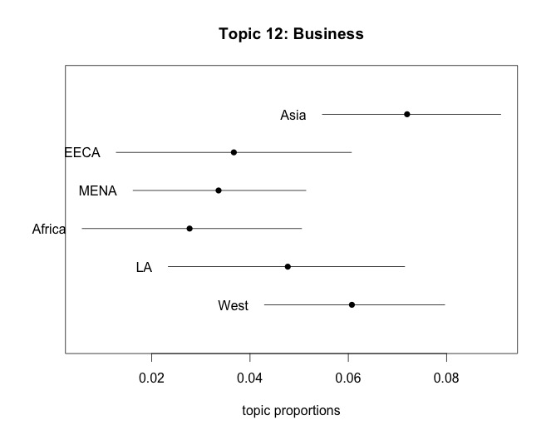

Slide 42
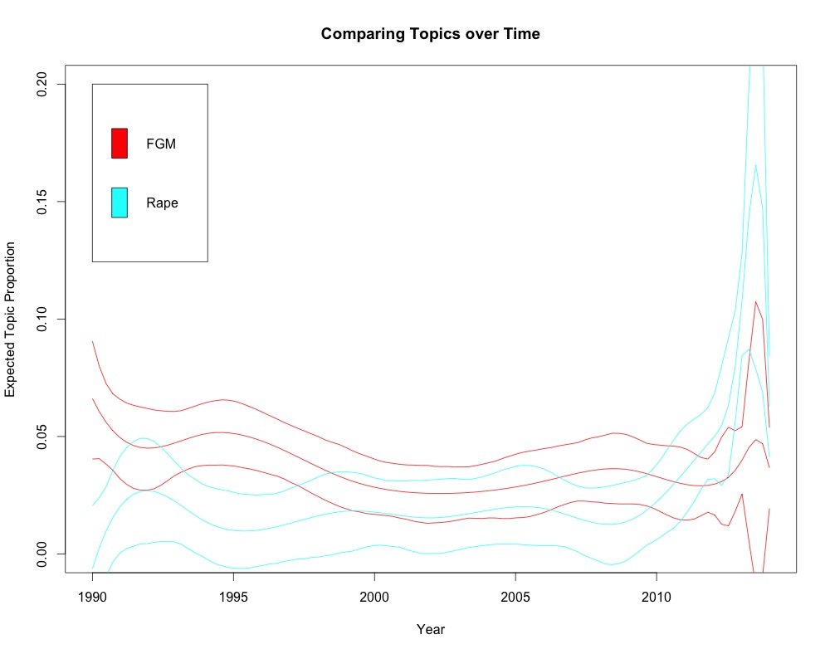

Slide 43
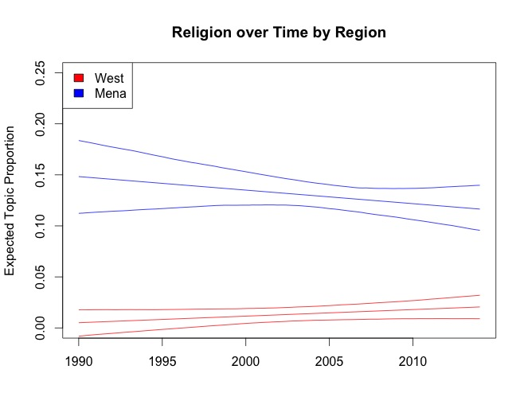

Slide 44
Resources
Computational Narratology
Analyzing Plots with Sentiment Analysis
Plot Mapper (in 2D space)
Other tools from Nick Beauchamp (who did plot mapper)
Text as Data Class by Justin Grimmer (check out the syllabus especially)
Computer Assisted Text Analysis for Comparative Politics (good stuff on foreign languages)

Slide 45
File structure
Task | Input | Script | Output
Clean Metadata | Data/raw-all.csv | clean-and-categorize.R | Data/women-all.csv, Data/women-foreign.csv
Descriptive Stats | Data/women-foreign.csv | descriptive.R | Results/
Pre Process | Data/women-foreign.csv | sentiments.ipynb | Data/women-processed.csv
Sentiment Analysis | Data/women-process.csv | sentiments.R | Results/
Discriminating Words | Data/dtm-python.csv | discriminating-words.R | Results/distinctive-words/
STM | Data/women-process.csv | stm.R | Results/

