Slide 1
Qualitative Data Analysis
with MaxQDA
Summer Starling, MPH, DrPH(c)
UC Berkeley
summerstarling@berkeley.edu
DLab Workshop
February 26, 2016
Notes:
General opening comments (as applicable)
Data organization/management - naming files, organizing data in folders on desktop, and organizing data across documents through QDA
Coding - what is coding? how to define your code and coding.
Ways to code - mention scissors and highlighters, Word, Excel, QDA. discuss some other options for QDA packages (NVivo, MaxQDA, Dedoose) and mention things to look for (e.g., does the package work with the format of your data? does it let you run queries that youc an define yourself? can you add metadata (data about your data)?)
Atlas.TI demo - here I show them the basic layout, how you can use "families" for metadata, basic code output and remind them why naming conventions matter, and query output and other advanced analysis tools (e.g., tables with counts of quotations in each code).

Slide 2
3-part workshop
Part I
Why use a QDA software program?
Familiarization with interface & functions
Part II
Demo MaxQDA
Part III
How to choose a QDA platform
Q&A
Notes:
Brief introductions from the group – 1 thing they’d like to get out of the workshop today; or why they signed up for the workshop today
DEMO will include:
Starting a new database – How to import data (NEW demo)
How can files be organized – Review how to de/activate documents; overview of the code system and file folders (ENG or DISS demo)
Adding and applying codes – How to do coding (ENG)
How do you view completed coding while you code – This is often highlighting of text or a coding stripe in the margin.
NOTE: Here people often have questions about your coding philosophy – How many codes should I have? Should codes be broad or narrow? Should I predefine my codes or let the data define them?
How to include characteristics about your data (meta-data) – This is sometimes called attributes, groups, or families.
NOTE: There are often questions about what should be done as a characteristic versus a code. (DISS)
Is it possible to capture a passage without applying a code – This is useful for those interested in more inductive coding processes. These are sometimes called quotations. Lexical searches (DISS)
How do you look at simple code output for one code (ENG)
How do you write memos within the QDA package (ENG)
NOTE: There are usually questions about what you should write memos about.
Analysis tools:
Can you table relationships between codes – This is sometimes called a co-occurrence table.(Visual Tools > Code Matrix Browser and Code Relations Browser) (DISS)
Can you produce distribution of codes across documents – This is sometimes called a code and primary document table. (Document table) DISS
How do you look at codes by characteristics about your data – This is often done through queries.
How do you look at where codes interact, do not interact, or have one code of the other –This is often done with queries.

Slide 3
What is MAXQDA?
Software for
Qualitative Data Analysis
Qualitative Data |  | Analysis
Interviews, transcripts, articles, documents, discussions, online statements, webpages, field notes, pictures, audio, video, geographical references, bibliographical data, ... |  | Case study, focus group analysis, grounded theory, content analysis, mixed methods, ... ... MAXQDA is not limited to one kind of method.

Slide 4
Benefits of using research software
Organize Data
Import text, tables, images, audio, video, tweets & results from surveys
Knowledge management
Transcribe media files
Analyze Data
Categorize, link & annotate
Retrieve, filter & identify relevant information
Summarize Data
Summarize & visualise data
Export & present results

Slide 5
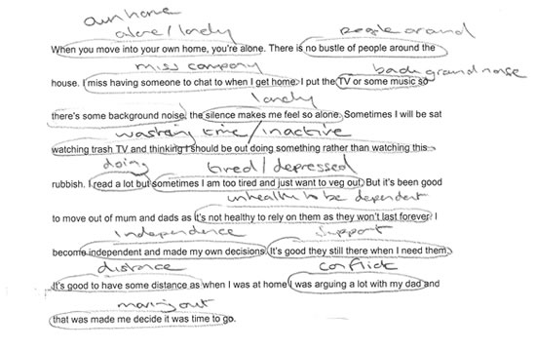
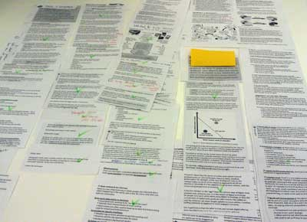
Notes:
Pic of old school QDA

Slide 6
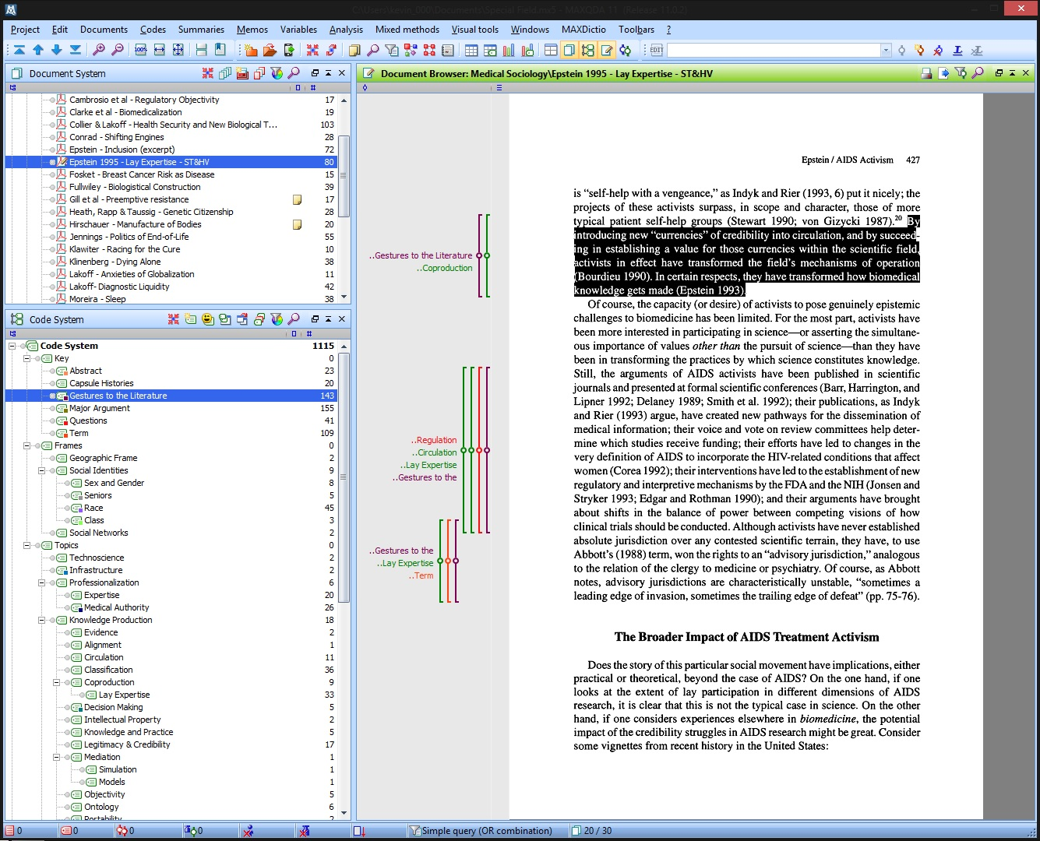
Notes:
“After” pic
Now get familiar with MaxQDA interface and how it’s designed
Before taking us through what it looks like to use it in real time

Slide 7
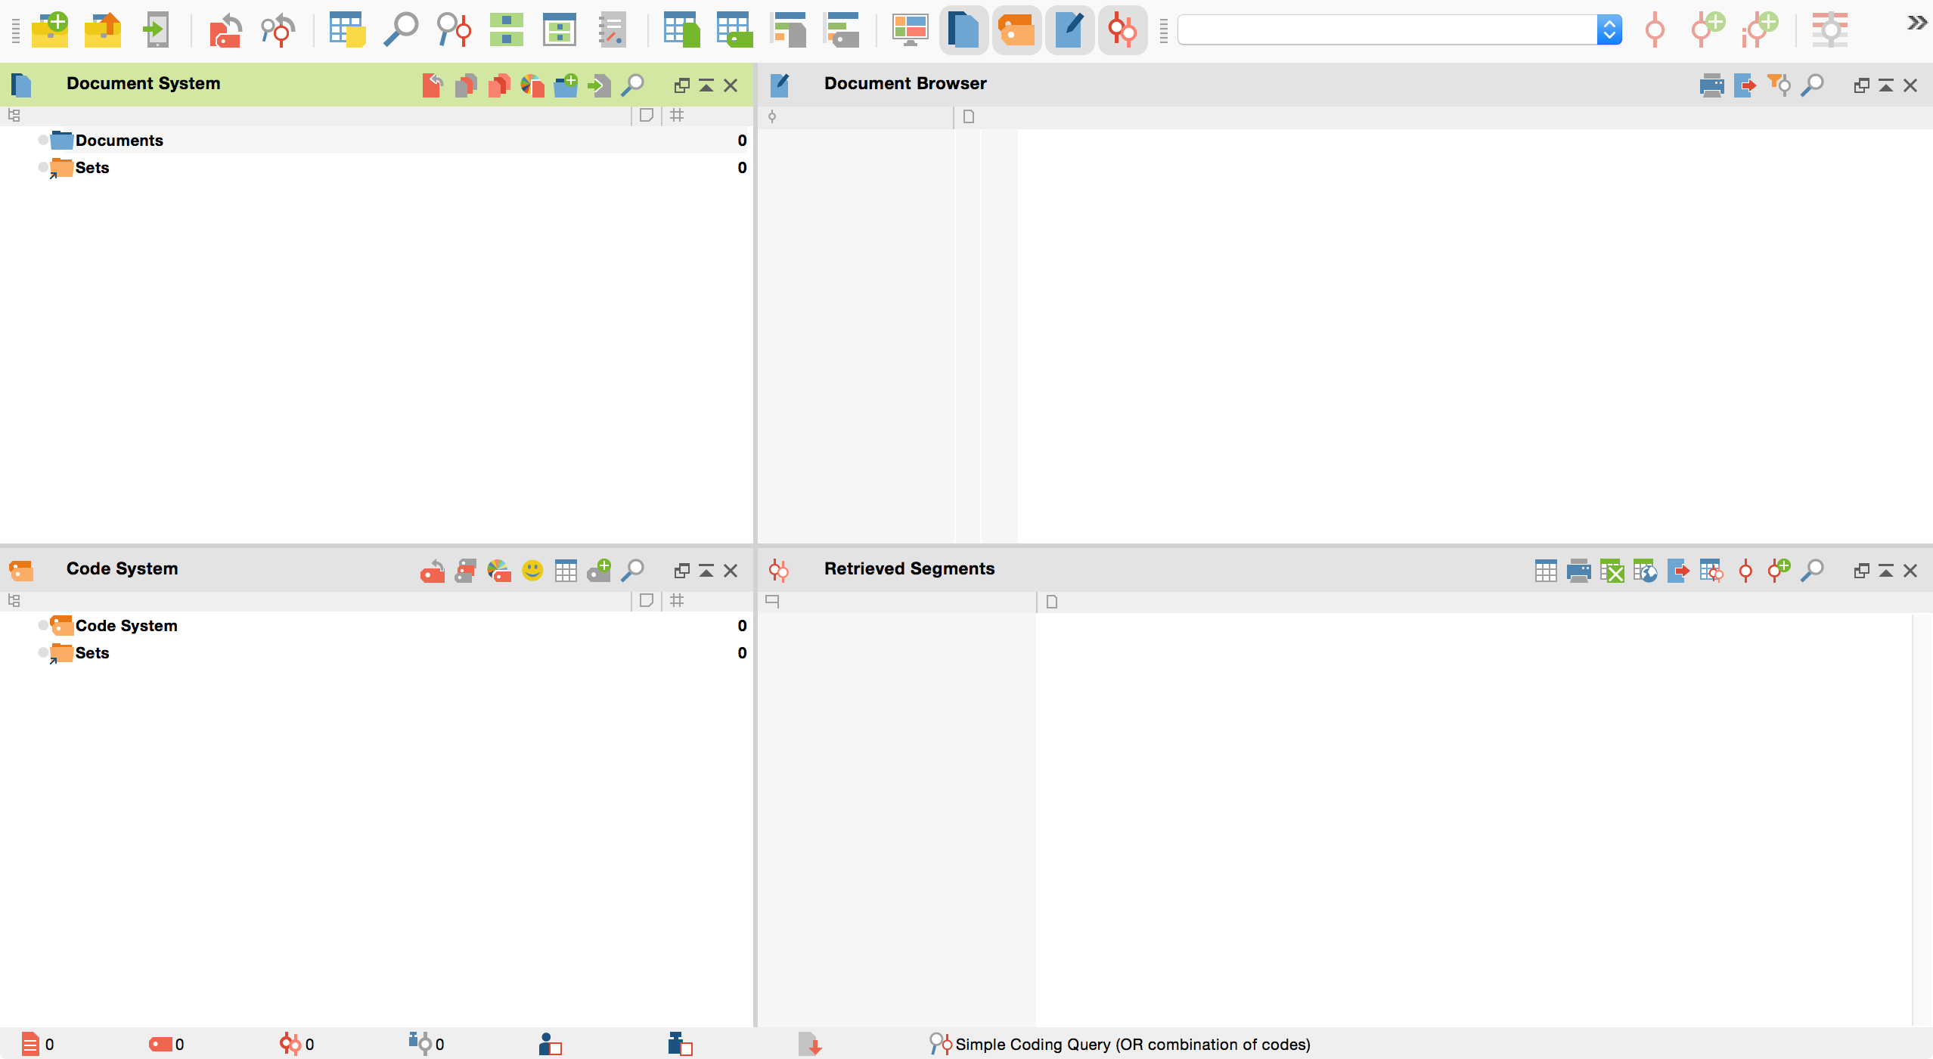
MAXQDA Overview – the empty box
Toolbar
Document
Reader/
Editor
Document
Organizer
Code
Organizer
Retrieved
Data
Statusbar

Slide 8
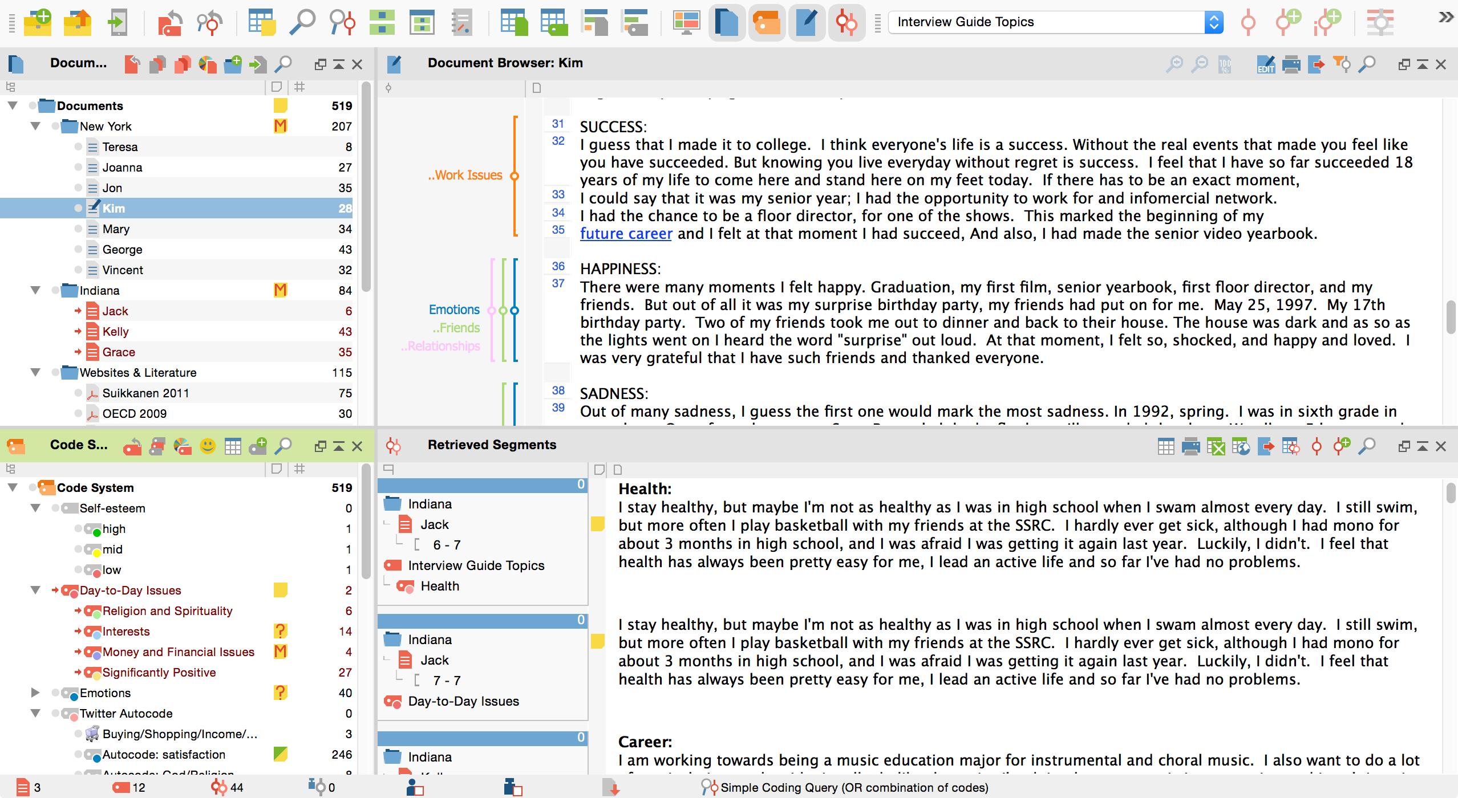
MAXQDA Overview – working screen
Toolbar
Document
Reader/
Editor
Document
Organizer
Code
Organizer
Retrieved
Data
Statusbar

Slide 9
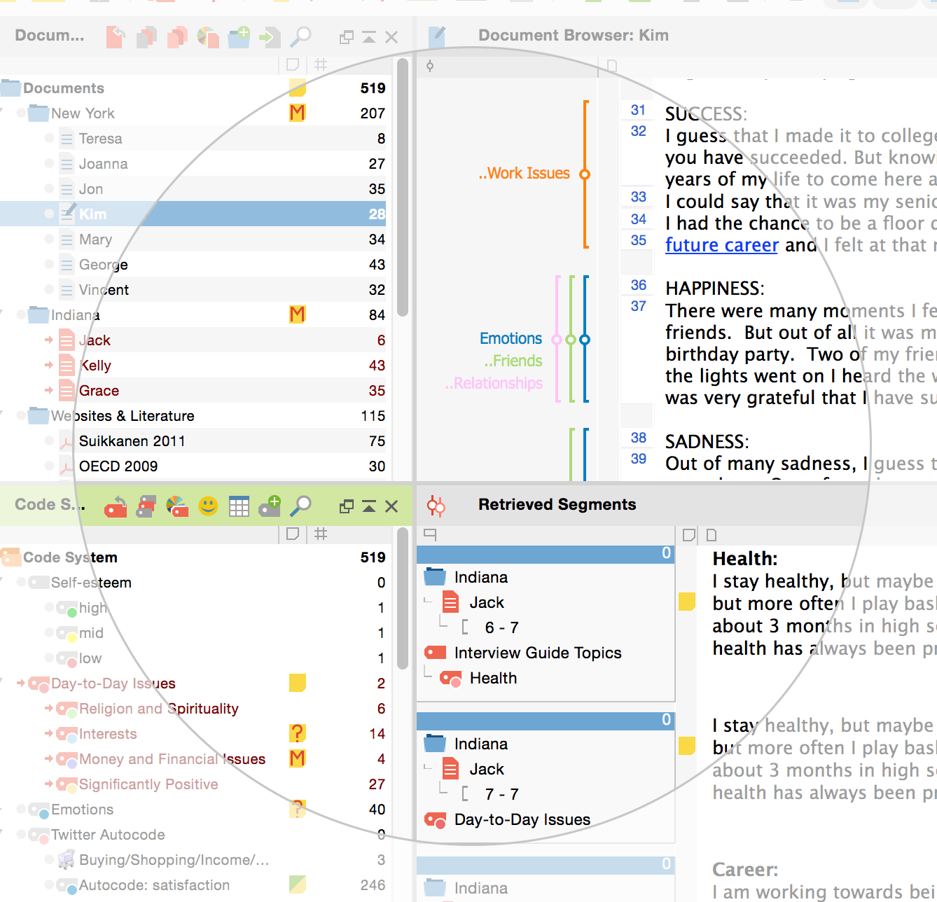
Code and annotate
Information can be linked to each other
Codes are displayed next to data
Memos
for your thoughts and ideas
Frequencies always in view

Slide 10
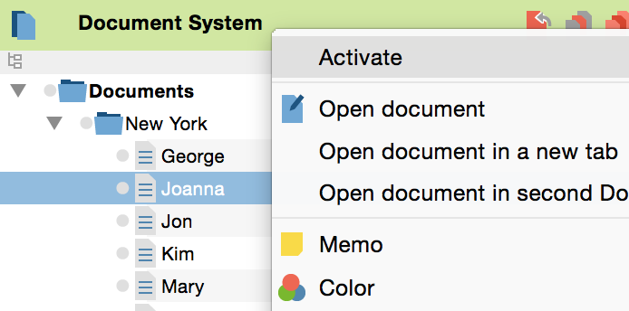
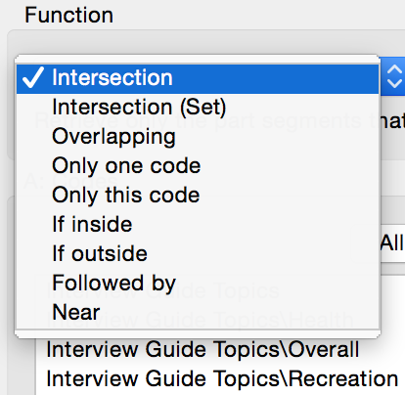
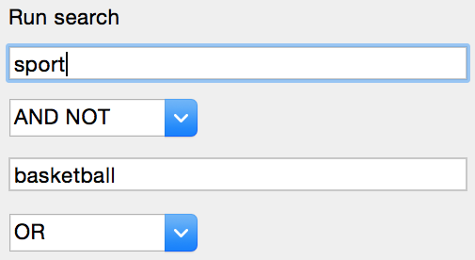
Search your data
Simple Retrieval: Interrogate data by simple activation of data and codes to view occurrences
Complex Retrieval: Search with complex filters, e.g. nearness of codes
Lexical Search: Search for word (combinations) in documents or memos

Slide 11
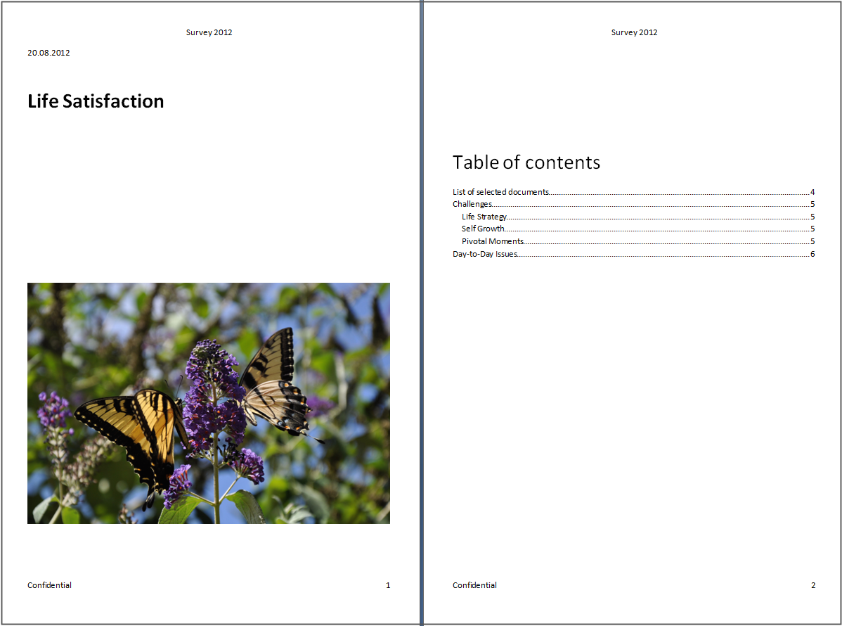
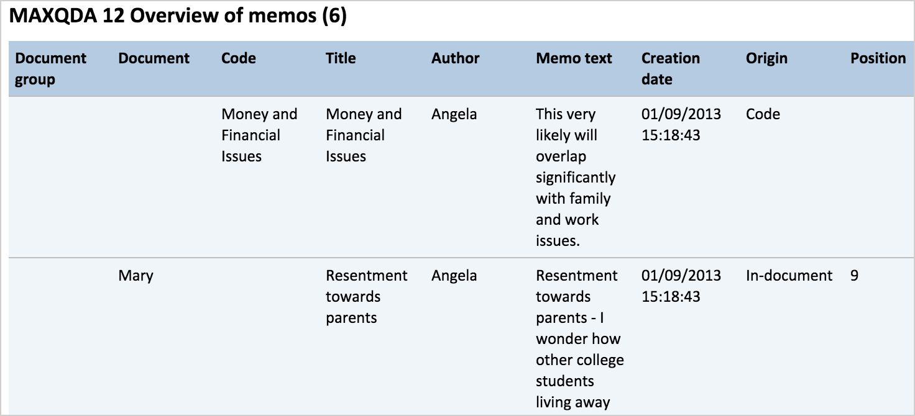
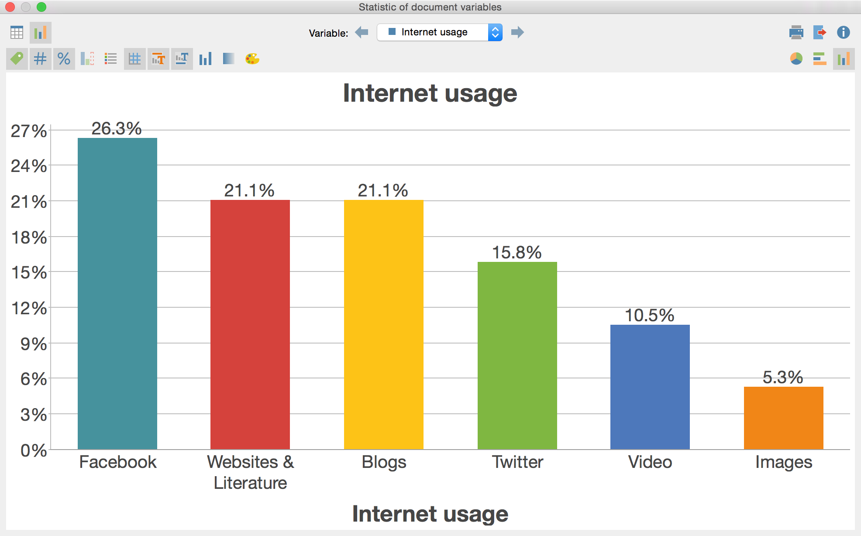
Exporting features
Export documents, codes, search results, memos, images, maps, or whole projects
Exchange selected elements with team members

Slide 12
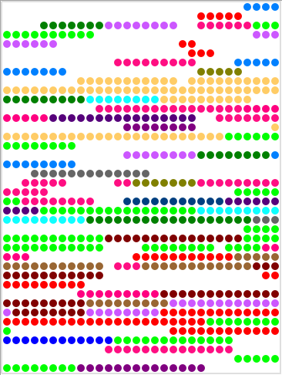
Visualize your results
Code Matrix
Document Portrait
Document Comparison Chart
Notes:
After this slide – break for some demo-ing
Open up the examples to show how it interacts
Start a new project and create a new code
Need to arrange these so they appear 1 at a time
Then move into Part II – demo

Slide 13
QDA Considerations
License type, cost
Data security, storage
Support
Trials
Types of data
Transcription feature
Compatibility
Intercoder functionality
Export formats
Comfort & familiarity
Expectations of committee, etc.
Coding & analysis functions
Code features
Query functions
Memo features
Data visuals
Theory builder or concept maps
Notes:
Break into groups?

Slide 14
Questions / Discussions
THANK YOU
Summer Starling
summerstarling@berkeley.edu

Slide 15
ANNOUNCEMENT
Qualitative Methods Group Talk
Moving from Quantification
to Visualization of Qualitative Data
for Deeper Analysis
March 17, 2016
2:30pm

Slide 16
Visualize your results
Document Portrait
MAXMaps
Word Cloud
Code Relations Browser
Document Comparison Chart
Notes:
After this slide – break for some demo-ing
Open up the examples to show how it interacts
Start a new project and create a new code
Need to arrange these so they appear 1 at a time
Then move into Part II – demo

Slide 17
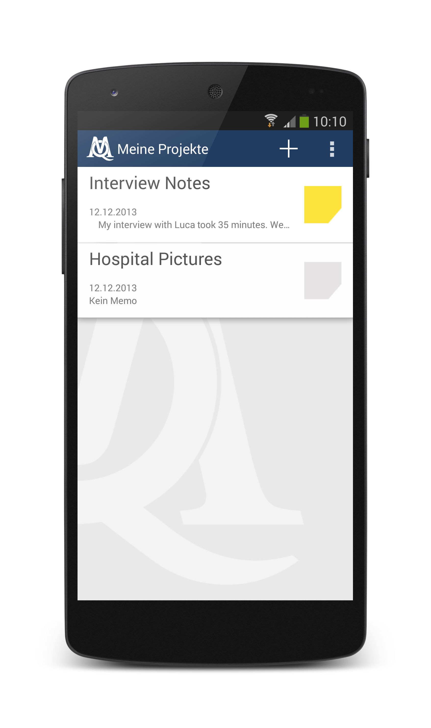
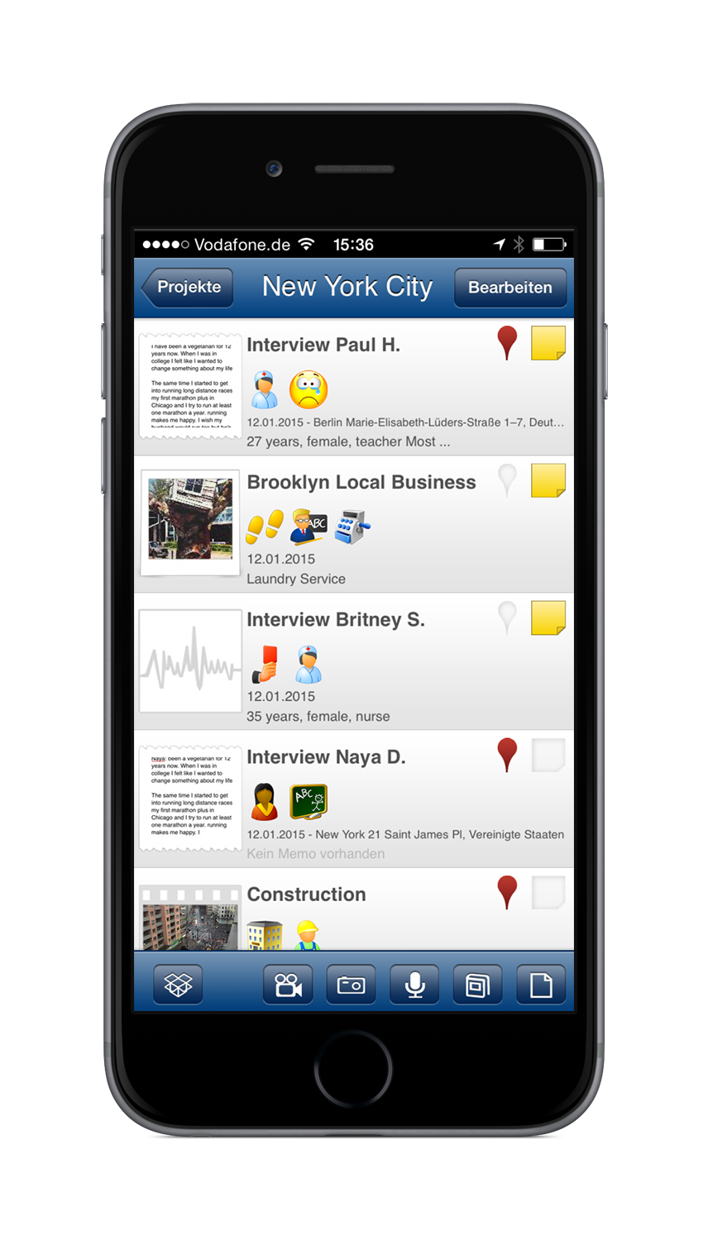
MAXApp – Research in the field tool
MAXApp
App for field research
Collect notes, pictures, audio, and videos, start coding, attach memos and transfer to MAXQDA for further analysis.
Free download for
iOS and Android Devices
Notes:
Want to point out an additional feature of Max – for field application or scanning text for entry into your database if you‘re working in the field
Additional info about max

Slide 18
MAXQDA trials and licensing
Universal software
for Mac OS X
& Windows
Free 30 Day Trial (fully functional)
License options: commercial, NGO, educational
Discounts for students and PhD candidates
Notes:
After this slide – start workflow

Slide 19
Additional resources
Free Services on MAXQDA Webpage
PDF Manual
Online tutorial
Video tutorials
Free introductory webinars
Free MAXQDA Reader
Your data is not locked in your software!
Use MAXReader to share your work with others

