Slide 1
Introduction to Social Science Methods: An Overview of Quantitative and Qualitative Methods
D-Lab Nora Broege Zawadi Rucks-Ahidiana March 31st – April 1st, 2016

Slide 2
Introduction to Social Science Methods: An Overview of Qualitative and Quantitative Methods
Part I: Research Design
Part II: Quantitative Research
Part III: Qualitative Research (Zawadi Ruck-Ahidiana)

Slide 3
Research Design
Identify the problem to be studied

Slide 4
Research Design
Identify the problem to be studied
Transform problem into a testable hypothesis/hypotheses
→ An idea that will be tested through systematic investigation

Slide 5
Research Design
Identify the problem to be studied
Transform problem into a testable hypothesis/hypotheses
→ An idea that will be tested through systematic investigation
Identify the population you need to examine in order to test your hypothesis/hypotheses

Slide 6
Research Design
Identify the problem to be studied
Transform problem into a testable hypothesis/hypotheses
→ An idea that will be tested through systematic investigation
Identify the population you need to examine in order to test your hypothesis/hypotheses
Identify the sample you can reasonably access to gather data

Slide 7
Research Design
Identify the problem to be studied
Transform problem into a testable hypothesis/hypotheses
→ An idea that will be tested through systematic investigation
Identify the population you need to examine in order to test your hypothesis/hypotheses
Identify the sample you can reasonably access to gather data
Determine the appropriate method for data collection

Slide 8
Research Design
Identify the problem to be studied
Transform problem into a testable hypothesis/hypotheses
→ An idea that will be tested through systematic investigation
Identify the population you need to examine in order to test your hypothesis/hypotheses
Identify the sample you can reasonably access to gather data
Determine the appropriate method for data collection
Determine the appropriate set of instruments to collect data

Slide 9
Research Design
Identify the problem to be studied
Transform problem into a testable hypothesis/hypotheses
→ An idea that will be tested through systematic investigation
Identify the population you need to examine in order to test your hypothesis/hypotheses
Identify the sample you can reasonably access to gather data
Determine the appropriate method for data collection
Determine the appropriate set of instruments to collect data
Collect data

Slide 10
Research Design
Identify the problem to be studied
Transform problem into a testable hypothesis/hypotheses
→ An idea that will be tested through systematic investigation
Identify the population you need to examine in order to test your hypothesis/hypotheses
Identify the sample you can reasonably access to gather data
Determine the appropriate method for data collection
Determine the appropriate set of instruments to collect data
Collect data
Analyze data

Slide 11
Research Design
Identify the problem to be studied
Transform problem into a testable hypothesis/hypotheses
→ An idea that will be tested through systematic investigation
Identify the population you need to examine in order to test your hypothesis/hypotheses
Identify the sample you can reasonably access to gather data
Determine the appropriate method for data collection
Determine the appropriate set of instruments to collect data
Collect data
Analyze data
Interpret results
Notes:
This workshop will mainly focus on research design & methods …Once you’ve determined the method you think you should use and figured out the instruments questions about data collection, analysis and interpretation can be addressed through D-Lab workshops and one-on-one consultations

Slide 12
Research Design
Unit of analysis/observation
Individuals or aggregates
Groups, institutions, organizations

Slide 13
Research Design
Unit of analysis/observation
Individuals or aggregates
Groups, institutions, organizations
Primary v. secondary data

Slide 14
Research Design
Unit of analysis/observation
Individuals or aggregates
Groups, institutions, organizations
Primary v. secondary data
Will you be collecting your own data or using preexisting data?
Often easier to use secondary data:
International data
Can’t get a large enough sample size
Can’t get nationally representative sample
Time constraints

Slide 15
Methods
Depending on:
Type of data you want/need
Sample size
Access
Location
Time – qual. Often requires periods of months/years of intensive study, moving, embedding, etc.
Resources

Slide 16
Methods
Depending on:
Type of data you want/need
Cross-sectional, longitudinal
Quantitative or qualitative
Sample size
Access
Location
Time
Resources

Slide 17
Methods
Depending on:
Type of data you want/need
Sample size
Generalizability
Small- or large-N
Access
Location
Time
Resources

Slide 18
Methods
Depending on:
Type of data you want/need
Sample size
Access
Is it a protected population? (e.g. minors/students)
Can you gain access?
Human subjects
Location
Time
Resources

Slide 19
Methods
Depending on:
Type of data you want/need
Sample size
Access
Location
local, state, national, international
Time
Resources

Slide 20
Methods
Depending on:
Type of data you want/need
Sample size
Access
Location
Time
Timeline for data collection
Resources

Slide 21
Methods
Depending on:
Type of data you want/need
Sample size
Access
Location
Time
Resources
Are you conducting the research alone? (do you have RAs)
Cost of instrument design
Cost of data collection
Cost of analysis

Slide 22
Quantitative Research
Systematic empirical investigation of observable phenomena using statistical (computational) techniques
Aims at causal explanation - answering “Why”
Numeric analysis and measurement are the key parts of quantitative research that state the fundamental connection between observation and analytic statement(s)
Quantitative methods are mostly used to justify the hypotheses and draw a general conclusion on selected hypotheses
Statistics, tables and graphs, are often used to present the results of these methods

Slide 23
Quantitative Research
Based on the idea that aspects of environment can be quantified, measured and expressed numerically
The information about a phenomenon of environment is expressed in numeric terms that can be analysed by statistical and spatial methods
The observations can be directly numeric information or can be classified into numeric variables

Slide 24
Quantitative Research
Systematic empirical investigation of observable phenomena using statistical (computational) techniques
Aims at causal explanation
Primarily answering “Why”
Characteristics of quant research
Scientific
Positivist
Objective
Experimental
Macros (events/processes/relations)
Deductive
Hard/factual
Representative/generalizable
Apolitical
Realist

Slide 25
 | Designs & Techniques | Methods | Details | Sample
Q U A N T I T A T I V E M E T H O D S | Experimental Designs | Lab Experiment | Applying scientific method to experimentally examine an intervention in a controlled setting | 2 or more groups
 |  | Field Experiment | Applying the scientific method to experimentally examine an intervention in a real world setting | 2 or more groups
 |  | Quasi-Experimental | Selecting a group to test a variable w. out random pre-selection processes | 2 or more groups
 | Descriptive Designs | Survey/Questionnaire | Series of ques & other prompts to gather info from respondents | Large (most often), representative, often random sample
 |  | Meta-Analysis | Statistical method for combining the results from a set of studies that address related hypotheses | 2 or more pre-existing studies
 |  | Case Study | In-depth investigation of an individual, group or event | At least 1 individual, group or event
 |  | Applied Behavioral Analysis | An examination of individual responses to an intervention(s) | At least 1 individual
 | Longitudinal | Experiments, surveys, case-study, applied-behavioral analysis | Applying a specific method & corresponding instruments to a sample over time | Individuals, groups or institutions over time (may be the same or similar)
 | Pre-Test Designs | Pilot Study | Small scale preliminary study conducted before main research to check feasibility of research design, time line, instruments, etc … & make necessary changes | Small group who can inform/comment on research design
 |  | Usability Testing | Evaluating a product (i.e. instrument) by testing it on a sample of potential users | Small group who can inform/comment on validity and reliability of instrument
Notes:
We will focus on experimental, descriptive and longitudinal designs …

Slide 26
EXPERIMENTAL DESIGNS

Slide 27
Experimental Research
Compare two or more groups that are similar except for one factor or variable
Can occur in lab or field (natural setting)
Conditions can be highly controlled; variables can be manipulated by the researcher
Tend to use randomized samples
2 groups – treatment & control

Slide 28
Quant Research - Experiments
How does a factor influence the behavior of an individual or a group?
Lab experiments
Require lab settings
Controlled environment
Results highly reliable
Develop cause & effect relationships
Can only use small samples – often too costly for large-N
Can only study snapshot of present (not past)
Field experiments
Occur in naturally occurring environments
Examining an intervention in the real world
Subjects don’t always know they are involved in experiment
Seen as having higher degree of external validity since occur in real world
Notes:
More commonly used in Psychology and social psychology

Slide 29
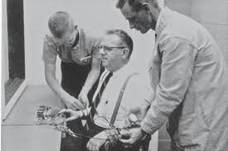
Experiments - Examples
Lab
Milgram exp
Zimbardo Prison exp
Field
Drug/pharmaceutical trials
Poyner on reducing theft in public spaces
Notes:
Although not common in social science – a good example are drug trials
Poyner & Webb – discovered a high rate of theft in a shopping center – redesign of layout of the store (improved lighting quality, setting stalls further apart…)

Slide 30
DESCRIPTIVE DESIGNS

Slide 31
DESCRIPTIVE DESIGNS SURVEYS

Slide 32
Survey Research
Use set of predetermined, standardized, questions
Collect answers from representative sample
Answers are categorized and analyzed so tendencies can be discerned

Slide 33
Quant Research - Survey
Used to assess thoughts, opinions, feelings, habits, activity logs
Primary v. secondary data
Developing survey instruments to conduct primary data can be difficult – may require piloting questionnaire
Order of the questions is v. important
Often easier to use secondary survey data or instruments
Instruments have been proven reliable
Can be issues or reliability & validity relating to self-reports
Response bias
Can be checked/corrected by test-retest of questions and standardization procedures

Slide 34
Survey - Examples
General Social Survey
US Census
Notes:
GSS – standard core of demographic, behavioral, attitudinal questions + special topics of interest – annual starting in 1972
ACS – ongoing, annual, survey that provides info on subsample of US population

Slide 35
DESCRIPTIVE DESIGNS META-ANALYSIS

Slide 36
Meta-Analysis
Numerous experimental studies with reported statistical analysis are compared
Distinguishes trends
Effect size (the influence of the independent variable on the dependent variable) can be compared
Similar studies can yield a common truth
Conducting research about previous research

Slide 37
Quant Research – Meta-Analysis
Using a statistical approach to combine the results from multiple studies in an effort to increase power (vs. individual studies)
Improves estimates of effect size
Can also resolve uncertainty when reports disagree
Can only be used if a common statistical measure is included across studies
Results generalizable to larger population
Precision & accuracy of estimates can be improved as you add more data
Hypothesis testing can be applied to summary estimates
Does not predict the results of a single, larger study
Can’t control for sources of bias – a meta-analysis of badly designed studies will produce bad statistics

Slide 38
Meta-Analysis - Examples
Meta-Analysis
Study 1
Study 2
Study 3
Study 4
Overall Effect Size

Slide 39
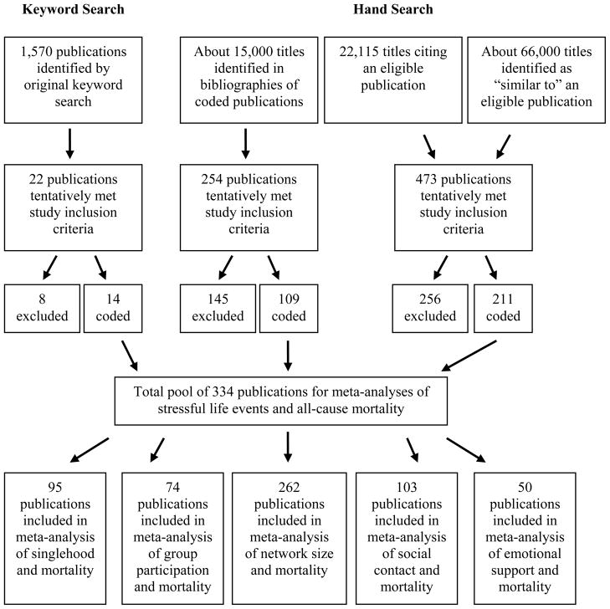
Meta-Analysis - Examples

Slide 40
DESCRIPTIVE DESIGNS CASE STUDIES

Slide 41
Quant Research - Case Study
Also called single case design
Describes numerically a specific case (can be organization, group, event, action or individual)
May test or generate hypotheses
Results often presented with tables and graphs

Slide 42
Quant Research – Case Study
Up-close, detailed examination of a subject & related contextual conditions
→ an empirical inquiry that investigates a phenomenon within its real world contexts
Holistic approach
Not to be confused w. qualitative research – can be a mix of quantitative and qualitative data
No random sample – information oriented sampling
Outlier cases may reveal more than a representative case
Types of cases:
Explanatory
Exploratory
Multiple-case study
Intrinsic
Instrumental
Collective

Slide 43
Case Study - Examples
Case study type | Details | Example | Small N | Large N
Explanatory | Seeking an answer to a question on the causal links in real life interventions that may be too complex for survey or experimental strategies | Analyzing a web-based e-commerce site in Colombia |  | ✔
Exploratory | Explore situations when intervention has no clear, single set of outcomes | An observational study of the development and implementation of a teacher-student relationship | ✔ | ✔
Multiple-case | Explore differences btwn & within cases – goal is to replicate findings across cases | Studying various units within identifiable cases – examining/comparison different social services available to violent crime victims |  | ✔
Intrinsic | When intent is to better understand the case, it’s particularities and ordinariness | An examination of how Alzheimer's effects couples | ✔
Instrumental | Provides insight into an issue or helps to refine a theory – the actual case is of secondary interest (unlike intrinsic) | Examining the components of individual behavior that indicate the potential for domestic violence | ✔ | ✔
Collective | Similar to multiple-case | A collective case study of stress among HS math teachers | ✔ | ✔
Notes:
Multiple-case (vs. single which is purely descriptive and qualitative)

Slide 44
DESCRIPTIVE DESIGNS APPLIED BEHAVIORAL ANALYSIS

Slide 45
Quant Research - Applied Behavior Analysis
Developing and analyzing procedures that produce effective and beneficial changes in behavior
Examine the individual’s responses in different situations (conditions) across time
Usually conducted in experimental form
Also known as behavior modification
Notes:
**NOTE:

Slide 46
Quant Research – Applied Behavioral Analysis
All studies require:
At least 1 participant
At least 1 behavior (dependent variable)
At least 1 setting
A system for measuring the behavior
At least 1 treatment/intervention
Manipulations of the independent variable so that its effects on the dependent variable may be analyzed
A beneficial intervention (for the participant)
Usually small-N studies
Require manipulation and control of method
Notes:
**most common in psychology

Slide 47
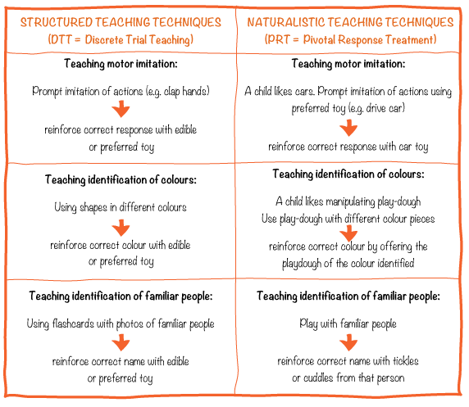
Applied Behavior Analysis - Example
Testing interventions for autistic students

Slide 48
LONGITUDINAL DESIGNS

Slide 49
Quant Research - Longitudinal
Individual or group research conducted across time, often decades
Cohort Study: data is gathered from the same subjects repeatedly, over time
Panel study: data is gathered from similar subjects, over time
May be conducted using other methods (surveys, case studies)
Studying developmental trends, the lifespan

Slide 50
Quant Research - Longitudinal
Subject attrition is major problem
“missing data”
Replacing with participants w. similar characteristics
Preserving confidentiality is also difficult
Specific standardized tools may change over time
Mostly observational – observe the state of things w.out manipulation → may have less causal power than experiments
BUT the inclusion of repeated observations at the individual level → more power than cross-sectional observational studies
Exclude time invariant unobserved differences
Include temporally ordered events
Allow researchers to distinguish short v. long term phenomena

Slide 51
Longitudinal - Example
Survey Data
National Longitudinal Survey of Youth (ages 12-16 in 1997)
Case Study
“UP” – British documentary of 14 British children starting in 1964
Notes:
NLSY97 – cohort of 12-16 yr olds in 1997 – asked annually about demographics, attitudes, behaviors, life events, etc.
“UP” – cohort of 14, British, 7 yr olds in 1964 – a look at the effect of social class on future outcomes – follow up every 7 years

Slide 52
Quant Methods - Instruments
Printed images, paper/pencil
Online
Survey Monkey
Zoomerang
Poll Daddy
Additional online survey instruments
Electronic devices: Smart phones, ipads, bio-physio readers, computers

Slide 53
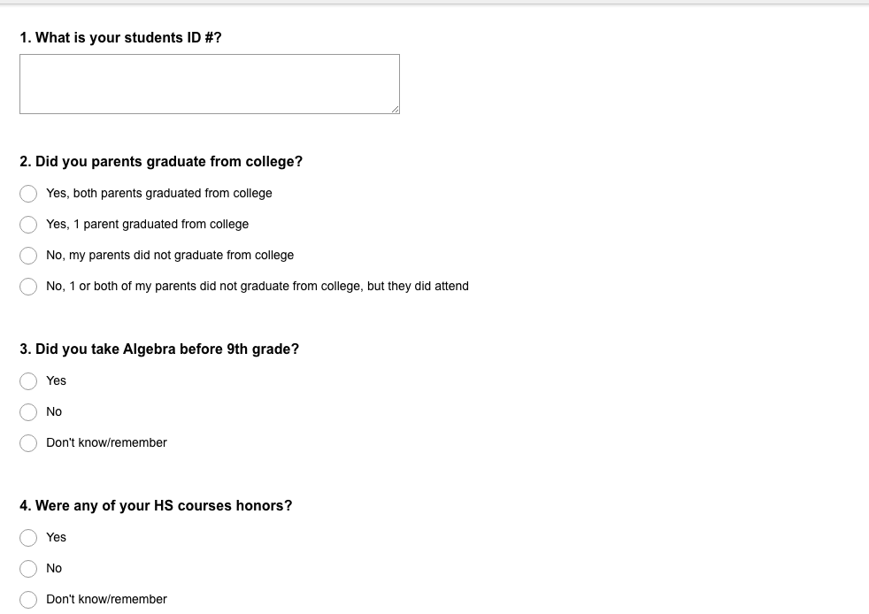
Quant Methods - Instruments
Online
Survey Monkey

Slide 54
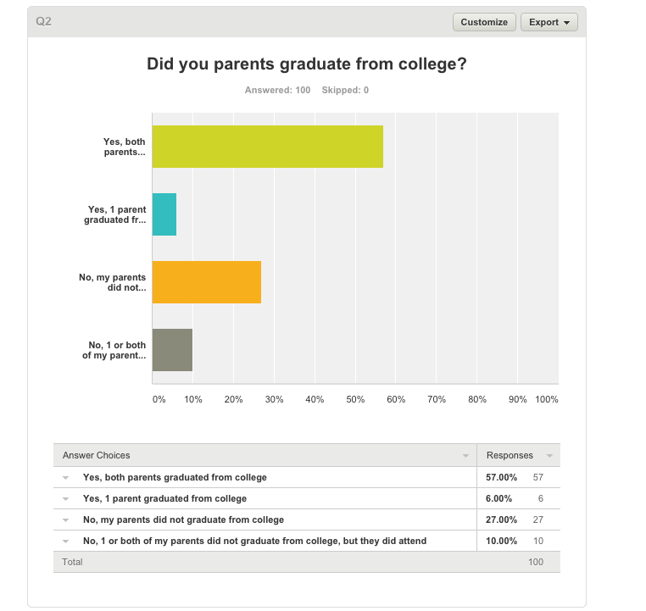
Quant Methods - Instruments
Online
Survey Monkey

Slide 55
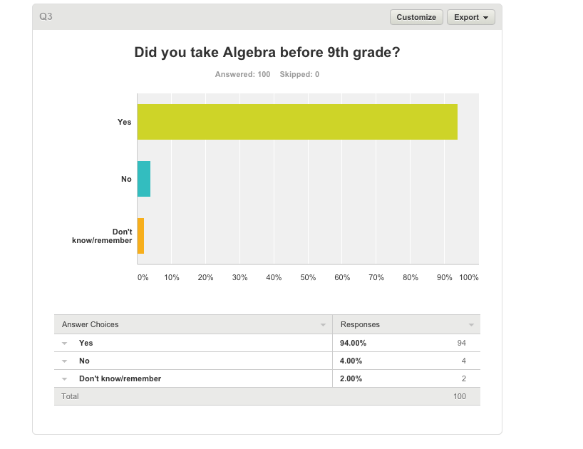
Quant Methods - Instruments
Online
Survey Monkey

Slide 56
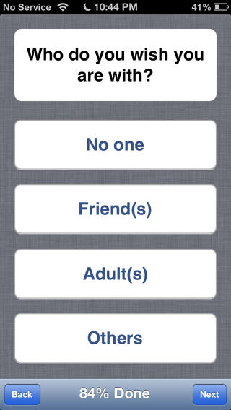
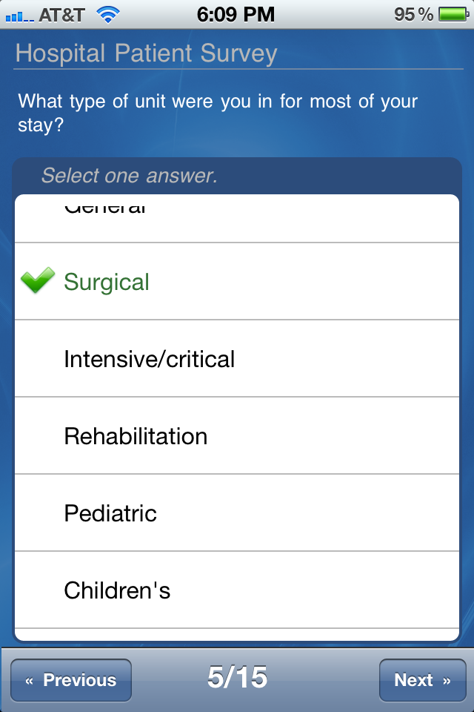
Quant Methods - Instruments
Electronic devices: Smart phones, ipads, bio-physio readers, computers

Slide 57
METHOD SELECTED, NOW WHAT? MEASUREMENT CRITERIA

Slide 58
Measurement Criteria
Objectivity
Accuracy
Precision
Reliability
Validity

Slide 59
Measurement Criteria
Objectivity - researchers stand outside the phenomena they study. Data collected are free from bias
Accuracy – Are the methods adequate to answer your questions; reveal credible information; convey important information?

Slide 60
Measurement Criteria
Objectivity - researchers stand outside the phenomena they study
Data collected are free from bias
Accuracy – Are the methods adequate to answer your questions?
Do they reveal credible information?
Do they convey important information?
Precision – How trustable are the measure?
How confident is the result?
Pilot testing & Usability testing

Slide 61
Measurement Criteria
Objectivity - researchers stand outside the phenomena they study. Data collected are free from bias
Accuracy – Are the methods adequate to answer your questions; reveal credible information; convey important information?
Precision – How trustable are the measure; how confident is the result?
Pilot testing & Usability testing
Reliability - if something was measured again using the same instrument, would it produce the same or nearly the same results?
Yielding consistent results over time or under similar conditions

Slide 62
Measurement Criteria
Objectivity - researchers stand outside the phenomena they study. Data collected are free from bias
Accuracy – Are the methods adequate to answer your questions; reveal credible information; convey important information?
Precision – How trustable are the measure; how confident is the result?
Pilot testing & Usability testing
Reliability - if something was measured again using the same instrument, would it produce the same or nearly the same results?
Yielding consistent results over time or under similar conditions
Validity – do the measures reflect all the facets you are attempting to study?

Slide 63
Content Validity
The extent to which the items on a testing tool (that being used to measure the dependent variable) reflect all of the facets being studied
All aspects are sampled

Slide 64
Criterion-Related Validity
Also called predictive validity
The extent to which a testing tool yields data that allow the researcher to make accurate predictions about the dependent variable

Slide 65
Construct Validity
The extent to which the testing tool measures what it is supposed to measure
Relationship between the items on the tool and the dependent variable
Also relates to actual (physical) construction of a written tool (e.g. Dean’s Survey) and how this impacts the accuracy of the results

Slide 66
Internal Validity
Relates to the internal aspects of a study and their effect on the outcome:
Researcher planning and preparation
Judgment – participants should feel free of judgment
Control for potential confounding variables

Slide 67
External Validity
Relates to the extent to which findings can generalize beyond the actual study participants
“How valid are these results for a different group of people, a different setting, or other conditions of testing, etc.?”

Slide 68
METHOD SELECTED✔ MEASUREMENT CRITERIA✔ ANALYSIS

Slide 69
Quantitative Research
Summarizing data
variables; simple statistics; effect statistics and statistical models; complex models

Slide 70
Quantitative Research
Summarizing data
variables; simple statistics; effect statistics and statistical models; complex models
Generalizing from sample to population
precision of estimate, confidence limits, statistical significance, p value, errors

Slide 71
Quantitative Research
Summarizing data
variables; simple statistics; effect statistics and statistical models; complex models
Generalizing from sample to population
precision of estimate, confidence limits, statistical significance, p value, errors
Data are a set of values of one or more variables

Slide 72
Quantitative Research
Summarizing data
variables; simple statistics; effect statistics and statistical models; complex models
Generalizing from sample to population
precision of estimate, confidence limits, statistical significance, p value, errors
Data are a set of values of one or more variables
A variable is something that has different values.
Values can be numbers or names, depending on the variable:
Numeric – year of birth
Counting - number of natural disasters
Ordinal – highest level of education (values are numbers or names/labels)
Nominal – gender (values are names/labels)

Slide 73
Independent Variable
The variable that is controlled or manipulated by the researcher
The variable that is thought to have some effect upon the dependent variable
The one difference between the treatment (experimental) and control groups

Slide 74
Dependent Variable
That which is measured
The outcome
That which is influenced or affected by the dependent variable

Slide 75
Quantitative Research
Y (dep variable) | X (ind variable) | Model/Test | Effect statistics
Numeric | Numeric | Regression | Slope, intercept, correlation
Numeric | Nominal | T-test, ANOVA | Mean difference
Nominal | Nominal | Chi-square | Frequency difference or ratio
Nominal | Numeric | Categorical | Frequency ratio per …

Slide 76
Analysis Programs
Software (all except SAS available on D-Lab machines)
Stata
SPSS
SAS
R
Python
GIS
Excel

Slide 77
Pros of Quantitative Research?
Clear interpretations
Make sense of and organize perceptions
Careful scrutiny (logical, sequential, controlled)
Reduce researcher bias
Results may be understood by individuals in other disciplines

Slide 78
Cons of Quantitative Research?
Can not assist in understanding issues in which basic variables have not been identified or clarified
Only 1 or 2 questions can be studied at a time, rather than the whole of an event or experience
Complex issues (emotional response, personal values, etc.) can not always be reduced to numbers
Difficulties in distinguishing opinions and facts from surveys
Results from surveys sometime have serious limitations
People’s perceptions and scientific observation may contradict

Slide 79
Quantitative vs. Qualitative
There is/shouldn’t be a rivalry between quantitative and qualitative methods
Each can be used to confirm the other
Quantitative data and findings have underlying qualitative dimension
Qualitative data can also add description, detail and texture to quantitative data
Quite often availability of data and its characteristics determine the method and what is possible – not a preference for one over the other
Notes:
Double confirmation, mixed methods, speaking to multiple audiences, adds to breadth & depth of study

Slide 80
Quantitative vs. Qualitative
There is/shouldn’t be a rivalry between quantitative and qualitative methods
Each can be used to confirm the other
Quantitative data and findings have underlying qualitative dimension
Qualitative data can also add description, detail and texture to quantitative data
Quite often availability of data and its characteristics determine the method and what is possible – not a preference for one over the other
Both quantitative and qualitative research can aim at description of built environment
Complementary - not contradictory
different kinds of research questions and objects of research
different perspectives on the same research objects / questions (methodological triangulation)
Notes:
Double confirmation, mixed methods, speaking to multiple audiences, adds to breadth & depth of study

Slide 81
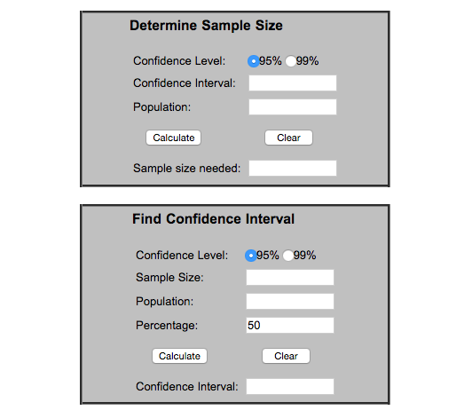
Best Practices – Sample Size
Sample size
Data collection – a large enough sample so that missing data won’t become an issue
Sample size calculator - how to generalize to population

Slide 82
Best Practices – Things to Consider
Time constraints
Choose the method that best suits your research time
1 year is not enough for a longitudinal study
Resource constraints
Choose the method that best suits your budget and resources available
If you don’t have access to a lab, a lab experiment is unrealistic
Access
Do you have access to a generalizable sample?

Slide 83
Best Practices
Ethics
Maintaining respect for participants
Can participants opt out at any point?
Balancing benefit & harm
Will participation cause harm?
Does the potential benefit outweigh any potential harm (psychological effects, stress, anxiety, time)
Will the method allow protection of anonymity?
Anonymity – pseudonyming is key!!
How involved will the researcher be – will he/she bias results?

Slide 84
Thank You!
References/Resources
The Practice of Social Research – Earl Babbie
Statistical Methods for the Social Sciences – Agresti & Finlay
Sage Research Methods - http://srmo.sagepub.com/
Ethics: Guidelines for Research Ethics
Best Practices: NIH Office of Behavioral and Social Sciences Research
Statistics – www.ats.ucla.edu
Workshops & consulting – www.dlab.berkeley.edu
If you have any further questions or comments, please feel free to email me, nbroege@berkeley.edu

