Slide 1
Open Genomic Data Repositories and Analysis Resources
4-26-16
Megan Laurance, Ph.D.
Research Informationist @UCSF Library

Slide 2
Bioinformatics Resources for Biologists Workshop Series @ UCSF
Genomic Data Repositories & Analysis Resources
Methods in Pathway Analysis
Introduction to Human Genetic Variant Databases – Germline
Introduction to Human Genetic Variant Databases – Somatic
Software Carpentry boot camp – Python & R
http://www.library.ucsf.edu/help/classes (lots of other classes, Pop-Ups: EndNote, PubMed, Open Access policy, etc.)

Slide 3
Goals for today’s workshop
Awareness of genomic data repositories and related resources
Gene expression data
Sequencing data
Where did all this data come from?
Background on data sharing policies and standards
Tools available to mine, analyze, interpret datasets
Focus on resources accessible to researchers who don’t have programming experience
Hands-on exercise: search, analysis, interpretation of public gene expression data
Hopefully convince you that these “big” data sets and analyses are approachable
Slides will be made available

Slide 4
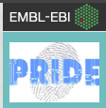
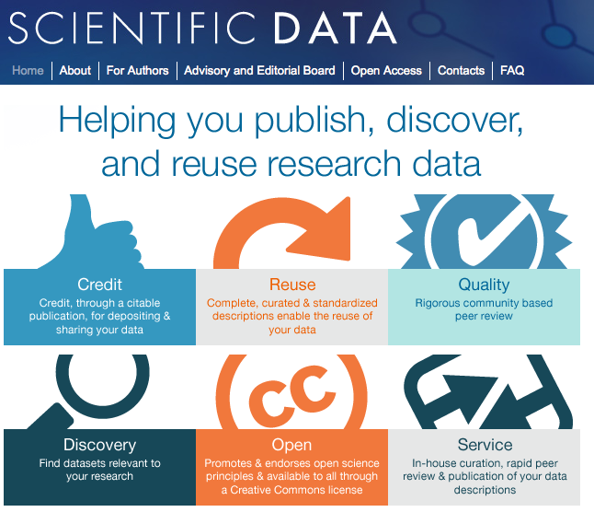
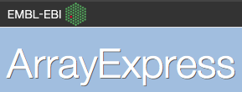
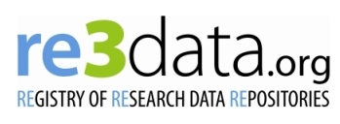
Research Data Repositories and Directories: lots of data out there
Directories

Slide 5
How did all this data get out in the public domain?

Slide 6
Why Share Data? Sometimes you have to…
Funders
Publishers
Data repositories are useful when you need to comply with Funder or Publisher Policy
Notes:
NIH Policy:
If you have an NIH grant with >500k in direct costs in a single year – or work for a PI who has one of these grants – a Data Sharing plan is expected to be included in the grant – and – rumor has it – is starting to impact the grant review process.
OSTP memo: Feb 2013: Instructs the heads of executive departments and agencies with a research and development budget of more than $100 million annually to develop policies and plans to disseminate publicly funded research openly. The memo does not solely focus on journal articles, ending its first paragraph with the clear statement that “such results include peer-reviewed publications and digital data.”
NIH Data Sharing Policy
http://grants.nih.gov/grants/guide/notice-files/NOT-OD-03-032.html
Application seeking $500K or more in direct costs in any single year of the project period, or
As a special requirement of a Funding Opportunity Announcement (FOA)
Applies to the sharing of Final Research Data for applications submitted on or after October 1, 2003
Data sharing plan expected in and in included in application
NIH acceptance of the grantee’s submitted or negotiated sharing plan is incorporated as a term and condition of the award.
NIH Grants Policy Statement: Access to Research Data
http://grants.nih.gov/grants/policy/nihgps_2010/
Any applications
Not a special requirement of a Funding Opportunity Announcement
NIH will communicate its expectations with respect to data sharing and facilitate and encourage communication among the parties involved to promote sharing.

Slide 7
Example of Funder Requirements for Data Sharing
NIH Genomic Data Sharing Policy
Updated August, 2014 https://gds.nih.gov/pdf/NIH_GDS_Policy_Overview.pdf
Strikes a balance between encouraging data sharing as broadly as possible and addressing concerns re: identification of patient donors from genomic data
NIH database of human genotypes and phenotypes, dbGaP, will remain the required data repository for all NIH-funded human genetic studies, GEO for gene expression studies.
Data release is mandated at the time of publication of results or earlier
This policy applies to NIH intramural research projects generating genomic data on or after January 25, 2014

Slide 8
Example of Publisher Requirements for Data Sharing
From Nature Publishing:
A condition of publication in a Nature journal is that authors are required to make materials, data and associated protocols promptly available to others without undue qualifications.
Data sets must be made freely available to readers from the date of publication, and must be provided to editors and peer-reviewers at submission, for the purposes of evaluating the manuscript.
For the following types of data set, submission to a community-endorsed, public repository is mandatory. Accession numbers must be provided in the paper. Examples of appropriate public repositories are listed below.
Microarray data
MIAME-compliant microarray data: deposit in GEO or ArrayExpress upon submission to the journal.
Data must be MIAME-compliant, as described at the MGED web site specifying microarray standards.
Simple genetic polymorphisms should be submitted to dbSNP.
For data linking genotyping and phenotyping information, we strongly recommend submission to dbGAP or EGA, two repositories that have mechanisms for access control for human health-related phenotypes.

Slide 9
Getting Prepared for Big Data: NIH Big Data 2 Knowledge Initiative

Slide 10
Getting Prepared for Big Data: NIH Big Data 2 Knowledge Initiative
The major challenges to using biomedical Big Data include:
Locating data and software tools
Gaining access to data and software tools
Standardizing data and metadata
Extending policies and practices for data and software sharing
Organizing, managing, and processing biomedical Big Data
Developing new methods for analyzing biomedical Big Data
Training researchers for analyzing and for designing tools for analyzing biomedical Big Data effectively
Research libraries are here to educate and partner with researchers to help with compliance, promote data management/data sharing best practices, and encourage discovery and reuse of research datasets.

Slide 11
Why would you reuse someone else’s data?

Slide 12
Benefits of Data Sharing and Reuse
Compare results from related published experiments to your own. Gain confidence in novel insights.
Identify novel drug targets, fish for new genes/biomarkers associated with disease, drug response, phenotype of interest.
Get your feet wet in an experimental method before doing it yourself.
Develop new analysis methods and test software
Supports more efficient use of funding by avoiding duplicate data collection
Encourages reproducibility/Discourages fraud

Slide 13
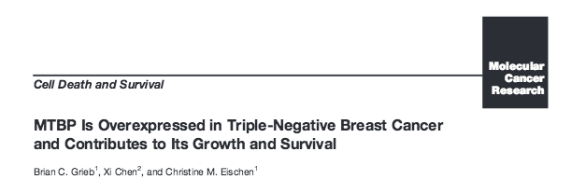
Re-analysis of TCGA gene expression and copy number alteration data
http://www.ncbi.nlm.nih.gov/pubmed/24866769
“By using TCGA data, researchers found that MTBP is expressed at different levels in TNBC subtypes. These findings may have positive implications for further study and future treatments. The data used in this research, and all available TCGA data, can be found through the TCGA Data Portal and the cBioPortal.”
http://cancergenome.nih.gov/

Slide 14
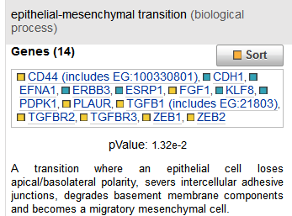
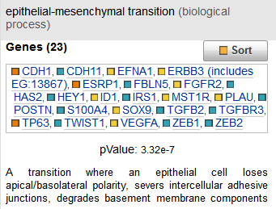
Small scale example: Gain confidence in novel findings.
RNA-Seq data from breast cancer samples highlighted a “pro epithelial mesenchymal transition” gene expression pattern. Searched GEO for “EMT”, found dataset where EMT had been reversed by introduction of a wound-healing gene. Analyzed and compared the public array data to our RNASeq data and found a flip in the gene expression pattern of key EMT genes.
Our breast cancer EMT signature
Cells where EMT had been reversed

Slide 15
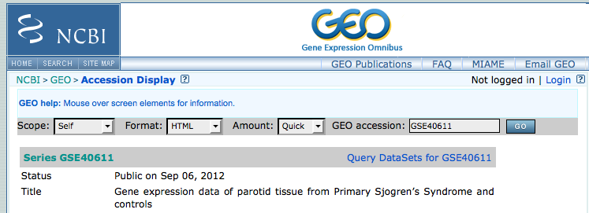
Small scale example: Mining Datasets for Potential Biomarkers
Project Specific Aim: Identify salivary markers of Primary Sjogren’s Disease
What are the known markers of Sjogren’s?
Scour the literature, curated disease databases
Limited by the curation goals of that database, their criteria
Going directly to the original data removes those limitations, freedom to mine according to your criteria

Slide 16
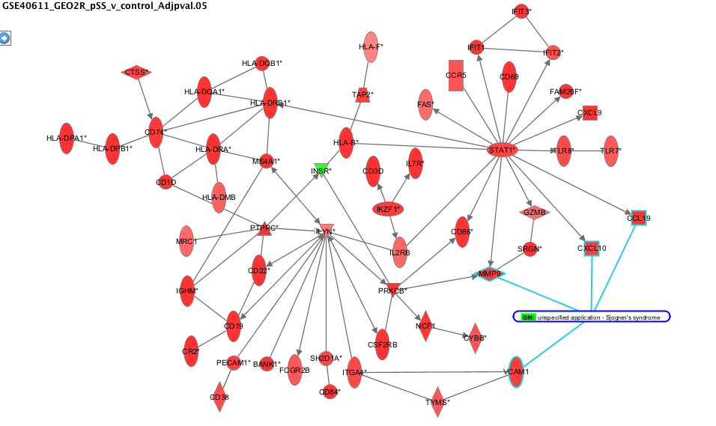
Example: Mining Datasets for Potential Biomarkers
Use GEO2R to identify significantly differentially expressed genes between primary Sjogren’s patients and healthy controls
Use pathway and functional enrichment analysis to find subsets of genes involved in relevant phenotypes, implicated in related diseases

Slide 17
Genomic Data Repositories

Slide 18
Genomic Data Repositories
Gene Expression Data
Microarray
PCR
RNA-Seq
Sequencing Data
Whole Genome
Exome
Targeted resequencing

Slide 19
Repositories with Gene Expression Data
The biggies….
GEO: http://www.ncbi.nlm.nih.gov/geo/
Array Express: http://www.ebi.ac.uk/arrayexpress/
Institution or Field Specific:
Curated database of gene expression profiling of mouse KO models http://rnaseqmetadb.ece.tamu.edu/
Open-TG Gates: http://toxico.nibio.go.jp/open-tggates/english/search.html
Immunological Genome Project (ImmGen) http://www.immgen.org/
For a pretty comprehensive list, see PMID: 23269463, “Reuse of public genome-wide gene expression data”, Rung and Brazma, Nature Reviews Genetics

Slide 20
GEO: Gene Expression Omnibus
A public, NCBI repository for the archiving and distribution of gene expression data submitted by the scientific community.
MIAME compliant data.
Minimum Information About a Microarray Experiment http://www.mged.org/Workgroups/MIAME/miame.html
Convenient for deposition of gene expression data, as required by funding agencies and journals.

Slide 21
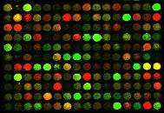
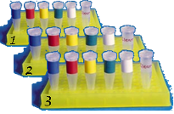
Organization of Data in GEO
Submitted by Researchers:
1,663,308 Samples
64,573 Series
Submitted by
Manufacturer:
15324 Platforms
Curated by
NCBI:
3848 Datasets
GPL
Platform
descriptions
GSM (Samples)
Raw/processed
spot intensities
from a single
slide/chip
GSE (Series)
Grouping of
slide/chip data
“a single experiment”
GDS (Datasets)
Grouping of
experiments
teachline.ls.huji.ac.il/72351/2008/talks/GEO%202008.ppt

Slide 22
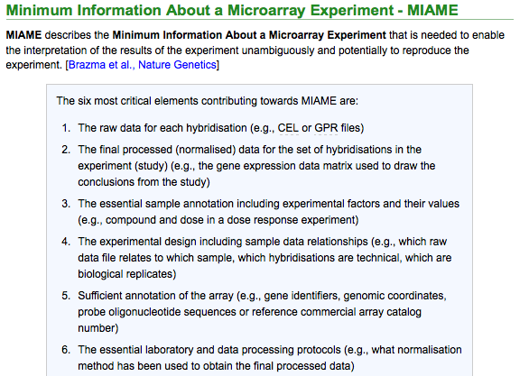
Why is GEO such a valuable repository? Policy and Standards
MIAME
Nature Genetics 29, 365 - 371 (2001) Minimum information about a microarray experiment (MIAME)—toward standards for microarray data

Slide 23
Submitting your data to GEO
http://www.ncbi.nlm.nih.gov/geo/info/submission.html
http://www.ncbi.nlm.nih.gov/geo/info/spreadsheet.html

Slide 24
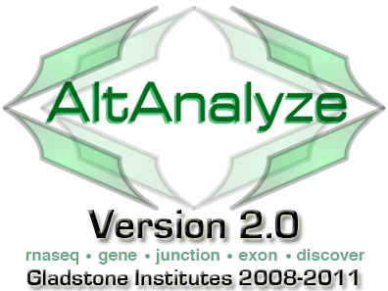
GEO, ArrayExpress Ecosystem
DEE & Degust for RNASeq
GEO2R

Slide 25
Digital Expression Explorer & Degust
“We downloaded RNA-seq raw data from SRA, processed it and made it freely available on our webserver. http://dee.bakeridi.edu.au/
Learn how to analyse RNA-seq data sets in just a few minutes. No need for Linux servers or command line tools, it even works on smartphones or tablet computers.”
http://dee.bakeridi.edu.au/ https://www.youtube.com/watch?v=qlWVAHrM4NE

Slide 26
Repositories with Sequencing Datasets
The SRA is part of the International Nucleotide Sequence Database Collaboration (INSDC, www.insdc.org).
Notes:
The data model, data transfer protocols, and accession space are shared with the INSDC collaborators: European Bioinformatics Institute (EBI, http://www.ebi.ac.uk) and the DNA Data Bank of Japan (DDBJ, http://www.ddbj.nig.ac.jp).
Data is shared between these 3 archives

Slide 27
Sequence Read Archive – what’s in there?
The SRA is a repository of raw sequencing data (reads) in FASTQ files.
A lot of data processing requiring heavy computational power and data storage has to be applied to raw sequencing data (reads) before it is useful to a biologist.

Slide 28
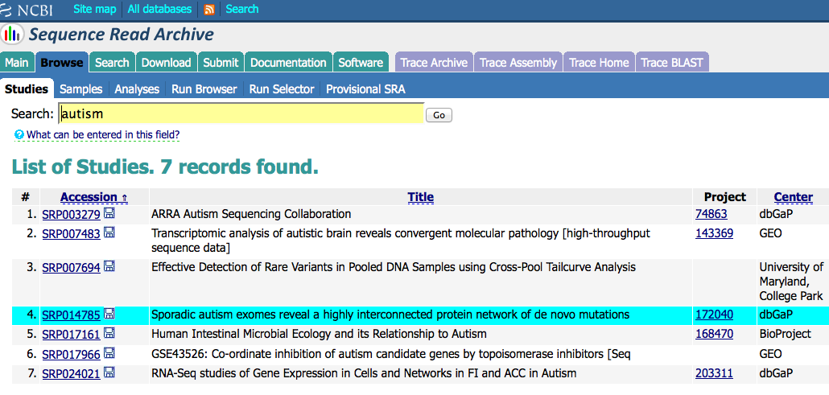
Sequence Read Archive
https://dbgap.ncbi.nlm.nih.gov/aa/wga.cgi?page=login

Slide 29
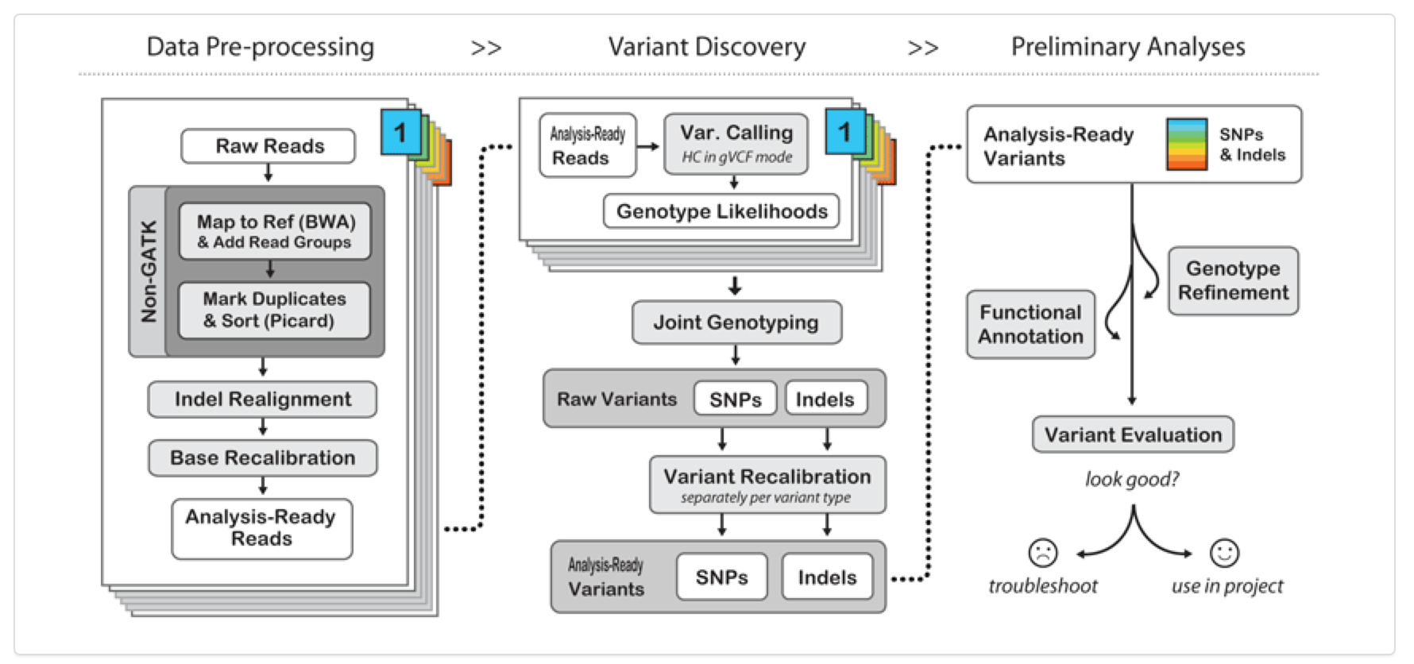
NGS Data Analysis Process
Downloading and analyzing raw sequencing data is not for the faint of heart…..
But some of this data has been analyzed and re-packaged in a biologist-accessible databases
Cancer data in particular

Slide 30
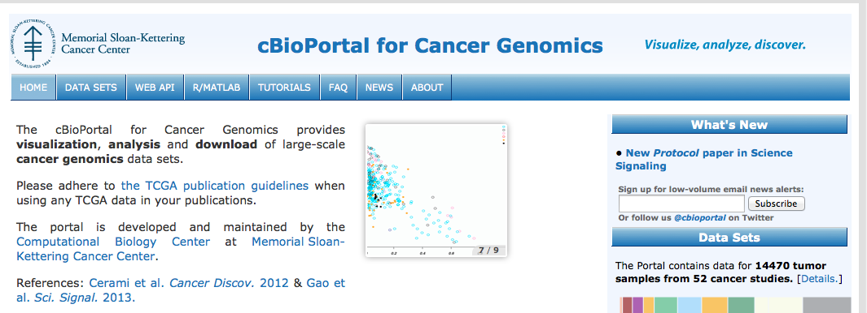
Sequencing Data Ecosystem
Data Analysis Tools
Notes:
dbGAP = data and documents, questionnaires, research protocols. Database of Genotypes and Phenotypes (dbGaP) An archive and distribution center for the description and results of studies which investigate the interaction of genotype and phenotype. These studies include genome-wide association (GWAS), medical resequencing, molecular diagnostic assays, as well as association between genotype and non-clinical traits.

Slide 31
CGHub to TCGA to cBioPortal
Lower Level BAM files, Controlled Access.
Analyzed expression data, variant files, copy number alterations, some open, some controlled access.
Data from 52 cancer genomics studies, including some from TCGA
http://bioinformatics.ca/workshops/2015/cancer-data-and-its-analysis-ccrc-2015
Notes:
Keep it in….

Slide 32
cBioPortal
Search “CDKN2A”

Slide 33
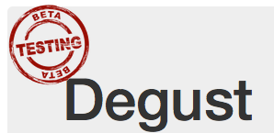
Hands-on data mining and analysis exercise
Raw Data
Results
Novel Insights (Findings)
Manuscript & Dataset
Search Existing Data & Findings

Slide 34
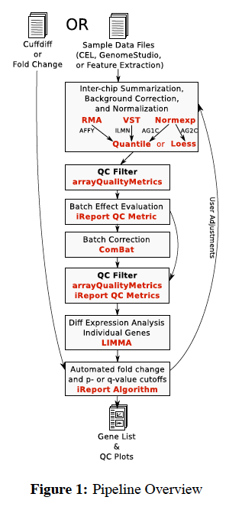
Analyze microarray data within GEO: GEO2R
GEO2R can be used to run a two-group comparison analysis directly within GEO (uses the normalized data matrix provided by submitter, don’t need to download the raw array files)
It is based on the LIMMA analysis package (which is written in R)
LIMMA = Linear Models for Microarray Data: A software package for the analysis of gene expression microarray data, especially the use of linear models for analyzing designed experiments and the assessment of differential expression.
Generates the scripts of R commands for your reference
For a simple two-group comparison it can save a lot of time and effort.
Not appropriate for analysis of multiple datasets, or more complicated statistical analysis (ANOVA)

Slide 35
GEO2R Tutorial Video
http://www.ncbi.nlm.nih.gov/geo/geo2r/

Slide 36
Hands-on Exercise
Goal: Get comfortable browsing through a genomic dataset repository, launch a gene expression array analysis. It’s an easy way to get your feet wet with a big dataset, see some of the statistics in practice, and view the programming code that enabled it.
Find an experiment of interest in GEO using the search/filtering options
Review the GEO record to identify microarray samples from the conditions you want to compare (treated vs. untreated, disease vs. normal, etc.)
Create a comparison of groups of samples and apply statistical analysis using GEO2R
Review expression value distributions across samples to see if the samples can be compared, and/or identify outliers
Obtain an expression dataset (an exportable text file) with all the genes and values from the selected case-control comparison. This file can be used later for pathway, functional enrichment, or network analysis.
Identify genes with most significant gene expression changes in case vs. control samples
Review the R script used by GEO2R
How do you know it worked?
Compare to published analysis results
Run the same pair-wise analysis on another pipeline: AltAnalyze, insilicoDB, GenePattern
Run Pathway or Network Analysis to put the data in a biological context: STRING, GeneTrail (covered in more depth in Methods in Pathway Analysis class)

Slide 37
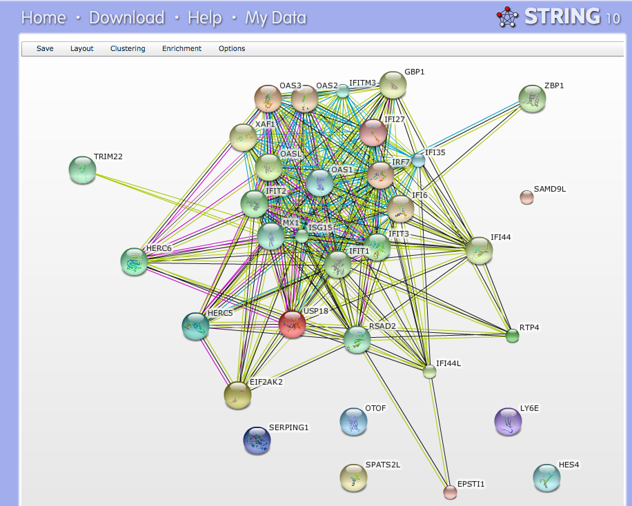
DEGs → Networks using STRING

Slide 38
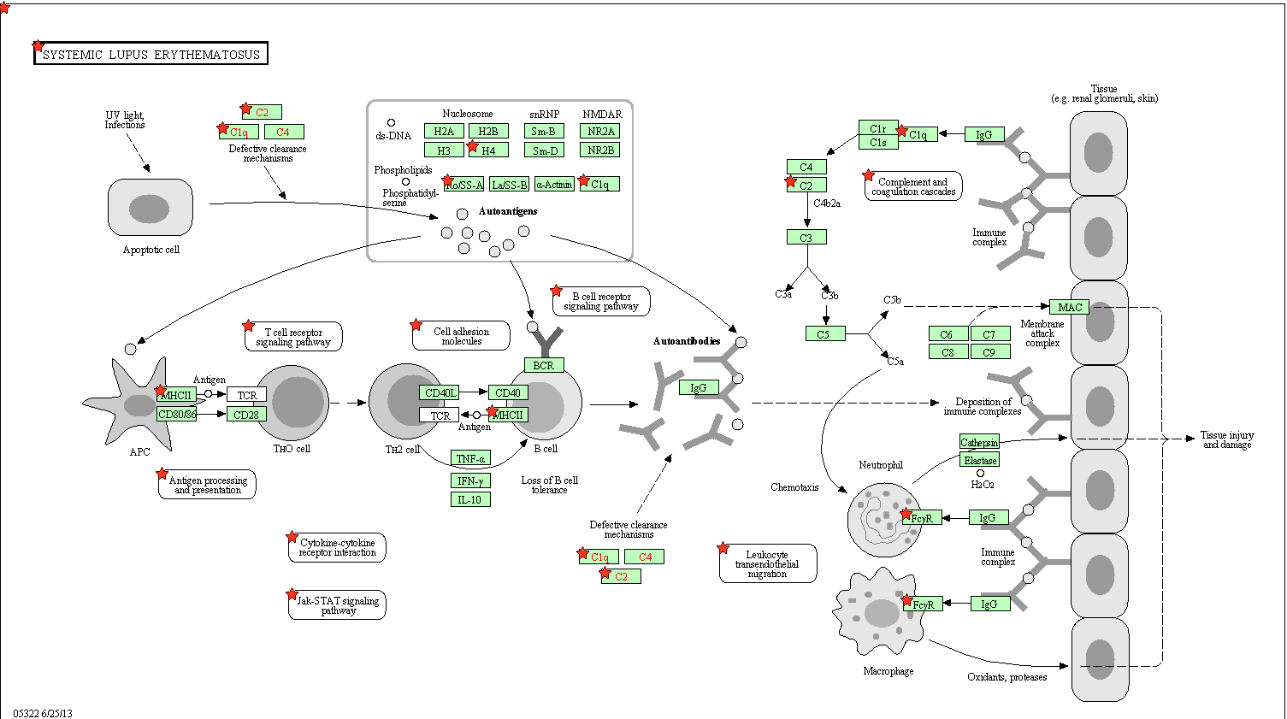
DEGs → Pathways using GeneTrail

Slide 39
Which resource to use for which situation?
If you want to find a gene expression datasets generated from experimental conditions of interest to you:
GEO, ArrayExpress, InSilicoDB
Action: Download raw data (.CEL files) and re-analyze it, or analyze normalized data in GEO using GEO2R
If you want to find experimental conditions in which your gene of interest is up/downregulated:
GEO Profiles curated from GEO Datasets, BioGPS, Oncomine, NextBio
Action: Searching for results, gene expression values
If you want to find whole genome or exome sequencing data that measures genetic variants:
SRA, dbGAP, ENA – EBI, 1000 Genomes, TCGA
Action: Download data (may be access controlled) and re-analyze it using Galaxy, GATK

Slide 40
Links to Additional Resources
AltAnalyze – free microarray data analysis pipeline http://www.altanalyze.org/
GEO2R – free microarray data analysis pipeline http://www.ncbi.nlm.nih.gov/geo/geo2r/
Galaxy NGS data analysis tools:http://galaxyproject.org/ https://wiki.galaxyproject.org/Teach/GTN
GATK NGS data analysis tools: http://www.broadinstitute.org/gatk/
Lectures and slides on RNASeq from Bioinformatics.ca http://bioinformatics.ca/
Coursera Genomic Data Science course on Galaxy here: https://www.coursera.org/specializations/genomics
UC Davis Bioinformatics Training Program http://training.bioinformatics.ucdavis.edu/events/
list of in-person courses, online material, or other resources on bioinformatics: http://stephenturner.us/edu.html
SeqAnswers – Q&A, methods forum, http://seqanswers.com/
BioStars – Q& A, methods forum, http://www.biostars.org/
Getting Genetics Done - http://gettinggeneticsdone.blogspot.com/
GenomeWeb - http://www.genomeweb.com/front
DataBib: directory of research data repositories http://databib.org/index.php
Registry of Research Data Repositories: http://www.re3data.org/
PLoS Data Sharing Policy: http://www.plosone.org/static/policies.action#sharing
PLoS Field Guide to Genomics Research: http://www.plosbiology.org/article/info%3Adoi%2F10.1371%2Fjournal.pbio.1001744;jsessionid=E43C899FDFB15430E6E9726AF7ABCA61

Slide 41
Thanks for attending…..
Questions?
Contact me: megan.laurance@ucsf.edu
Link to Library Classes http://www.library.ucsf.edu/help/classes

Slide 42
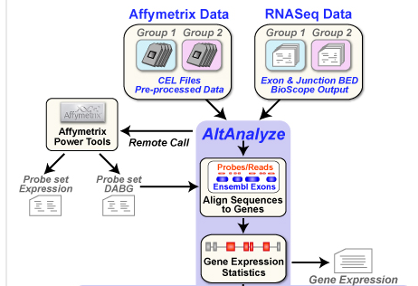
Re-analyze Raw Microarray Data: AltAnalyze
http://code.google.com/p/altanalyze/

