Slide 1
Basics of thematic mapping in GIS (ArcMap)
Kelly Clonts
Presentation for UC Berkeley, D-Lab
October 29th, 2014

Slide 2
1. Data files
Download Zip file:
tinyurl.com/dlab-gis1
(Just in case that doesn’t work):
dropbox.com/s/kzpxpddqh4u06h0/Dlab.zip?dl=0
Open download and extract the files to a folder in an easy to find location

Slide 3
Learning Objectives
What you will learn
What a thematic map is
Where to find appropriate data
How to download and format data in Excel
How to join Census data to Shapefiles (geographic data) based on shared IDs
How to create thematics maps
You are not learning the basics GIS, just how to use the tool for certain tasks (however, you are not required to have prior GIS experience)

Slide 4
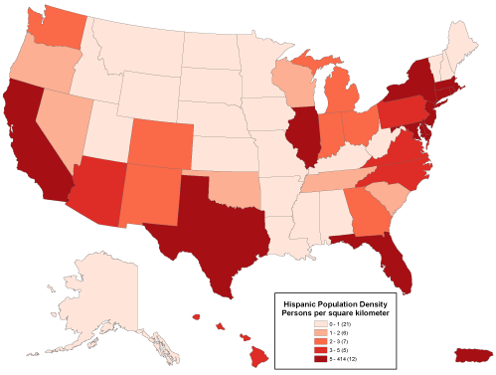
What is a thematic map?
Also called a “cloropleth map” or “heat map”
Similar to a “heat map”
Best used when you have defined areas
Best used when you can group the data into 3-6 categories.

Slide 5
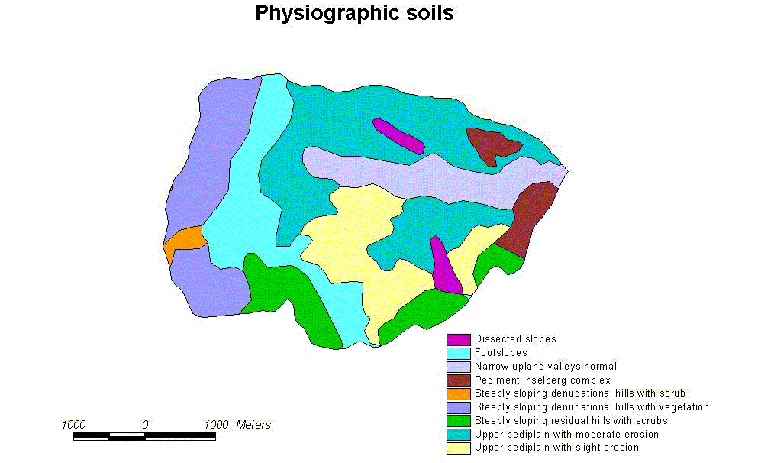
What is a thematic map?

Slide 6
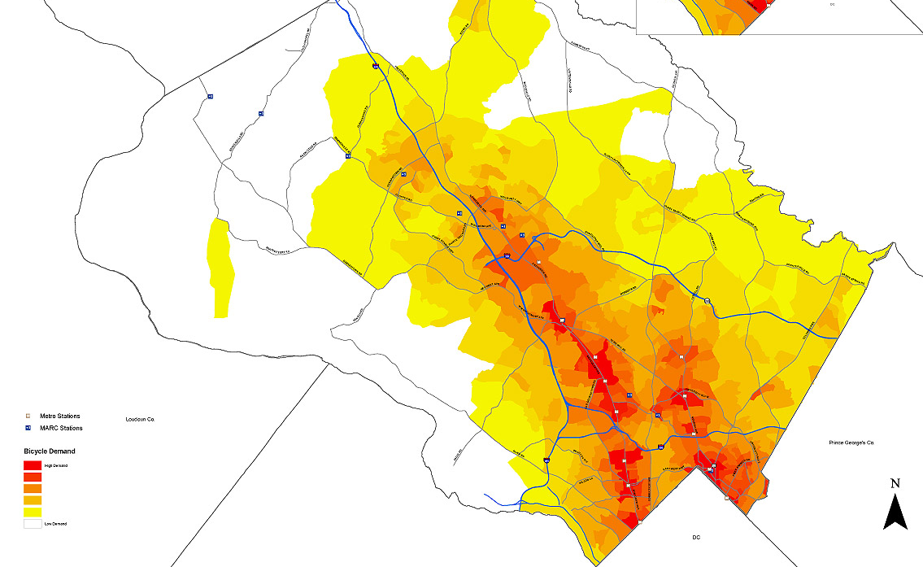
What is a thematic map?
Heat Map: “thematic application as a choropleth map.”
Not discrete amounts or categories

Slide 7
What will we be doing?
We will create a map that shows the density of Households in SF by Census Block.
Show you the steps to create a map that shows the distribution/density/number of (demographic data) in (geographic location) by (discrete area size).
Density of minority races in Alameda County by Census tract
Means of transportation to work in Berkeley by Census Block Group
Population density in California by County

Slide 8
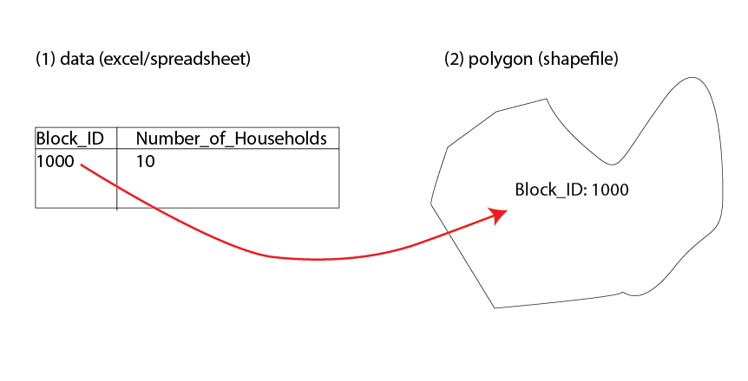
1. Data files
We will create a map that shows the density of Households in SF by Census Block.
So what do we need?
Households data in SF
Census block shapes in SF

Slide 9
What will we be doing?
Overview
Find the data files
Open shapefile in GIS
Join Geographic data with Attribute data using a common ID
Categorize and map data

Slide 10
1. Data files
Geographic information (GIS shapefile)
This data can be found on the US Census TIGER website: https://www.census.gov/geo/maps-data/data/tiger-line.html
Tiger/line shapefiles > 2013 > Download > web interface > blocks >california
Download and Extract (to an easy-to-find location)
Demographic information (Excel/.CSV)
This data can be found on the US Census Factfinder2 Website http://factfinder2.census.gov/faces/nav/jsf/pages/index.xhtml
Advanced Search > Show me All
Geographies > Name > “block” “San Francisco”
Select: all Blocks within San Francisco County, California
In search: “housing units” (or H1), Download file
Download and Extract (to an easy-to-find location)

Slide 11
1. Data files
Download and Extract (to an easy-to-find location)
.dbf (attribute data – think of it as an excel file)
.prj (projection – open in notepad)
.shp (geometry data)
.sph.xml (ArcMap’s file)
.shx (index file)

Slide 12
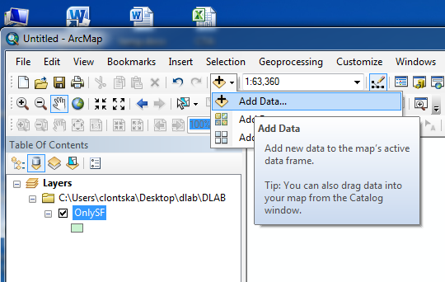
2. GIS
Start ArcMap
Start menu – All Programs – ArcMap10.1
Add data, select shapefile and excel file
Notes:
Raster vs Vector files
Pixels
Points, lines, polygons
Vector files
Analysis and editing
Attribute data (this is what we map)

Slide 13
2. GIS: Basic Tools
Check projection:
View > Data Frame Properties
NAD 1983 StatePlane California III FIPS 0403
Notes:
Raster vs Vector files
Pixels
Points, lines, polygons
Vector files
Analysis and editing
Attribute data (this is what we map)

Slide 14
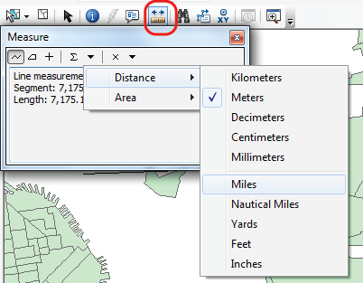
2. GIS: Basic Tools
Explore toolbars
Layout vs. data view
Table of Contents
layers in “List by Drawing Order,” “List by Source,” “List by Visibility” and “List by Selection”.
Layers on bottom = below / top = above
Zoom: mouse, zoom toolbar, and right click
Customize>ArcMap Options… (for changing mouse zoom)
To measure, click the ruler, then click your map. Options to change units will appear

Slide 15
2. GIS: Basic Tools
Toolbars: Customize>Toolbars (if the toolbars aren’t already there)
Selection Tool
Editing session
The toolbar: zoom in/out, move, select, information, measure options and more

Slide 16
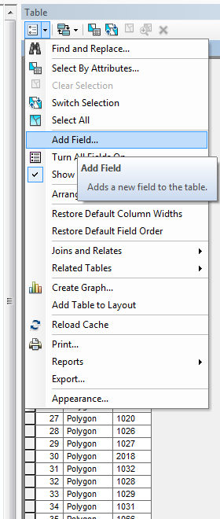
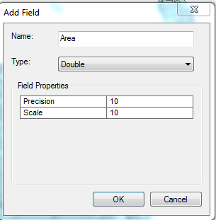
2. GIS: Basic Tools
Calculate Area of each Polygon
Right click > open attributes table
Table > Add Field
Notes:
Raster vs Vector files
Pixels
Points, lines, polygons
Vector files
Analysis and editing
Attribute data (this is what we map)

Slide 17
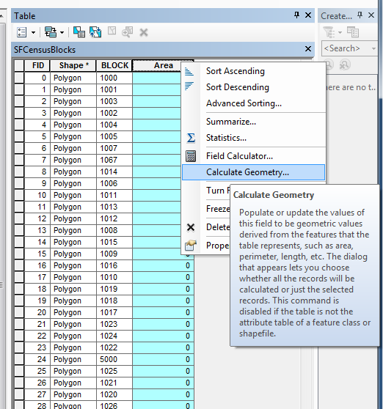
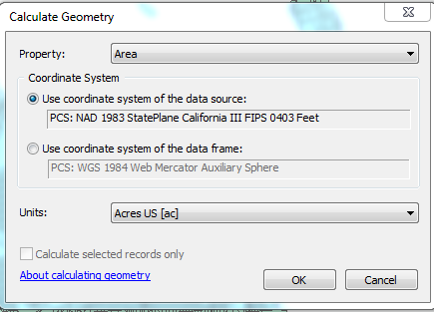
2. GIS
Right click Area > Calculate Geometry
Notes:
Raster vs Vector files
Pixels
Points, lines, polygons
Vector files
Analysis and editing
Attribute data (this is what we map)

Slide 18
CENSUS DATA FILE
Census Data
Can Only have 1 column, specific naming rules
begin with a letter (not a number!)
no more than 64 characters
may not consist solely of reserved words (these are typically very simple, such as: date, name, text, year)
Need to create a “Block” column that matches our GIS data

Slide 19
CENSUS DATA FILE
What ID number do we use?
Find an ID number on your shapefile that matches one on your spreadsheet
We need to make sure these numbers match exactly

Slide 20
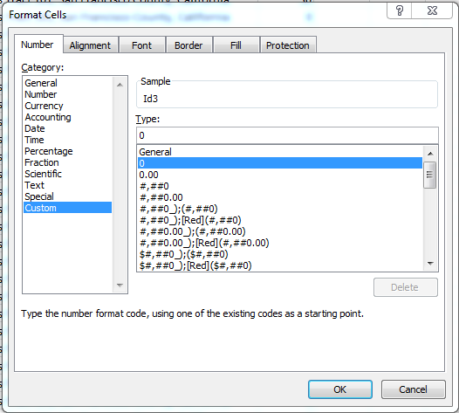
CENSUS DATA FILE
What ID number do we use?
Need to create a new column with a “0” in from of the GEO.id2 (or Id2)
Create new column, called “Id3”
Go to Number > Custom > Type > 0
Type a new formula, =0&B2 to create new ID number
Drag down to all cells
Save file

Slide 21
3. Join Data
Add Spreadsheet data to ArcMap

Slide 22
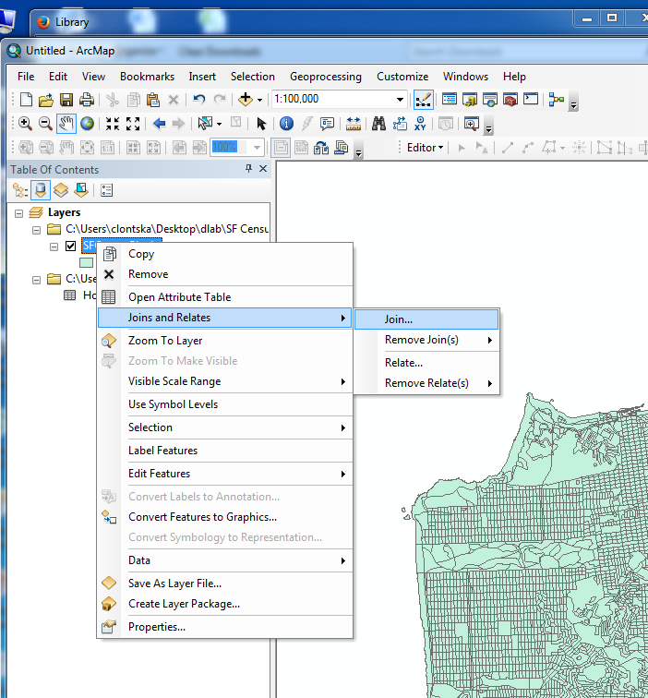
3. Join Data
Join data
Choose Block ID field on both files

Slide 23
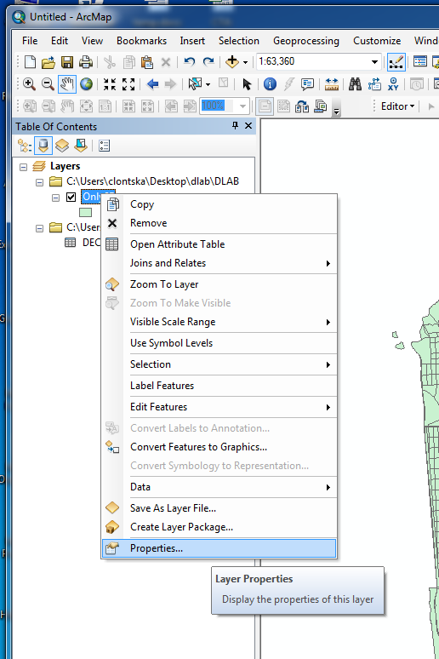
4. Create Map
Right click on your map layer with joined data
Go to Properties

Slide 24
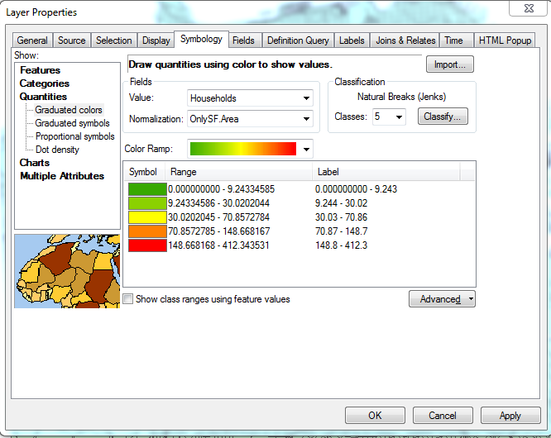
4. Create Map
Go to Symbology > Quantities
Select Households and Normalize by Area
Experiment with different kinds of breaks (under classification)

Slide 25
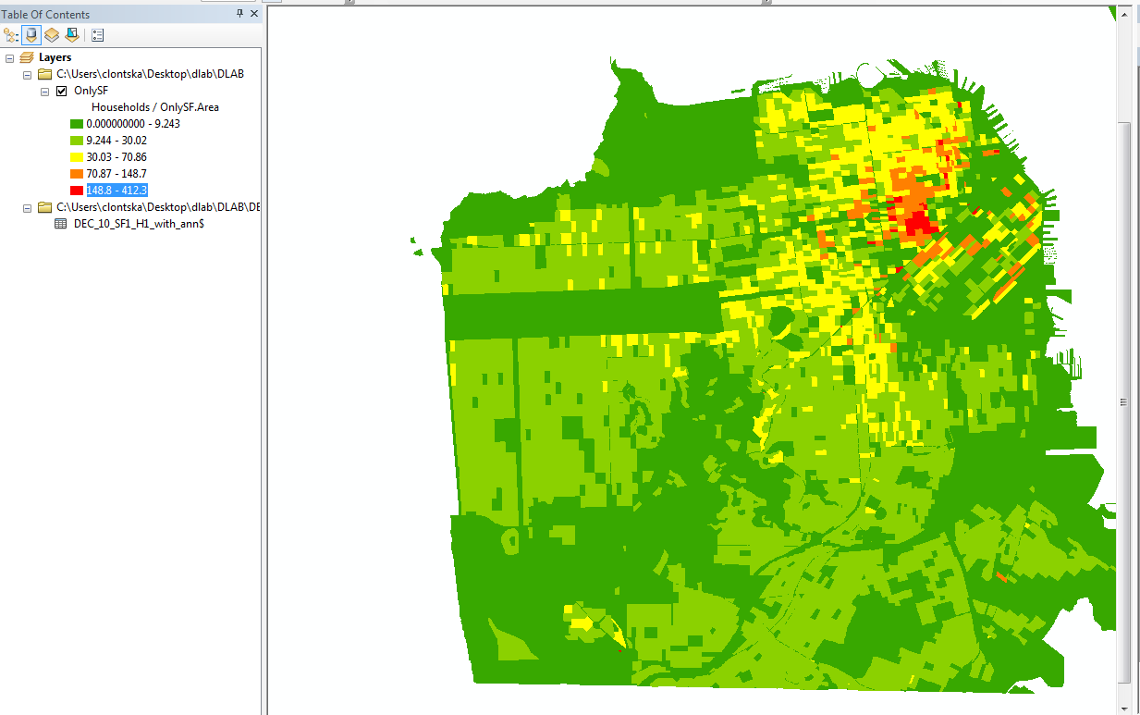
4. Create Map
You can change the colors of your map by clicking on the colored box in the Table of Contents

Slide 26
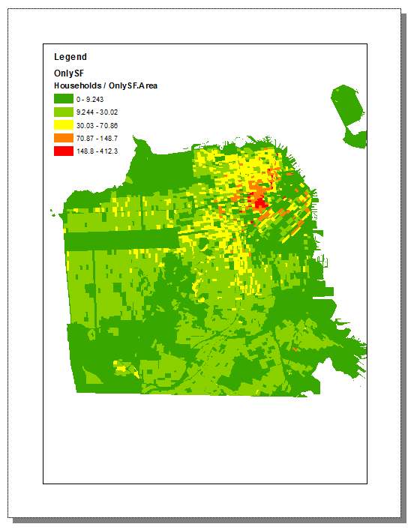
4. Create Map
Go to the Layout View, add a table of contents
Export > Illustrator or PDF

Slide 27
Resources
http://resources.arcgis.com/

