Slide 1
Searching, Exporting, Cleaning, & Graphing US Census Data
Kelly Clonts
Presentation for UC Berkeley, D-Lab
October 14, 2014

Slide 2
Learning Objectives
To become familiar with the types of data published by the US Census Bureau
US Decennial Census
American Community Survey
To understand how to search and analyze US Census data
Find appropriate data
Download and format data in Excel
Create population pyramids using Excel

Slide 3
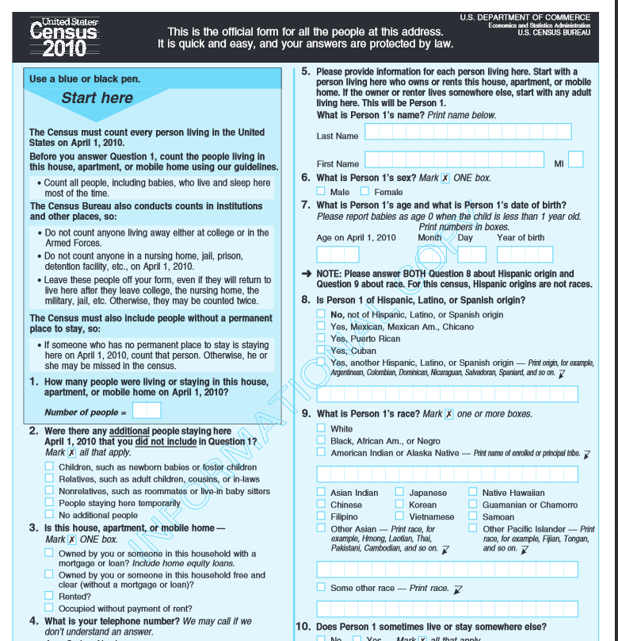
The Census
The Census
Decennial
American Community Survey
Notes:
Decennial: 100% of the US population (obviously there are problems here…homeless, students!?...but it’s actually pretty close)
Congress: “If we make the 10-year census too complicated, it will be much harder to get 100%....so instead we can do the ACS, which only gets 1 in 6 households” -> this is more detail HOWEVER, it means there is also a Margin of Error (more on this later)
ACS is a continuous survey (taken throughout the decade)
Samples about 3 million addresses each year
More detailed information (place of birth, income, employment status, tenure, monthly rent)

Slide 4
The Census
Go to census.gov
Quick Facts
Select State or City
Notes:
Good source of quick numbers

Slide 5
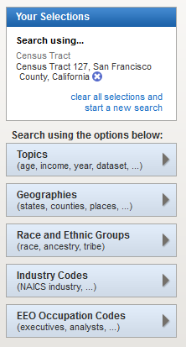
Fact Finder 2
Go to American Fact Finder 2 on your web browser at: factfinder2.census.gov
“Advanced search”
Layout
Geographies
Notes:
Click “Advanced search”
Go to “geographies”

Slide 6
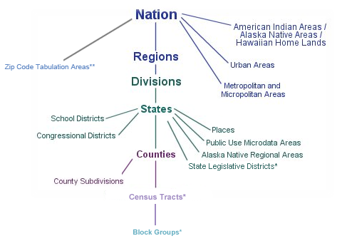
Fact Finder 2: Locating an Area
Level of Geography
Notes:
Click “Advanced search”
Go to “geographies”

Slide 7
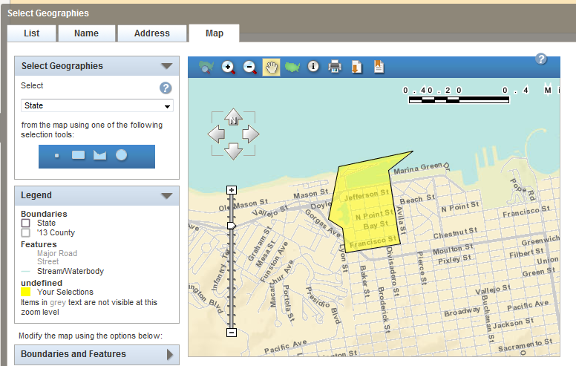
Fact Finder 2: Locating an Area
Find your neighborhood
Geographies > Address > Tract (like neighborhood)
Notes:
Enter your address (where you live) – look at the levels of geography (state, county, tract?)
What level of specificity are you looking for?
Select the “tract” level (think of this as a neighborhood), then go to “Map”
Click on the “Map” results, View your selection
Zoom out if you cannot see your area highlighted.
Close window (X in upper right) and look at “your selections”

Slide 8
Fact Finder 2: ACS data
What kind of data do you want?
Can add multiple geographies (but not overlapping subjects)
Select your current or home town tract & the city
Dataset
2012 ACS
Subject
Search B08301. Means of Transportation to Work
Must clear prior selection before re-searching
View Dataset

Slide 9
Fact Finder 2: ACS data
What kind of data do you want?
Subject
Search “income”
Search Means of Transportation to Work
Must clear prior selection before re-searching
View Dataset

Slide 10
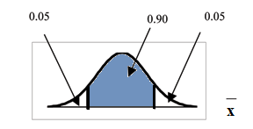
Margin of Error (ACS)
Margin of error (MoE)
Number of households = 1,000 +/- 100
Number of households = 20,000 +/- 400
1,000 +/- 100 tells us that we are 90% confident that the number of households is between 900 and 1100
When would the MoE
be a problem?

Slide 11
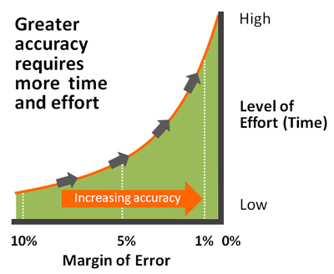
Margin of Error (ACS)
The uncertainty associated with an estimate that is based on data gathered from a sample of the population rather than the full population
-US Census claims no
Margin of Error

Slide 12
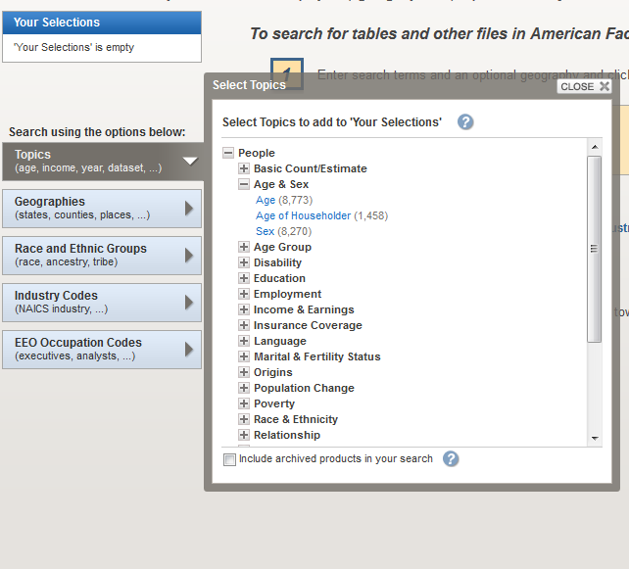
US Census
What kind of data do you want?
Dataset
2010 100%
Subjects
Population
Age Groups and Sex:
2010 Census Summary File 1

Slide 13
Locating an Area
Export Data
Download
CSV
Excel
Clean
CSV – change header names
Excel
Delete extra rows
Make Columns equal size, delete unnecessary
Change to number

Slide 14
Population Pyramid
Analyzing
Copy data to a new Sheet
Delete Unnecessary Data
Multiply Males by -1
Copy raw values
Graphing
Highlight data
Insert>bar
Clean up

Slide 15
Population Pyramid
Graphing and Analyzing Data
Compare to region (City, Bay Area, State)
Analyze data
Equality of gender?
Age distribution?

Slide 16
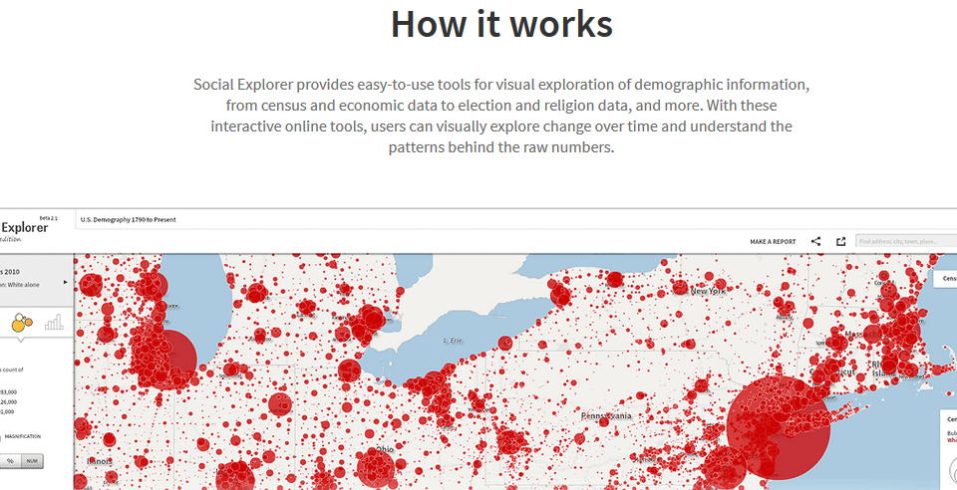
Social Explorer
Go to socialexplorer.com

Slide 17
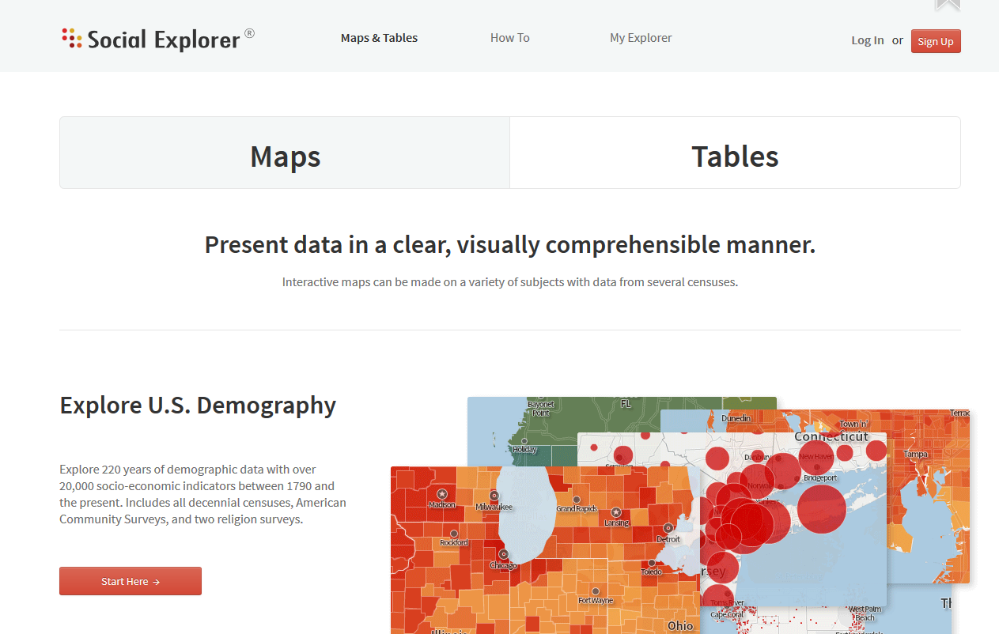
Social Explorer
Go to socialexplorer.com
Maps & Tables
Notes:
Click “Maps & Tables,” then “Start Here”

Slide 18
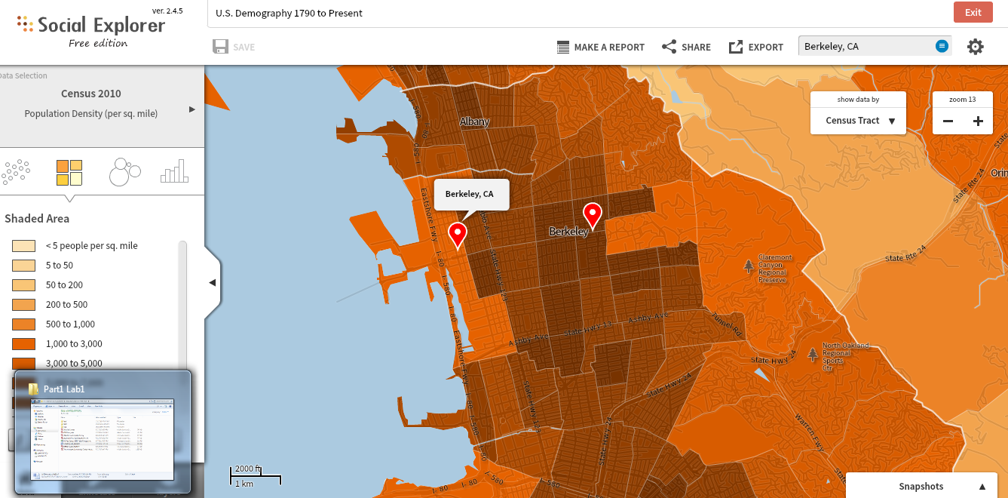
Social Explorer
Notes:
Click “Maps & Tables,” then “Start Here”

