Slide 1
Finding Health Statistics & Data Presented by Michael Sholinbeck, Outreach & Instruction Librarian, Sheldon Margen Public Health Library UC Berkeley D-Lab, March 1, 2016 me: msholinb@library.berkeley.edu

Slide 3
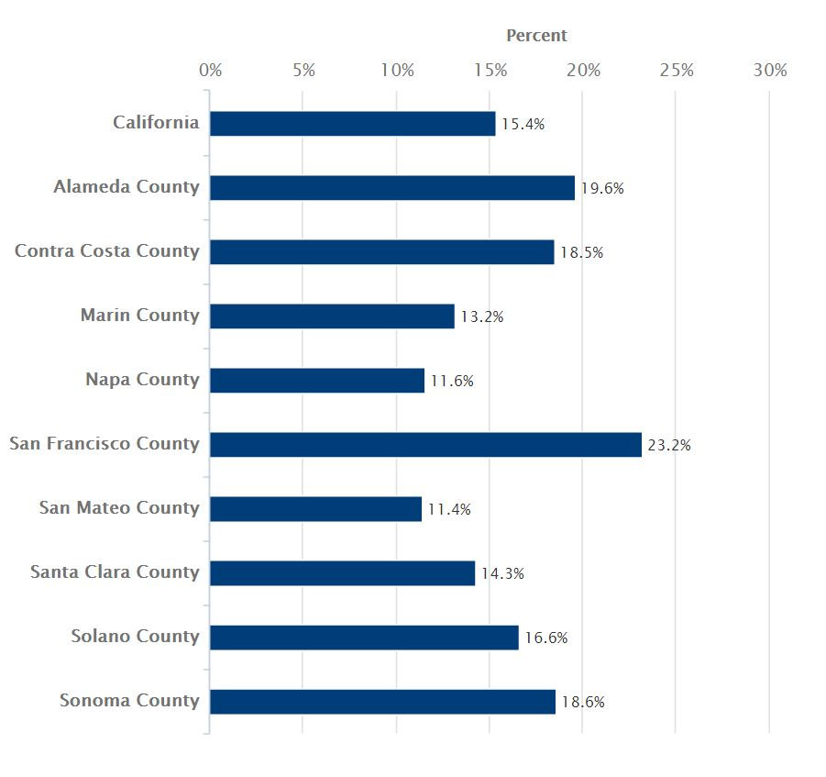
Asthma Diagnosis in Bay Area Kids, 2011-12 from Kidsdata.org

Slide 4
From NHANES data: http://www.cdc.gov/nchs/data/databriefs/db213.htm Caloric Intake From Fast Food Among Children and Adolescents in the United States, 2011–2012

Slide 5
Caution: Survey Ahead!
Lots of health data comes from surveys. Here are some issues to consider when looking at survey or estimated data:
Look at sample sizes and survey response rates - representative of your population? Enough responses to be valid?
Who was surveyed? - representative of population being compared to? Include group you are interested in?
Were the survey respondents from heterogeneous groups? Do the survey questions have a similar meaning to members of different groups?
How was survey conducted? Via telephone? - Many people only have cell phones. Random selection or targeted group?
What assumptions and methods were used for extrapolating the data?
Look at definitions of characteristics - Does this match your own definitions?
When was the data collected?
(Adopted from information on the UCSF Family Health Outcomes Project web site)

Slide 6
Reliability and Validity
Reliable data collection: relatively free from "measurement error."
Is the device used to measure elapsed time in an experiment accurate?
Is the survey written at a reading level too high for the people completing it?
Validity refers to how well a measure assesses what it claims to measure
If the survey is supposed to measure "quality of life," how is that concept defined?
How accurately can this animal study of drug metabolism be extrapolated to humans?
(Adopted from Chapter 3, Conducting research literature reviews : from the Internet to paper, by Arlene Fink; Sage, 2010.)

Slide 7
Is it “health”?

Slide 8
From Measuring What Works to Achieve Health Equity: Metrics for the Determinants of Health; Robert Wood Johnson Foundation, 2014

Slide 9
Let’s find some statistics! guides.lib.berkeley.edu/ publichealth/stats4dlab

Slide 10
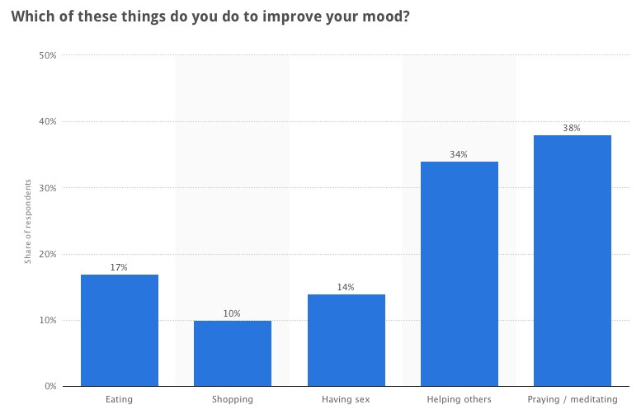

Slide 11
Thank you!

