Slide 1
Basics of Drupal
for Admins
Rochelle Terman
rterman@berkeley.edu

Slide 2
Who am I and why am I here?
Townsend Center for Humanities
Campus Technology Services
D-Lab
Social Science Matrix

Slide 3
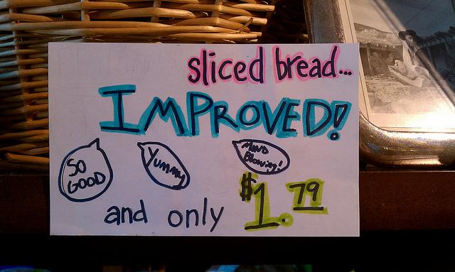
Quinn Dombrowski

Slide 4
Do you need Drupal?
… or WordPress?
… or Google Sites?
… or Wix/Weebly/SquareSpace?
… or custom programming?
… or any of the many web-building tools?

Slide 5
Builders & Software
 | Google Sites | Adobe Muse | CSS Templates | Wordpress | Drupal | Others for Sale (e.g. SquareSpace)
$$$ | Free | High* | Low* | Free* | Free* | High
Skill | None | Moderate (Design) | Moderate (Code) | Low (install) | Med - High | None
Static? | Static | Static | Static | Dynamic | Dynamic | Dynamic
Pretty? | Plain | Beautiful | Makeup | Beautiful | Makeup | Makeup
Power? | Weak | Weak | Weak | High | Superman | Muscle for Sale
FTP? | No | Yes | Yes | Kinda** | Yes | No
* Plus Hosting Costs
** It’s very possible to set up and maintain a WP site without ever having to use FTP.

Slide 6
Drupal at a glance
Free, open source Content Management System (CMS)
Many features and add-ons
Large community of developers
Used by companies, higher ed, NGOs, scholars
Very flexible

Slide 7
The Learning Curve

Slide 8
What this workshop will cover
Today:
Technical overview of Drupal
Setting up a new Drupal site
Installing & enabling modules
Key concepts for Drupal sites
Intro to data modeling

Slide 9
What this workshop will cover
Next week:
Further discussion of data modeling
Building content types
Adding content
Blocks
Themes

Slide 10
What this workshop will cover
Final week:
Views
Menus
Users / roles
Image styles
Slideshows, maps, timelines, etc. as needed

Slide 11
Hosting: Pantheon
Free for anyone to develop a site
$20/month for a basic site with few visitors
$75/month for more server resources
vs. < $10/month for inexpensive external shared hosting, capable of running multiple sites

Slide 12
Technical overview of Drupal

Slide 13
Technical overview of Drupal
Codebase
Database
Drupal core
Modules
Themes
Libraries
Views, blocks, breadcrumbs**
UI Configurations
Users
Permissions
Content (nodes, taxonomies)
Blocks Menus, Views
Other: File Uploads
in file structure with Code
but treated as Content by Pantheon

Slide 14
Site Building Components
Content types
Nodes
Taxonomies (vocabularies, terms)
Views
Blocks
Menus
Panels
Users
Roles

Slide 15
Example sites...

Slide 16
Your Site
Which major Drupal version (6, 7, etc)?
Where is it hosted?
Which distribution? (Berkeley, etc)
What modules are you using? (Core, contributed, custom)
What theme are you using (Core, contributed, custom, Berkeley)
Who built it and when?
Reverse engineering…

Slide 17
Installing modules
Administration menu
Backup and migrate
CTools
Pathauto
Token
Views

Slide 18
Modules for building content types
Date
Fieldgroup
Link
References
Hundreds of others

Slide 19
Data modeling considerations
Data or metadata?
Data becomes content types, metadata becomes fields (including taxonomy fields)
Taxonomy or content type?
Merging similar content types?
Drupal-based considerations
Hiding/displaying author/date information
Comments
URL patterns (Pathauto)
Permissions

