Slide 1
Basics of thematic maps in GIS (ArcMap)
Kelly Clonts
Presentation for UC Berkeley, D-Lab
April 1, 2014

Slide 2
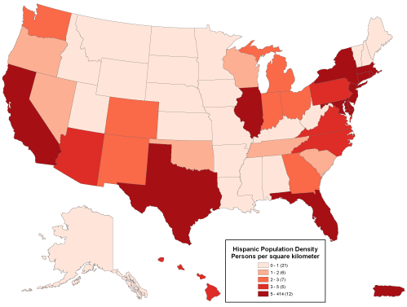
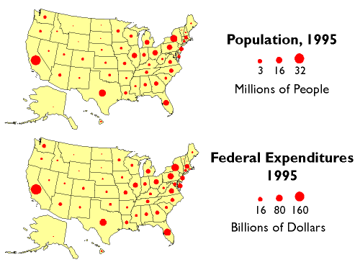
What is thematic mapping?
Wikipedia: A thematic map is a type of map or chart especially designed to show a particular theme connected with a specific geographic area. These maps "can portray physical, social, political, cultural, economic, sociological, agricultural, or any other aspects of a city, state, region, nation, or continent".

Slide 3
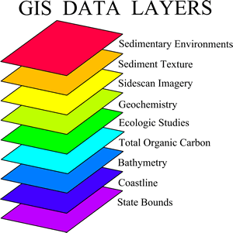
What is GIS?
A geographic information system (GIS) lets us visualize, question, analyze, interpret, and understand data to reveal relationships, patterns, and trends.
A computer tool for making maps? (sure, today)
Used for complex environmental research (example: flood risk)
Provides real world geographic information: location, attributes, spatial relationships (shape)

Slide 4
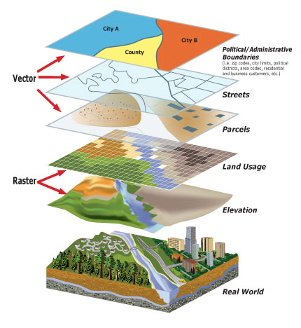
Learning Objectives
Feel comfortable with basic GIS skills
Understand basics of file types
Be able to use the basic tools
Import excel data and shape files
Join and relate data
Map and visualize data

Slide 5
ArcMap
Basics of spatial data
Shapefiles (.shp)
1. geographic shapes
2. Projection (coordinate system, transformations)
3. Spreadsheet (attribute data)
Kinds of spatial data
Polygons
Lines
points
Notes:
Shapefiles (.shp): Consist of at least three separate files (one that refers to the geographic shapes themselves, one that tells the computer how to project it, and a .dbf (spreadsheet) that contains attribute data. Three major kinds of spatial data: Polygons, lines, and points.

Slide 6
Getting Started
Download data
Download Dlab_data
1 excel file
2 shape files
Make sure files are extracted and in an easy-to-find location
Start ArcMap
Start menu – All Programs – ArcMap10.1

Slide 7
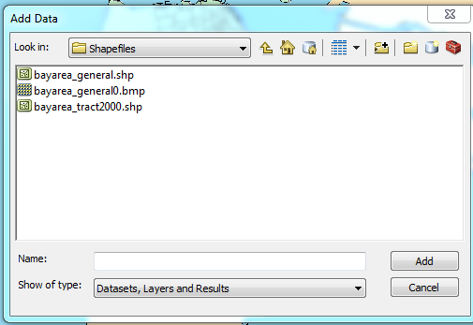
Getting Started: add data
Add data to your empty map
Click on the icon
Link your file folder
Add shapefiles:
bayarea_tract2000.shp
bayarea_general.shp
Notes:
The map you opened displays the Census 2000 tracts (same tracts as ACS 2005-2009, though different from ACS 2007-2011 and from Census 2010 tracts) for all of Alameda and San Francisco Counties. The data comes from the Metropolitan Transportation Commission (MTC), the transportation planning body for the nine-county Bay Area.

Slide 8
Basic Tools
View data in shapefile
Toolbars: Customize>Toolbars
Check the projection (Properties> Source)
The toolbar: zoom in/out, move, select, information, measure options and more

Slide 9
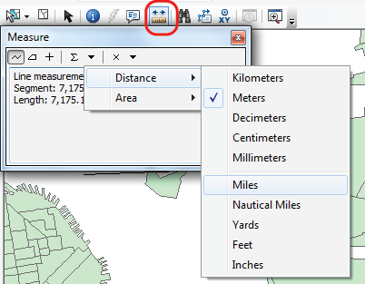
Basic Tools
Explore toolbars
Layout vs. data view
Table of Contents
layers in “List by Drawing Order,” “List by Source,” “List by Visibility” and “List by Selection”.
Zoom: mouse, zoom toolbar, and right click
Customize>ArcMap Options… (for changing mouse zoom)
To measure, click the ruler, then click your map. Options to change units will appear

Slide 10
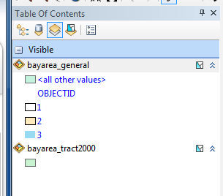
Basic Tools
Table of Contents
layers in “List by Drawing Order,” “List by Source,” “List by Visibility” and “List by Selection”.
Layers on bottom = below / top = above
Selecting only one layer at a time

Slide 11
Basic Tools
Change colors of bayarea_general so that land is hollow and water is blue.
Right click> Properites > Symbology > Categories> Add All Values
Double click on color icons
Click okay and arrange your layers accordingly

Slide 12
Data from FactFinder2
The data displayed in ALAMEDASF.xls were downloaded from American Fact Finder 2. The process:
Get your data from Fact Finder 2. Download the data into Excel.
Open the Excel file. Whatever format your data comes in, you need to make sure you have a field (column) that includes the tract numbers as a unique identifier.
Correct Column names

Slide 13
Joining Data
Add labels
Right click > Properties > Labels > tract ID#s
Join Data
Common Problems (naming, file specifics)
Add AlamedaSF$ excel file
Right click > Joins & Relates > Join

Slide 14
Joining Data
Add labels
Right click > Properties > Labels > tract ID#s
Join Data
Common Problems (naming, file specifics)
Add AlamedaSF$ excel file
Right click > Joins & Relates > Join

Slide 15
Thematic Maps
Make sure data is properly joined
Properties > Symbology > Quantities
(note: categorical data is for categories, such as “land use”)
Select value (MedYrBuilt, MedTenancy, MedRent, HomeValue)
Experiment with changing quantile breaks/labeling
equal interval (3-6%, 6-9%, 9-12%)
Defined interval (define your own)
Quantile (each class has an equal number)
natural breaks (groupings inherent in the data, if there are “clumps”)
Edit labels so they make more sense
Notes:
Chose the data you want to display
MedYrBuilt: median construction year for buildings in tract
MedTenancy: median householder move-in year for occupied residences in tract
MedRent: Median gross rent paid for all rental housing units in tract
HomeValue: Median home value for owner-occupied housing units in tract

Slide 16
Displaying Maps
After you have chosen data, quantity interval, and changed labels…
Change to Layout View, add:
A clear and readable legend
A scale bar
A north arrow
A title
Data source
Notes:
How to edit your legend title: After inserting a legend, right-click on it, and go to Properties>"Items" tab and click the "Style" button. If you want total control over your legend text, select the style option that includes only a title. You can edit the title however you wish (use more than one line, etc).
You can print or export the formatted map as a .JPG or a .PDF for use in MS Word, Powerpoint or other programs. Have fun.

Slide 17
Resources
GIS help: http://resources.arcgis.com/
Demographic data by tract: Factfinder2
Online mapping tools
Social Explorer - you can use this to QUICKLY map census and ACS data at the tract level, as well as data from a couple other data sets (religion!): www.socialexplorer.com/pub/maps/home.aspx
NY Times, Mapping America: Every City, Every Block – this QUICKLY shows mapped 2005-2009 ACS data at the tract level, using several different visual representations:
projects.nytimes.com/census/2010/explorer

Slide 18
Resources
Useful sites for downloading free spatial data
www.mtc.ca.gov/maps_and_data/GIS/data.htm
US Federal Government www.census.gov/geo/www/tiger/tgrshp2010/tgrshp2010.html
www.data.gov
www.nationalatlas.gov/maplayers.html
www.nationalmap.gov
msc.fema.gov
www.nrcs.usda.gov/Technical/NRI
datagateway.nrcs.usda.gov
cumulus.cr.usgs.gov
www.usgs.gov/ngpo/
California Government
atlas.ca.gov
ceres.ca.gov
atlas.resources.ca.gov
www.consrv.ca.gov/DLRP/fmmp
gis.abag.ca.gov
www.scag.ca.gov/mappingGIS.htm
www.sandag.org/index.asp
www.sfgov.org/site/gis_index.asp?id=371
www.sanjoseca.gov/gis/
GIS Community
data.geocomm.com/catalog/index.html
http://www.esri.com/data/free-data/index.html
Universities
www-sul.stanford.edu/depts/gis/web.html
issrweb.asu.edu/research_services/gis
www.ciesin.columbia.edu/download_data.html

