Slide 1
The Basics of Excel
Part II
Thursday, May 11th 2017
D-Lab | University of California, Berkeley

Slide 2
Contents
TRACKER
Introduction
Databases
Importing data
Sorting and filtering
Pivot Tables
Modeling

Slide 3
Last class we learned
Introduction
The structure of an excel document
How to enter data in a cell and what to enter
Referencing cells
Spreading formulas
Absolute references
Types of functions
The structure of formulas
Aggregate functions
Text functions
Logical functions

Slide 4
Today we will go over
Introduction
Databases
Importing data and text
Sorting and Filtering
Formatting
Conditional Formatting
Data validation
Pivot Tables
Modeling best practices
Modeling tools

Slide 5
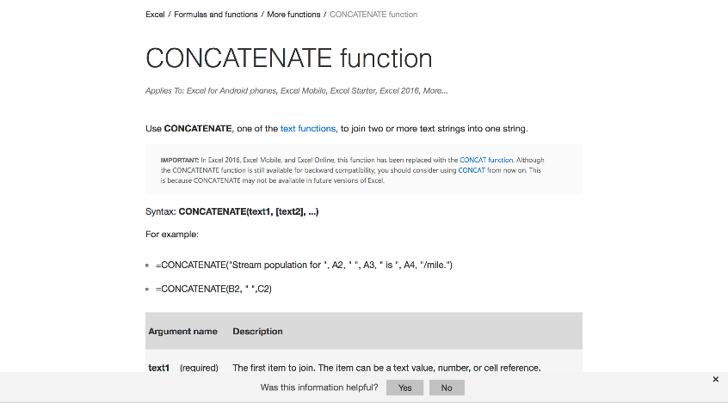
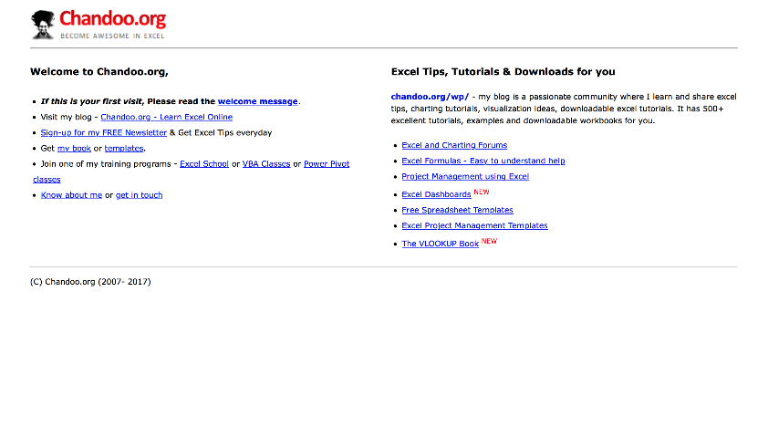
Useful resources
Introduction
Microsoft Office’s Excel help center
Chandoo.org

Slide 6
Contents
Introduction
Databases
Importing data
Sorting and filtering
Pivot Tables
Modeling

Slide 7
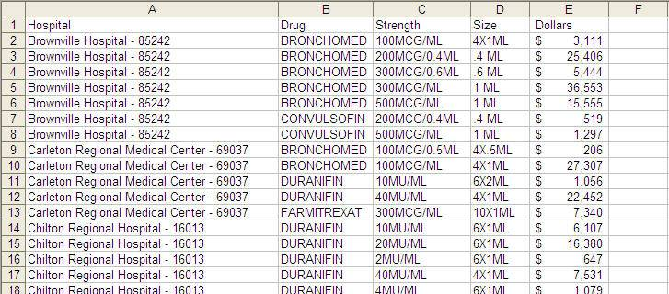
Database format
Databases
To analyze your data, you want to ensure your data is in the database format: a separate column for each field and each row corresponding to each record.
Notes:
This is how a database should look. Each column contains a separate piece of information and each row is called a record.
Data needs to be in this format if you want to use many of Excel’s built in data tools such as Sorting, Filtering, Subtotals and Pivot Tables
Data must conform to certain rules to be in ‘database’ format
no entirely empty rows
no entirely empty columns
each column (field) must contain a label/heading
A quick way of checking whether your data is in ‘database’ format is to select one cell and then press CTRL + A, if you have any empty columns or rows in your data then your compete data set will not be selected
CLICK to next slide

Slide 8
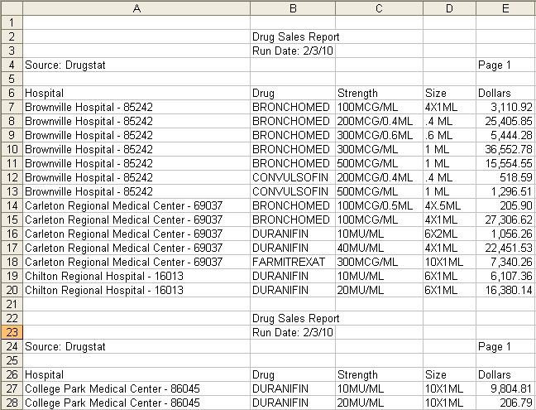
Examples of problem data
Databases
Data that is imported to Excel via a third party application often appears in a layout that requires conversion to database format. Examples include….
Segmented data with repeated headings
Notes:
Explain that the data we get from our clients isn’t always in the cleanest format. We will show some examples of data in its different formats, and give you tips on how to convert the files into database format in Excel.
The examples we are showing and techniques are by no means comprehensive, but they give you a great starting point to work with common data problems.
CLICK
Segmented data with repeated headings shows. This is a common format from Oracle
CLICK
Boxes around repeated headings appear
CLICK to next slide

Slide 9
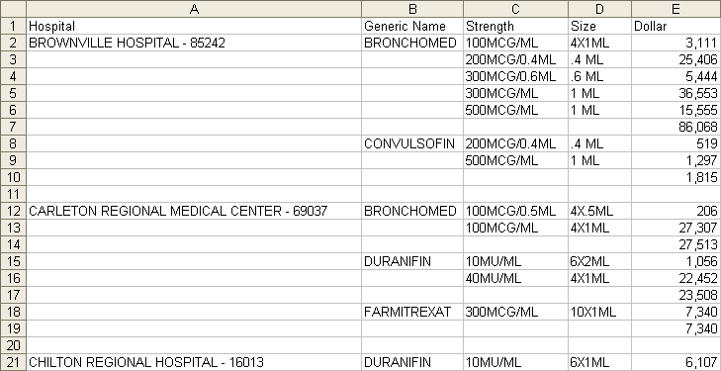
Examples of problem data
Databases
Data that is imported to Excel via a third party application often appears in a layout that requires conversion to database format. Examples include….
Stepped data
Notes:
Stepped data is where some of the fields are not repeated throughout the related records. For each piece of information to the right, you “step” down to the details. While this is aesthetically pleasing, it does not work for many of excel’s analysis tools. You may also find merged cells to the left of non-merged cells, depending on client formatting conventions.
CLICK
Highlight boxes appear around records. The hospital name and generic name need to be filled in throughout each corresponding record. Subtotal rows need to be removed
CLICK to next slide

Slide 10
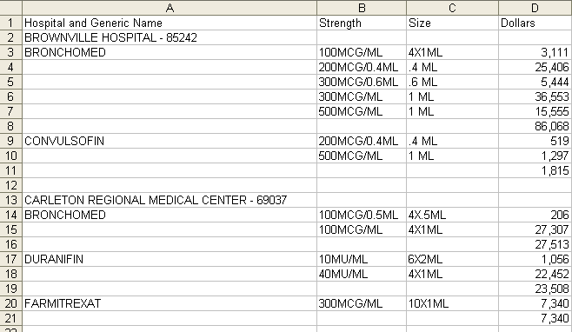
Examples of problem data
Databases
Data that is imported to Excel via a third party application often appears in a layout that requires conversion to database format. Examples include….
Stepped data with a twist
Notes:
Similar to previous example, but now the hospital and the generic drug name are listed in the same column.
CLICK
Highlights appear around records. The hospital name and generic drug name need to be put in separate columns, and repeated for the appropriate records
CLICK to next slide

Slide 11
Now you try it…
Databases
In the Excel exercise file
Go to the Stepped Data worksheet:
Highlight cells A7:B95
Use the F5 method to select blank cells
Type “=B2” then press CTRL + Enter
Remove the formulas and remove unneeded rows

Slide 12
Contents
TRACKER
Introduction
Databases
Importing data
Paste Special
Text to columns
Importing wizard
Sorting and filtering
Pivot Tables
Modeling

Slide 13
Contents
TRACKER
Introduction
Databases
Importing data
Paste Special
Text to columns
Importing wizard
Sorting and filtering
Pivot Tables
Modeling

Slide 14
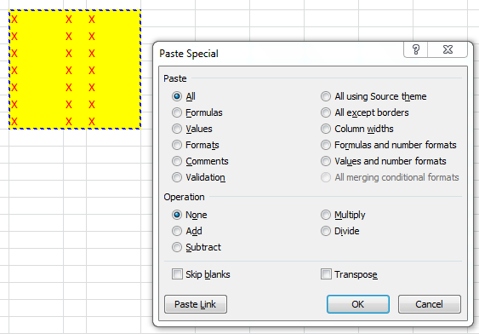
Paste special
Importing data
Description
Use the Paste Special dialog to copy complex items from a Microsoft Office Excel worksheet and paste them into the same worksheet or another Excel worksheet using only specific attributes of the copied data, or a mathematical operation that you want to apply to the copied data
How to use it

Slide 15
Contents
TRACKER
Introduction
Databases
Importing data
Paste Special
Text to columns
Importing wizard
Sorting and filtering
Pivot Tables
Modeling

Slide 16
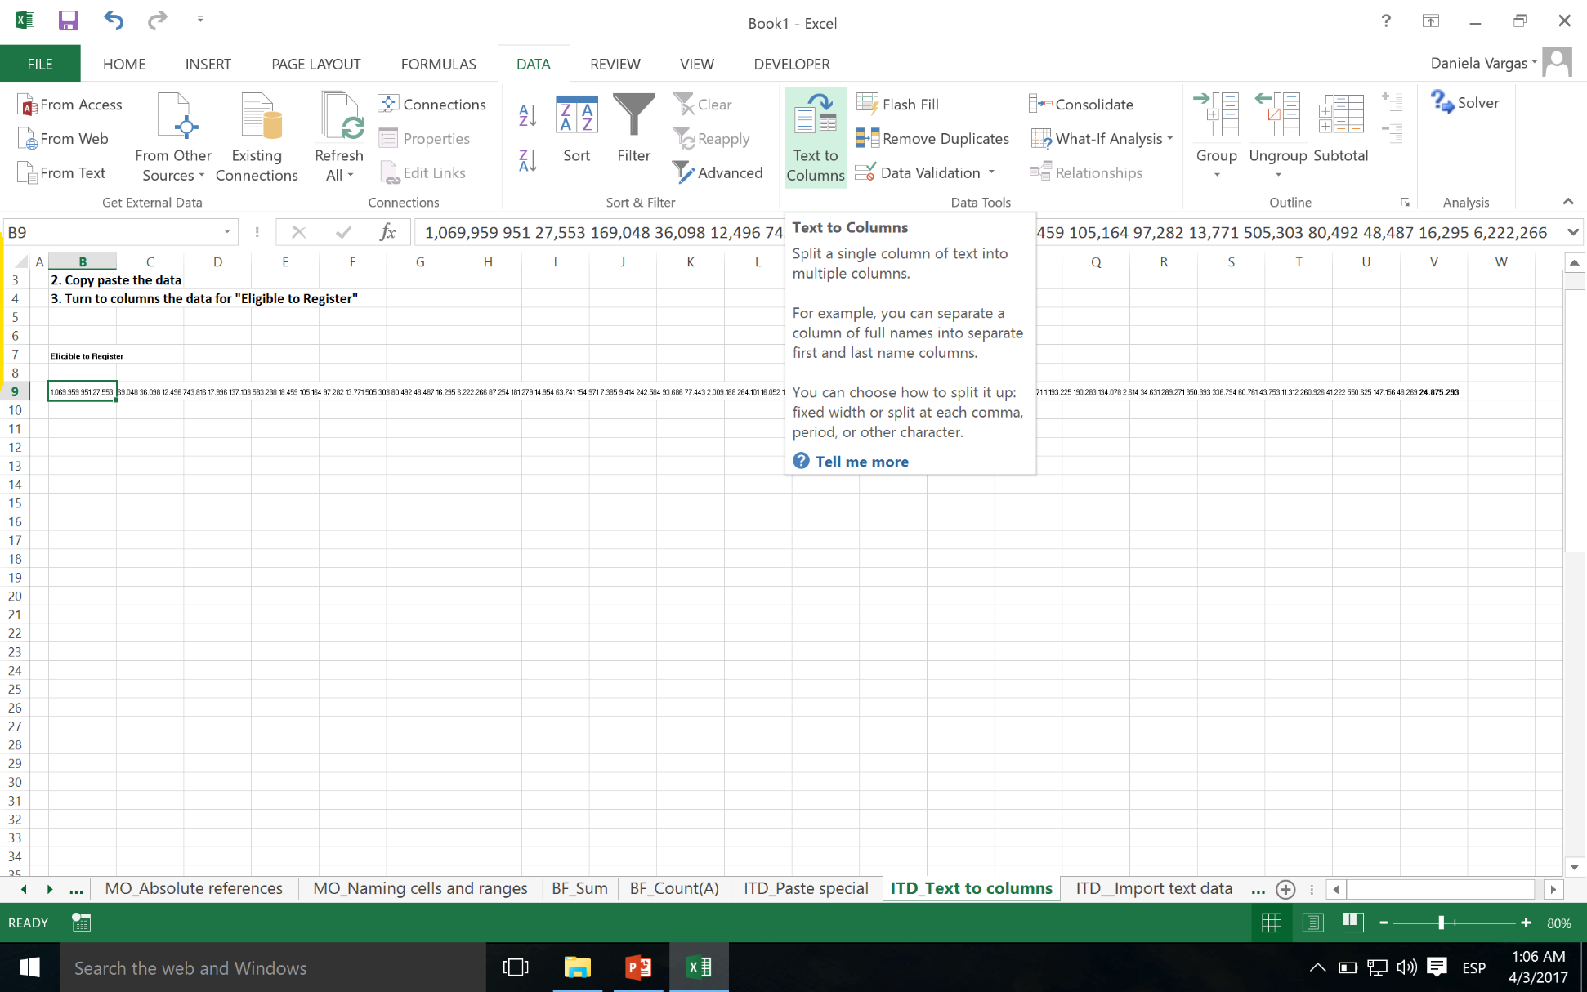
Text to columns
Importing data

Slide 17
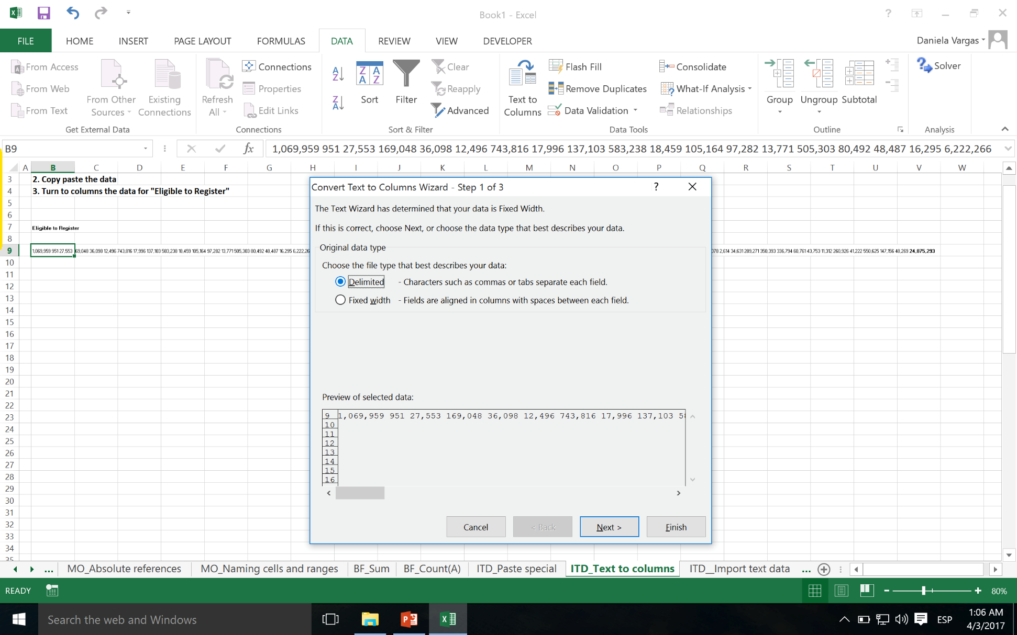
Text to columns
Importing data

Slide 18
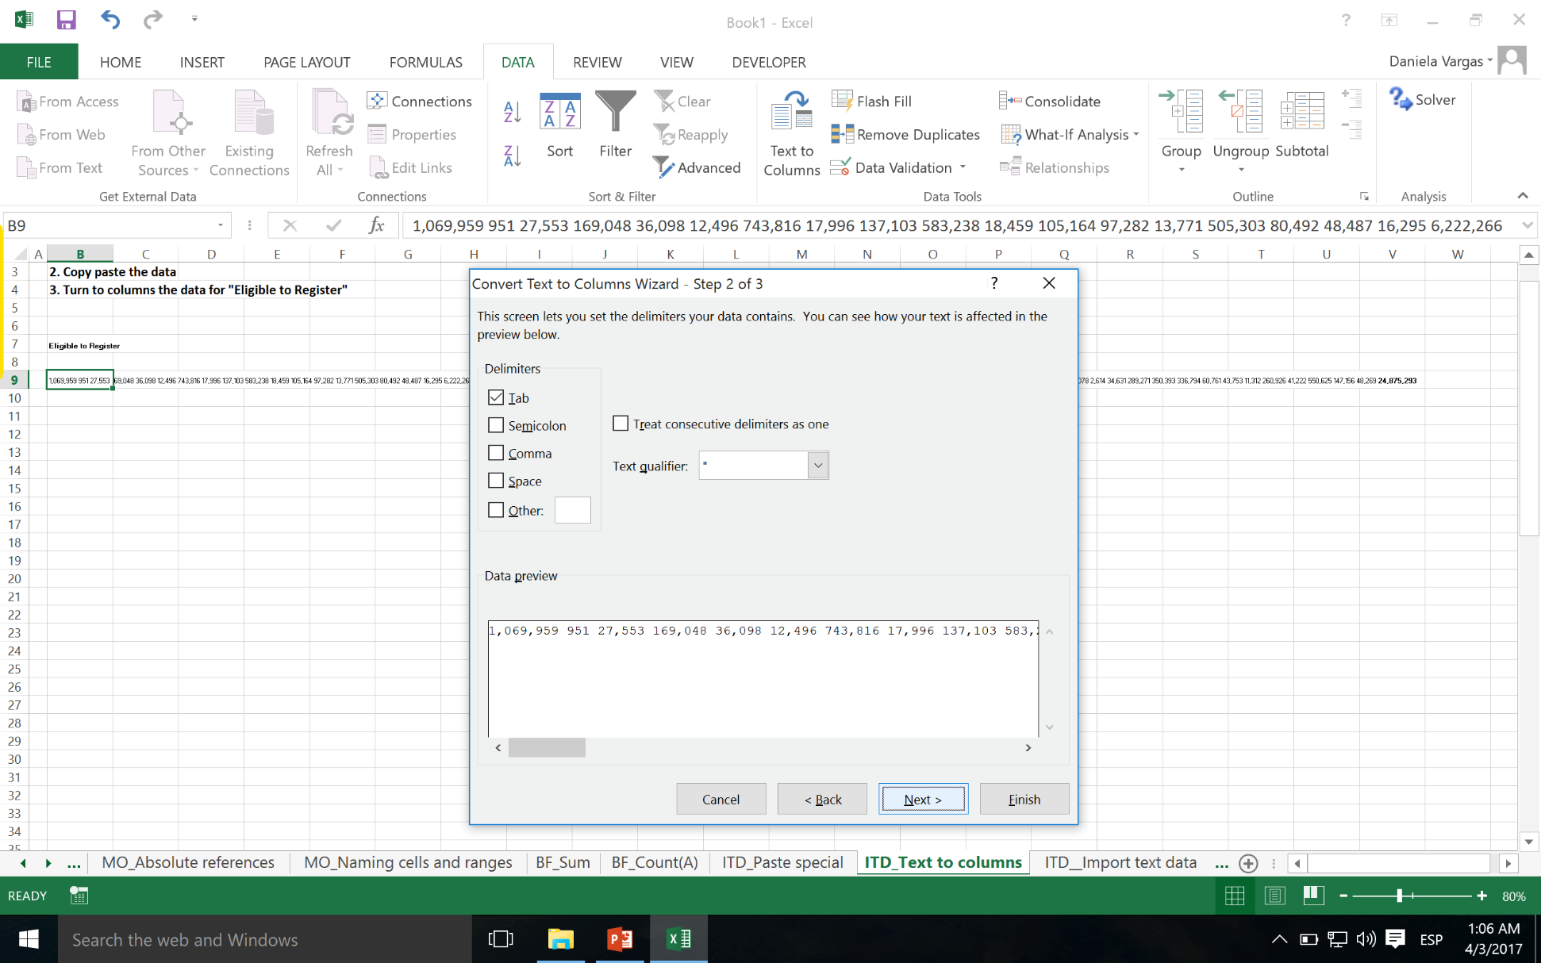
Text to columns
Importing data

Slide 19
Contents
TRACKER
Introduction
Databases
Importing data
Paste Special
Text to columns
Importing wizard
Sorting and filtering
Pivot Tables
Modeling

Slide 20
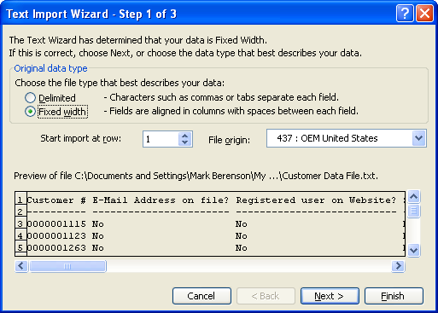
Importing wizard
Importing data
Data will often be provided in a text file (e.g., tab-delimited or plain-text with spaces). When this is the case, the data must be imported into Excel before it can be analyzed
To import data into Excel, use the import wizard (Data : Import External Data : Import Data)
Two types of data can be imported
Delimited: Data fields are split by commas or any other character and importing involves creating a cell each time the character appears
Fixed width: A column is the same width for each row (as seen in the example) and the user identifies how wide each column should be
Following the wizard will result in formatted data being imported

Slide 21
Contents
TRACKER
Introduction
Databases
Importing data
Sorting and filtering
Pivot Tables
Modeling

Slide 22
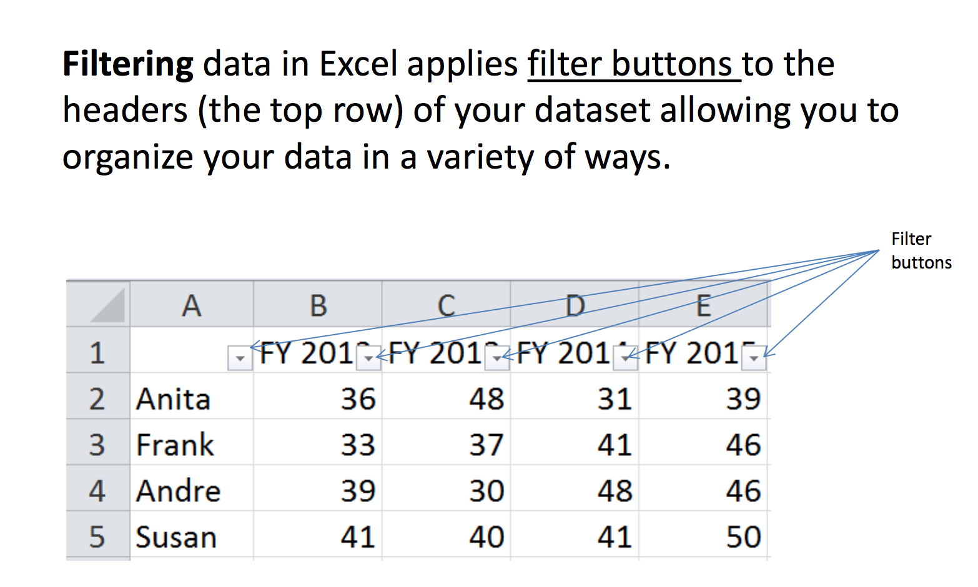
Sorting and filtering
Sorting and filtering

Slide 23
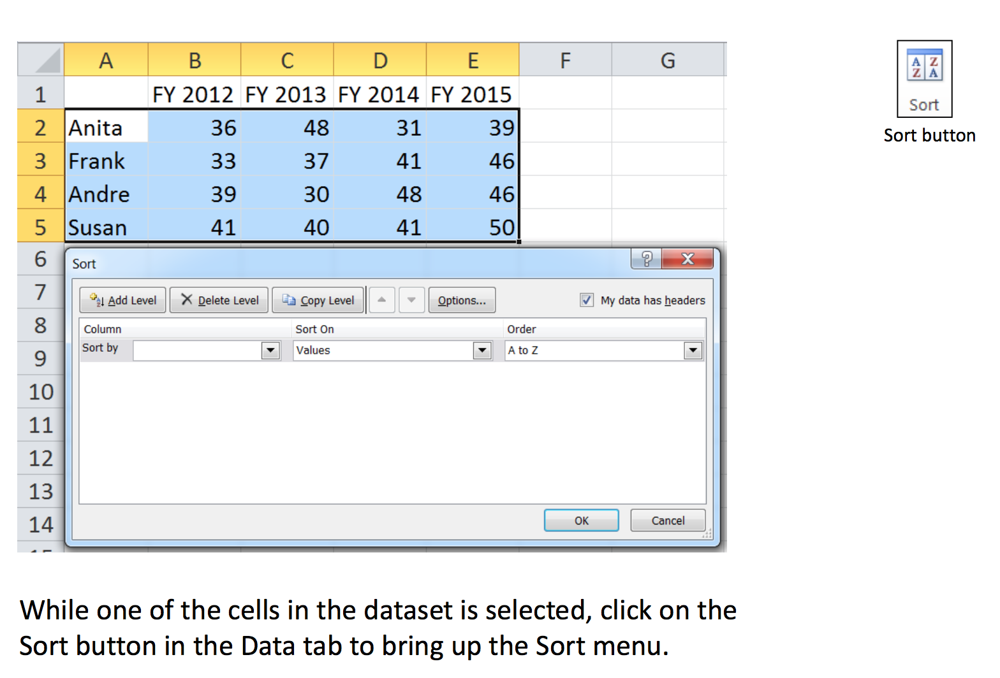
Sorting and filtering
Sorting and filtering

Slide 24
Contents
TRACKER
Introduction
Databases
Importing data
Sorting and filtering
Pivot Tables
Modeling

Slide 25
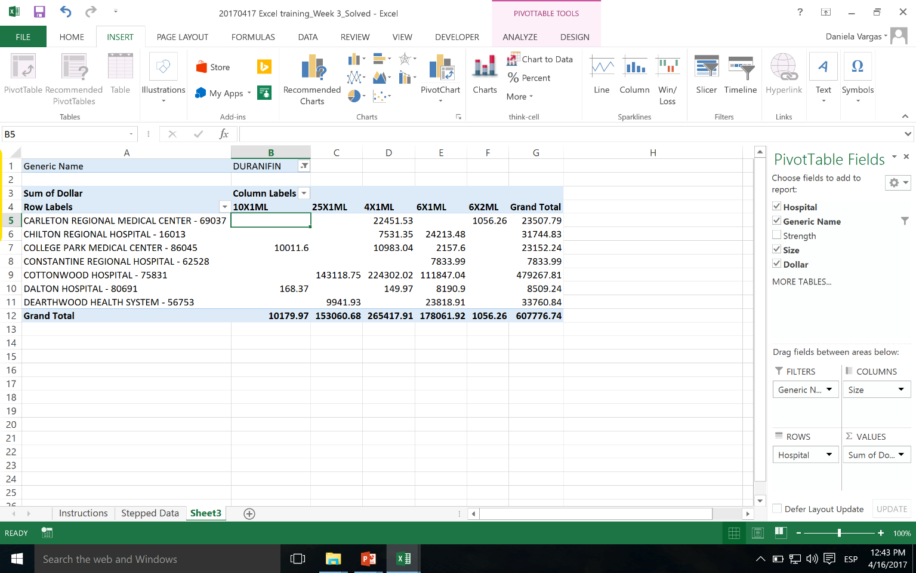
Pivot Tables - allows you to extract the significance from a large, detailed data set
5
Pivot Tables
Being able to analyze all the data in your worksheet can help you better understand it, but sometimes it’s hard to know where to start, especially when you have a lot of data
PivotTables are a great way to summarize, analyze, explore, and present your data
Notes:
24

Slide 26
Now you try it…
Pivot Tables
In the Excel exercise file
Go to the Stepped Data worksheet:
Highlight all the cells in your table
Go to the Insert tab
Select Pivot Table
Answer the questions in the instructions file

Slide 27
Contents
TRACKER
Introduction
Databases
Importing data
Sorting and filtering
Pivot Tables
Modeling
Modeling best practices
Modeling tools

Slide 28
When to create a model
Modeling
Model
Complex calculations
Possible need for revisions and extensions in the future
Other people will make use of it and will need to understand the logic
Worksheet
Relatively simple calculations
Used once
Personal use

Slide 29
Planning
Modeling
Relevant questions
Purpose
What is the purpose?
Who will be the users of the model?
Solution method
Which software to use?
What calculations are necessary?
How many scenarios will be required? Which ones?
Inputs
What information is required?
What are the relevant sources?
How you can deal with missing or incomplete information?
Outputs
What results should the model produce?
How will users interact with the model?

Slide 30
Contents
TRACKER
Introduction
Databases
Importing data
Sorting and filtering
Pivot Tables
Modeling
Modeling best practices
Modeling tools

Slide 31
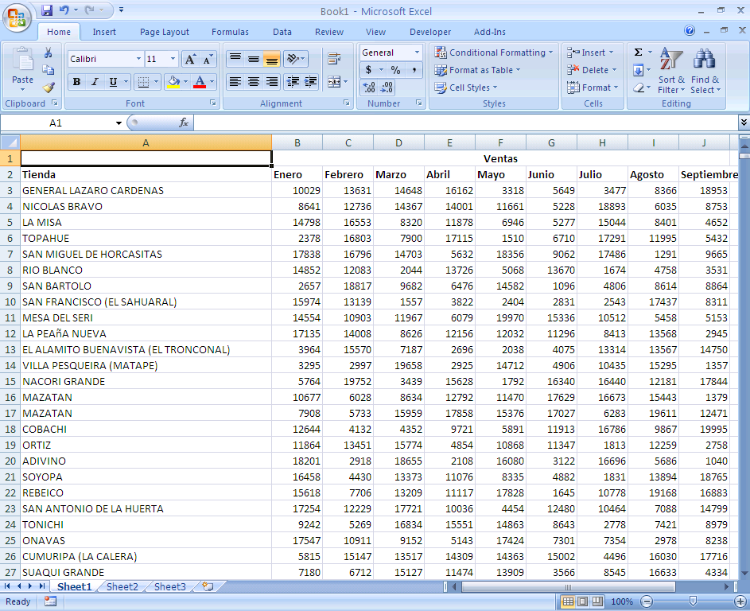
Excel Best practices (1/4)
Modeling best practices
Organize information vertically

Slide 32
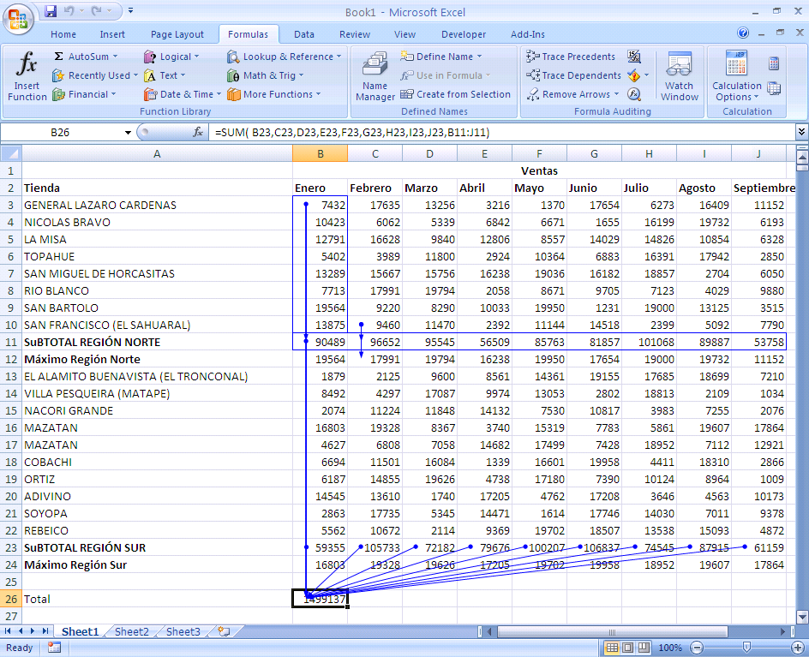
Excel Best practices (2/4)
Modeling best practices
A formula should only reference cells above it

Slide 33
Excel Best practices (3/4)
Modeling best practices
Formulas should be in the simplest possible form, to prevent unnecessary calculations:
= (A1*1000+B1*1000+C1*1000)/10 = (A1+B1+C1)*100
Setting parameters is preferable to inputting numbers directly into the formula, since it will later be easier to make changes and add comments to these parameters
= (A1+B1+C1)*100 = (A1+B1+C1)*$D$5

Slide 34
Excel Best practices (4/4)
Modeling best practices
Organize the spreadsheet forecasting potential changes
Do not waste much time on formatting until the spreadsheet is final
Save information frequently but carefully: do NOT rely on Auto Save
It is best to store files with consecutive names to keep working (file01.xls, file02.xls, file03.xls) and then erase earlier versions, than to find out you made irreparable changes to your file!

Slide 35
Contents
TRACKER
Introduction
Databases
Importing data
Sorting and filtering
Pivot Tables
Modeling
Modeling best practices
Modeling tools

Slide 36
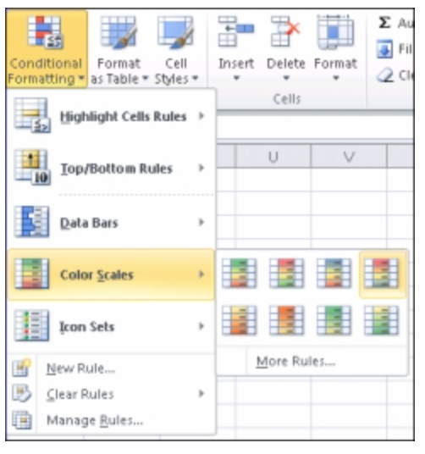
Conditional Formatting - quickly identify variances in a range of values with a quick glance
Modeling tools

Slide 37
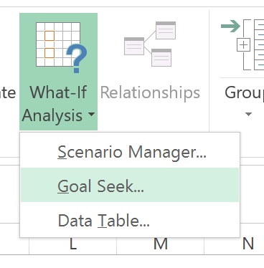
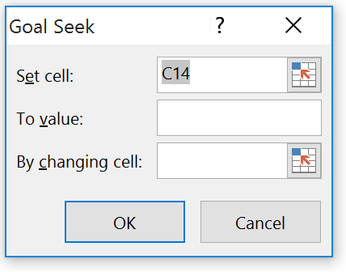
Goal Seek - find the result you want by adjusting an input value
Modeling tools
You need to enter a manual value here
If you know the result you want from a formula, but aren't sure of which input value will producte that result, use Goal Seek

Slide 38
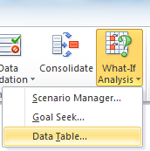
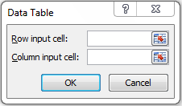
Sensitivity Analysis or “data table” - range of cells in which you can change values in some in some of the cells and come up with different answers to a problem
Modeling tools
The “Row input cell” is the cell where you would enter the different values on the x axis of your table
You need to have the top left cell on your table be a reference to the value you want to play with
The “Column input cell” is the cell where you would enter the different values on the y axis of your table

Slide 39
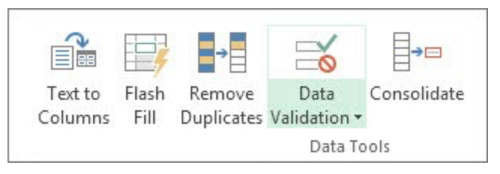
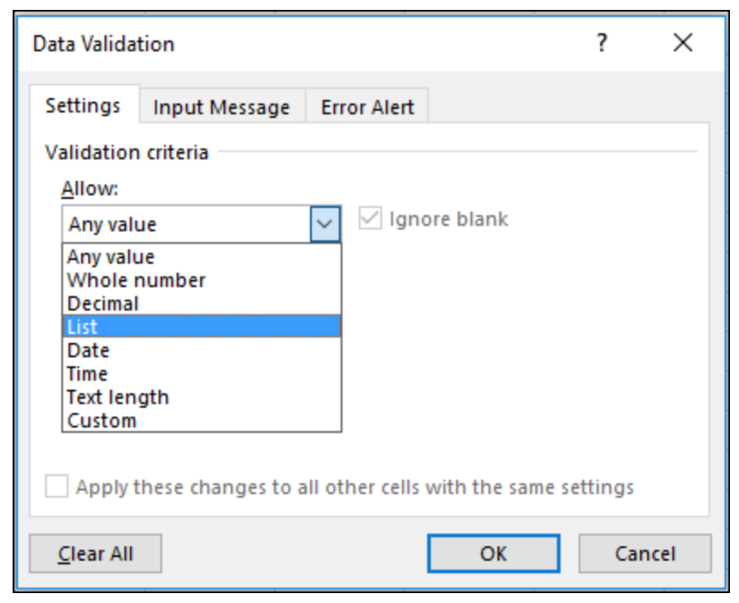
Data validation - restrict the type of data or the values that users enter into a cell
Data validation
One of the most common data validation uses is to create a drop-down list

