Slide 1
The Basics of Excel
Part I
Monday, April 3rd 2017
D-Lab | University of California, Berkeley

Slide 2
Contents
TRACKER
Intro
Excel 101
Math Operations
Formulas 101

Slide 4
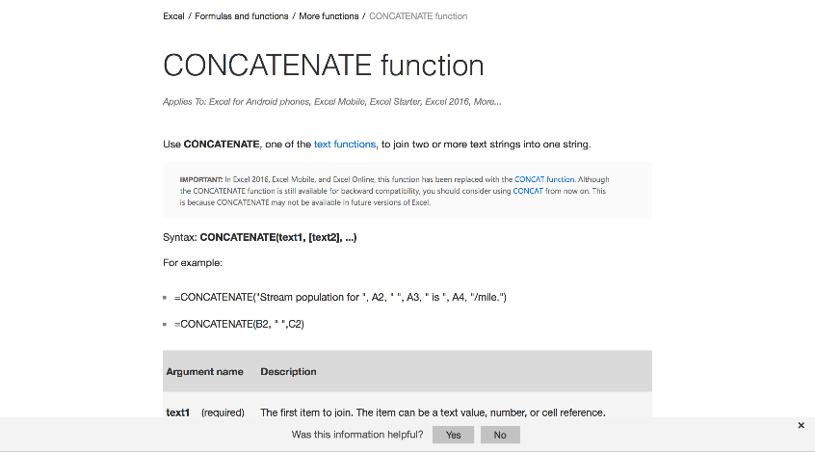
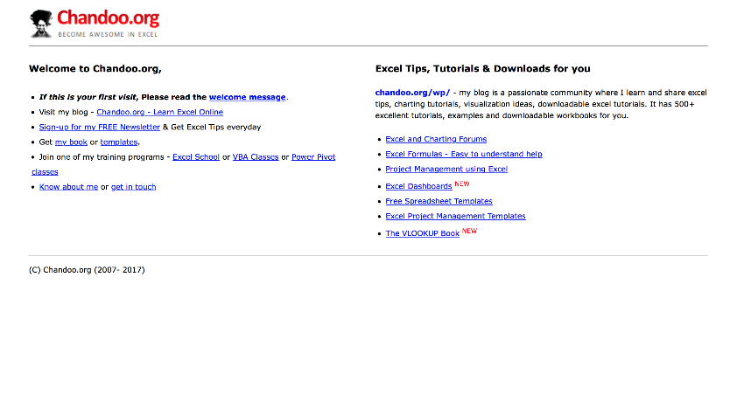
Useful resources
Introduction
Microsoft Office’s Excel help center
Chandoo.org

Slide 5
Contents
TRACKER
Intro
Excel 101
Structure of an Excel document
Excel toolbar
Entering data into cells
Math Operations
Formulas 101

Slide 6
Contents
TRACKER
Intro
Excel 101
Structure of an Excel document
Excel toolbar
Entering data into cells
Math Operations
Formulas 101

Slide 7
Structure of an Excel document
Excel 101
Workbook
Sheets
Columns
Rows
Cells

Slide 8
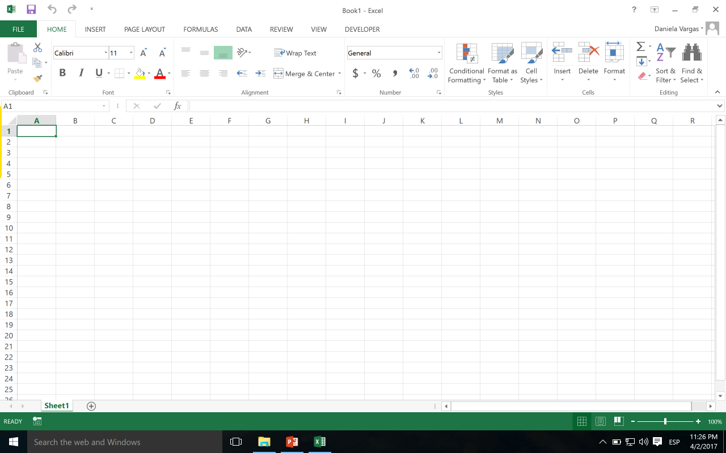
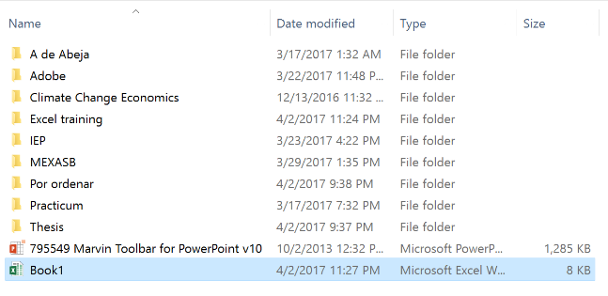
Structure of an Excel document
Excel 101
Workbook
Sheets
Columns
Rows
Cells

Slide 9
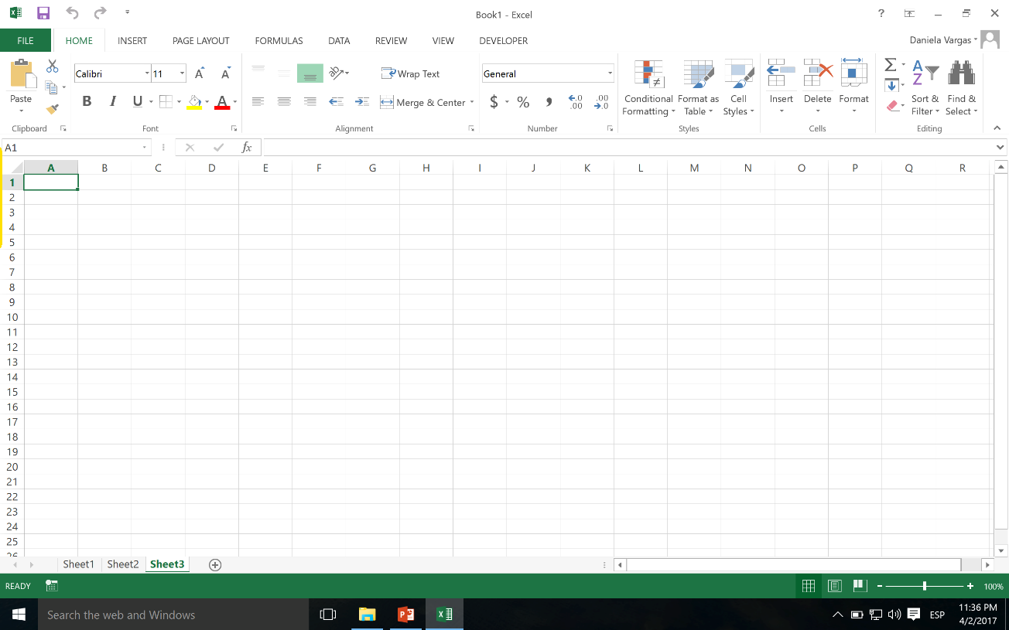
Structure of an Excel document
Excel 101
Workbook
Sheets
Columns
Rows
Cells

Slide 10
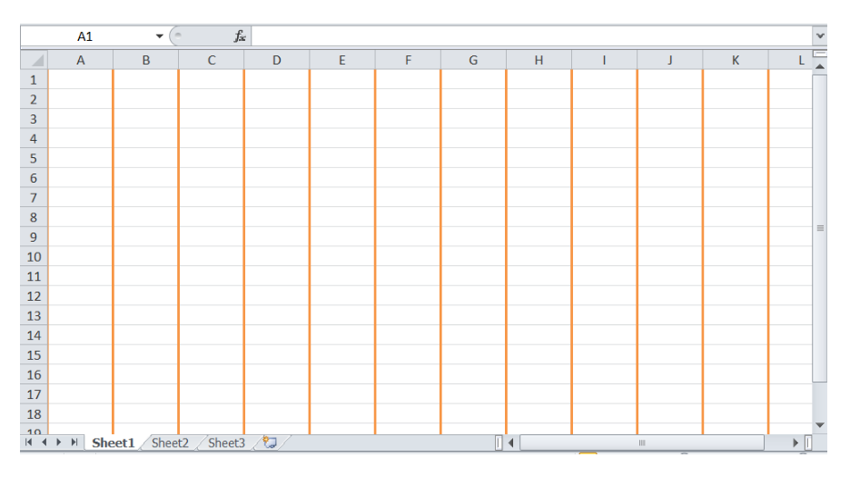
Structure of an Excel document
Excel 101
Workbook
Sheets
Columns
Rows
Excel 2013 supports 16,384 columns
Cells

Slide 11
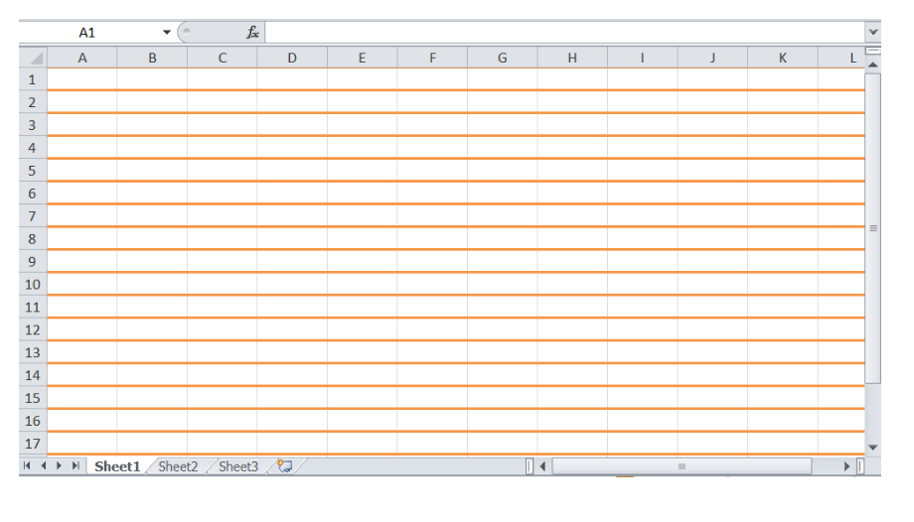
Structure of an Excel document
Excel 101
Workbook
Sheets
Columns
Rows
Excel 2007, 2010 and 2013 support 1,048,576 rows (2²⁰)
Cells

Slide 12
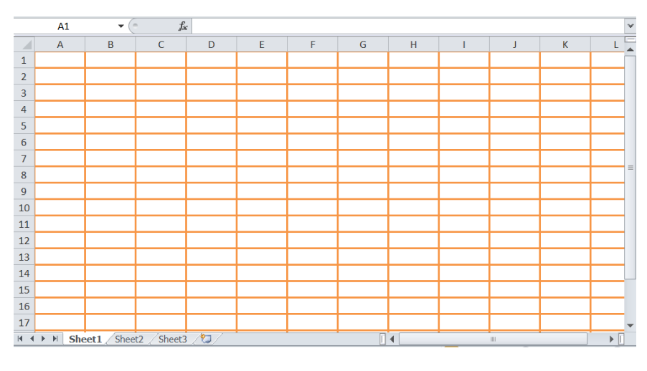
Structure of an Excel document
Excel 101
Workbook
Sheets
Columns
Rows
A group of cells (a rectangle) is called a “range” of cells
Cells

Slide 13
Contents
TRACKER
Intro
Excel 101
Structure of an Excel document
Excel toolbar
Entering data into cells
Math Operations
Formulas 101

Slide 14
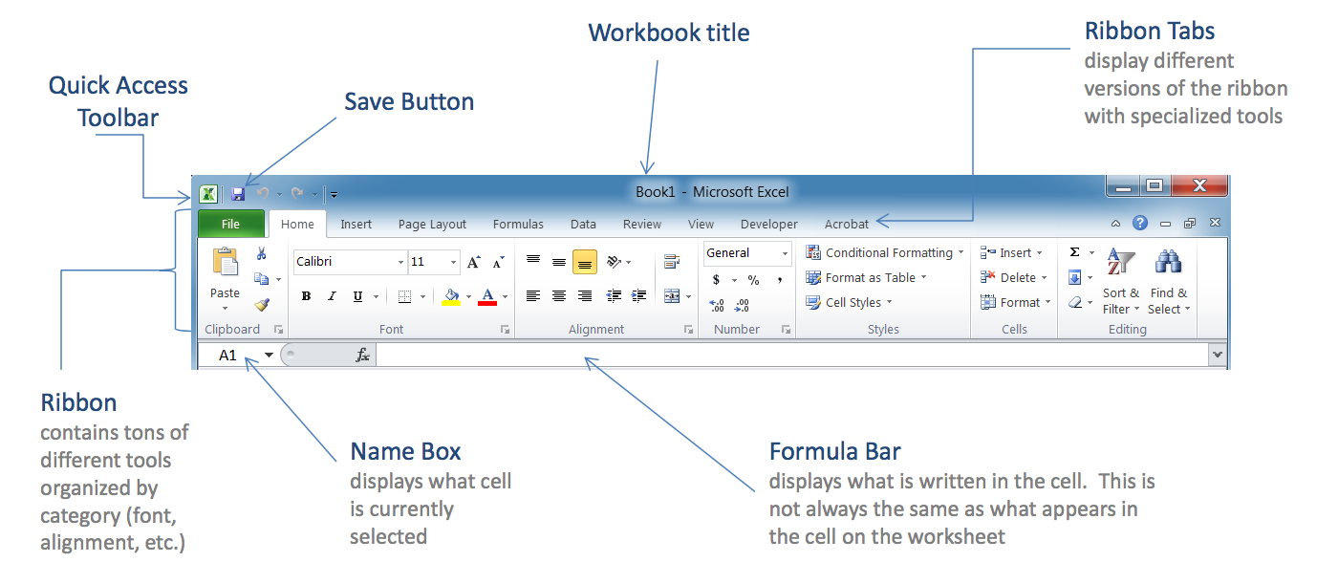
Excel toolbar
Excel 101

Slide 15
Contents
TRACKER
Intro
Excel 101
Structure of an Excel document
Excel toolbar
Entering data into cells
Math Operations
Formulas 101

Slide 16
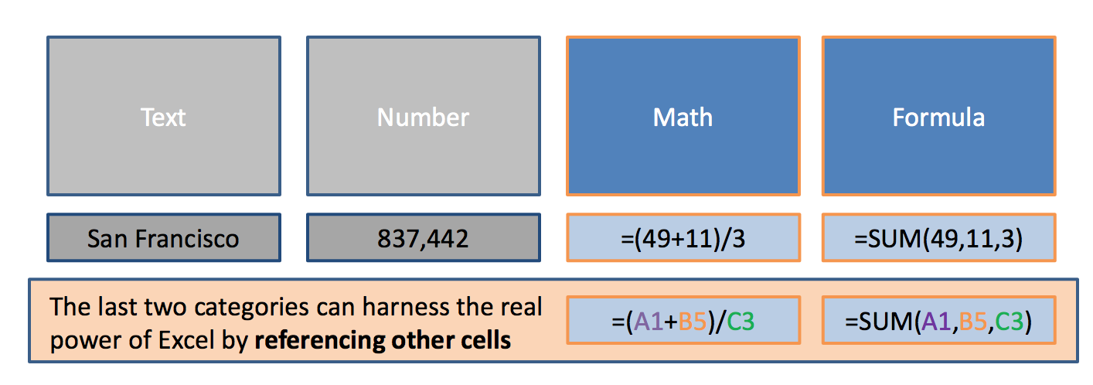
Entering data into cells
Excel 101

Slide 17
Contents
TRACKER
Intro
Excel 101
Math Operations
Referencing cells
Spreading formulas
Absolute references
Formulas 101

Slide 18
Contents
TRACKER
Intro
Excel 101
Math Operations
Referencing cells
Spreading formulas
Absolute references
Formulas 101

Slide 19
Referencing cells
Math Operations

Slide 20
Referencing cells
Math Operations

Slide 21
Contents
TRACKER
Intro
Excel 101
Math Operations
Referencing cells
Spreading formulas
Absolute references
Formulas 101

Slide 22
Spreading formulas
Math Operations

Slide 23
Spreading formulas
Math Operations
^{Double clicking only works} ^{when spreading a formula} down next to a non-empty column!

Slide 24
Contents
TRACKER
Intro
Excel 101
Math Operations
Referencing cells
Spreading formulas
Absolute references
Formulas 101

Slide 25
Absolute references
Math Operations

Slide 26
Absolute references
Math Operations
Description
G9 Both column and row float
$G$9 Both column and row are fixed
$G9 Only the column is fixed, the row can vary
G$9 Only the column can vary, the row is fixed
How to use it
Click a cell where you want to enter a formula
Type = to begin the formula
Select a cell, and then press the F4 key to make that cell reference absolute

Slide 27
Contents
TRACKER
Intro
Excel 101
Math Operations
Formulas 101
Formula format
Aggregate functions
Text functions
Logical functions

Slide 28
Contents
TRACKER
Intro
Excel 101
Math Operations
Formulas 101
Formula format
Aggregate functions
Text functions
Logical functions

Slide 29
Structure of formulas
Basic Formulas

Slide 30
Structure of formulas
Basic Formulas
Formula componentsare the most challenging part! Different formulas require different components. Whole other formulas can act as formula components; these are called “nested” formulas.But for now, let’s keep it simple!

Slide 31
Types of formulas
Introduction
Aggregate
Count(), CountA(), Sum(), etc.
Financial
PMT(), FV(), PV(), NPV(), etc.
Not mutually exclusive!
Statistical
AVERAGE(), MAX(), MIN(), etc.
Scientific
SIN(), COS(), LOG(), etc.
Text
CONCATENATE(), LEFT(), MID() and RIGHT(), etc.
Logical
IF(), OR(), etc.

Slide 32
Types of formulas
Introduction
Aggregate
Count(), CountA(), Sum(), etc.
Financial
PMT(), FV(), PV(), NPV(), etc.
Not mutually exclusive!
Statistical
AVERAGE(), MAX(), MIN(), etc.
Scientific
SIN(), COS(), LOG(), etc.
Text
CONCATENATE(), LEFT(), MID() and RIGHT(), etc.
Logical
IF(), OR(), etc.

Slide 33
Contents
TRACKER
Intro
Excel 101
Math Operations
Formulas 101
Formula format
Aggregate functions
Text functions
Logical functions

Slide 34
=SUM
Basic Formulas

Slide 35
=COUNT
Basic Formulas
This formula only works with numbers! It only counts the cells where there are numbers.

Slide 36
=COUNTA
Basic Formulas

Slide 37
Contents
TRACKER
Intro
Excel 101
Math Operations
Formulas 101
Formula format
Aggregate functions
Text functions
Logical functions

Slide 38
CONCATENATE(text1, [text2], [text3],…)
Text functions
Concatenate - joins two or more text strings into one string

Slide 39
LEN(text)
Text functions
Len - returns the number of characters in a text string

Slide 40
LEFT(text, [num_chars]) RIGHT(text,[num_chars]) MID(text, start_num, num_chars)
Text functions
Left, right, mid - returns the first character or characters in a text string, based on the number of characters you specify
Required. The text string containing the characters you want to extract
Optional. Specifies the number of characters you want RIGHT to extract
Required. Specifies the number of characters you want MID to return from text

Slide 41
Contents
TRACKER
Intro
Excel 101
Math Operations
Formulas 101
Formula format
Aggregate functions
Text functions
Logical functions

Slide 42
IF(logical_test, [value_if_true], [value_if_false])
Logical functions
If - make logical comparisons between a value and what you expect
F statement can have two results:
+ The first result is if your comparison is True
+ The second if your comparison is False
IF (logical_test, [value_if_true], IF(logical_test, [value_if_true], [value_if_false]))
Multiple IF statements require a great deal of thought to build them correctly: they require multiple open and closing parentheses (), which can be difficult to manage depending on how complex your formula becomes

Slide 43
Logical functions
If - make logical comparisons between a value and what you expect
You can use the following logical operators:
Comparison operator | Meaning | Example
= | equal to | A1=D1
> | greater than | A1>D1
>= | greater than or equal to | A1>=D1
< | less than | A1<d1< td=""></d1<>
<= | less than or equal to | A1<=D1
<> | not equal to | A1<>D1

Slide 44
SUMIF(range, criteria, [sum_range])
Logical functions
If functions - SUMIF
Optional. The actual cells to add, if you want to add cells other than those specified in the range argument. If the sum_range argument is omitted, Excel adds the cells that are specified in the range argument
Required. The range of cells that you want evaluated by criteria
Required. The criteria in the form of a number, expression, a cell reference, text, or a function that defines which cells will be added. For example: ">32", B5, "32", or "apples"
COUNTIF, AVERAGE IF

Slide 45
SUMPRODUCT (array1, [array2], [array3], ...)
Logical functions
Sumproduct - returns the sum of the products of corresponding ranges or arrays
Required. The first array argument whose components you want to multiply and then add
Optional. Array arguments 2 to 255 whose components you want to multiply and then add
The array arguments must have the same dimensions
If they do not, SUMPRODUCT returns the #VALUE! error value

Slide 46
SUMPRODUCT (array1, array2, (array3 = “condition”)*1)
Logical functions
Sumproduct - returns the sum of the products of corresponding ranges or arrays
Sumproduct can also be used as a conditional formula

Slide 47
VLOOKUP(lookup_value, table_array, col_index_num, range_lookup)
Logical functions
Vlookup/Hlookup - pull in information from a table of data based on a unique identifier
Required. The table that contains both the location of the lookup value and the data we are looking for
Required. The value we are looking up
Required. The column number that contains the value you are looking for
Required. Whether to look for approximate of exact matches: it can be either TRUE (approximate) or FALSE (exact)
The leftmost column of the table defined is 1

Slide 48
Logical functions
Vlookup/Hlookup – Possible errors that can occur
If your function's Col_Index_Num is larger than the number of columns in your Table_Array, your VLOOKUP function will return a #REF! error
If your function's Col_Index_Num is less than 1, your VLOOKUP function will return a #VALUE! Error
If you input FALSE (or 0) for your Range_Lookup parameter and no exact match can be found, your VLOOKUP function will return a #N/A error

Slide 49
INDEX(array, row_num, [column_num])
Logical functions
Index - returns a value or the reference to a value from within a table or range
Required. Selects the row in array from which to return a value. If Row_num is omitted, Column_num is required
Optional. Selects the column in array from which to return a value. If Column_num is omitted, Row_num is required
Required. A range of cells or an array constant

Slide 50
MATCH(lookup_value, lookup_array, [match_type])
Logical functions
Match - searches for a specified item in a range of cells, and then returns the relative position of that item in the range
Required. The value that you want to match in lookup_array
Required. The range of cells being searched
Optional. The number -1, 0, or 1. The match_type argument specifies how Excel matches lookup_value with values in lookup_array. The default value for this argument is 1

Slide 51
INDEX(array, row_num, MATCH(lookup_value, lookup_array, [match_type]))
Logical functions
INDEX(Match) - searches for a specified item in a range of cells, and then returns the relative position of that item in the range
You can also use a Match function to determine the row
The combo Index/Match is a more powerful version of vlookup
When nesting formulas you have to pay close attention to the parenthesis in order not to mess up the calculations!

