Slide 1
The Basics of Excel
Part II
Monday, April 10th 2017
D-Lab | University of California, Berkeley

Slide 2
Contents
TRACKER
Introduction
Text functions
Logical functions
Advanced formatting

Slide 3
Last class we learned
Introduction
The structure of an excel document
How to enter data in a cell and what to enter
Absolute references
Spreading formulas
Naming cells and ranges
The structure of formulas
Sum
Count
CountA
Subtotal
Importing text data
Paste special
Text to columns
Importing data
Sorting and filtering

Slide 4
Today we will go over
Introduction
Types of functions
Text functions:
Concatenate
Extracting substrings of text (mid/left/right)
Logical functions:
If
Countif
Sumproduct
Vlookup
Index & Match
Conditional formatting
Data validation

Slide 5
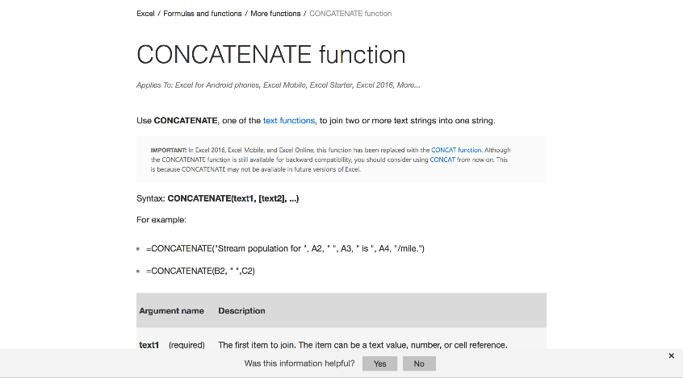
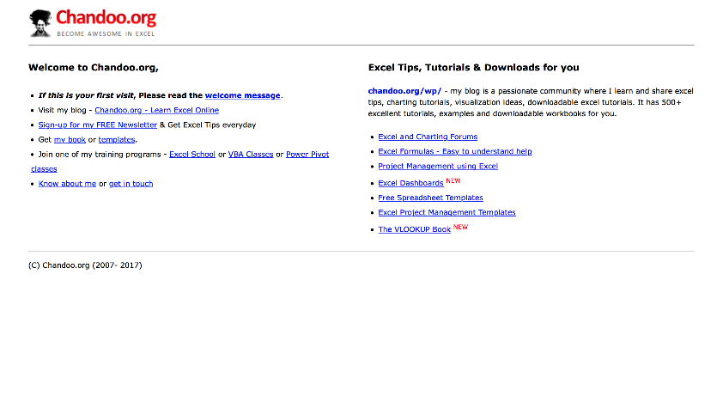
Other useful resources
Introduction
Microsoft Office’s Excel help center
Chandoo.org

Slide 6
Structure of formulas
Introduction
Different formulas require different components. Whole other formulas can act as formula components; these are called “nested” formulas.But for now, let’s keep it simple!

Slide 7
Types of formulas
Introduction
Aggregate
Count(), CountA(), Sum(), etc.
Financial
PMT(), FV(), PV(), NPV(), etc.
Not mutually exclusive!
Statistical
AVERAGE(), MAX(), MIN(), etc.
Scientific
SIN(), COS(), LOG(), etc.
Logical
IF(), OR(), etc.
Text
CONCATENATE(), LEFT(), MID() and RIGHT(), etc.

Slide 8
Types of formulas
Introduction
Aggregate
Count(), CountA(), Sum(), etc.
Financial
PMT(), FV(), PV(), NPV(), etc.
Not mutually exclusive!
Statistical
AVERAGE(), MAX(), MIN(), etc.
Scientific
SIN(), COS(), LOG(), etc.
Logical
IF(), OR(), etc.
Text
CONCATENATE(), LEFT(), MID() and RIGHT(), etc.

Slide 9
Contents
TRACKER
Introduction
Text functions
CONCATENATE
SEARCH
LEN
LEFT, MID, RIGHT
Logical functions
Advanced formatting

Slide 10
Contents
TRACKER
Introduction
Text functions
CONCATENATE
SEARCH
LEN
LEFT, MID, RIGHT
Logical functions
Advanced formatting

Slide 11
CONCATENATE(text1, [text2], [text3],…)
Text functions
Concatenate - joins two or more text strings into one string

Slide 12
Contents
TRACKER
Introduction
Text functions
CONCATENATE
SEARCH
LEN
LEFT, MID, RIGHT
Logical functions
Advanced formatting

Slide 13
SEARCH(find_text,within_text,[start_num])
Text functions
Search - locate one text string within a second text string, and return the number of the starting position of the first text string
Required. The text that you want to find
Optional. The character number in the within_text argument at which you want to start searching
Required. The text in which you want to search for the value of the find_text argument

Slide 14
Contents
TRACKER
Introduction
Text functions
CONCATENATE
SEARCH
LEN
LEFT, MID, RIGHT
Logical functions
Advanced formatting

Slide 15
LEN(text)
Text functions
Len - returns the number of characters in a text string

Slide 16
Contents
TRACKER
Introduction
Text functions
CONCATENATE
SEARCH
LEN
LEFT, MID, RIGHT
Logical functions
Advanced formatting

Slide 17
LEFT(text, [num_chars]) RIGHT(text,[num_chars]) MID(text, start_num, num_chars)
Text functions
Left, right, mid - returns the first character or characters in a text string, based on the number of characters you specify
Required. The text string containing the characters you want to extract
Optional. Specifies the number of characters you want RIGHT to extract
Required. Specifies the number of characters you want MID to return from text

Slide 18
Contents
TRACKER
Introduction
Text functions
Logical functions
IF
IF functions
SUMPRODUCT
VLOOKUP/HLOOKUP
INDEX/MATCH
Advanced formatting

Slide 19
Contents
TRACKER
Introduction
Text functions
Logical functions
IF
IF functions
SUMPRODUCT
VLOOKUP/HLOOKUP
INDEX/MATCH
Advanced formatting

Slide 20
IF(logical_test, [value_if_true], [value_if_false])
Logical functions
If - make logical comparisons between a value and what you expect
F statement can have two results:
+ The first result is if your comparison is True
+ The second if your comparison is False
IF (logical_test, [value_if_true], IF(logical_test, [value_if_true], [value_if_false]))
Multiple IF statements require a great deal of thought to build them correctly: they require multiple open and closing parentheses (), which can be difficult to manage depending on how complex your formula becomes

Slide 21
Logical functions
If - make logical comparisons between a value and what you expect
You can use the following logical operators:
Comparison operator | Meaning | Example
= | equal to | A1=D1
> | greater than | A1>D1
>= | greater than or equal to | A1>=D1
< | less than | A1<d1< td=""></d1<>
<= | less than or equal to | A1<=D1
<> | not equal to | A1<>D1

Slide 22
Contents
TRACKER
Introduction
Text functions
Logical functions
IF
IF functions
SUMIF, COUNTIF, AVERAGEIF
SUMPRODUCT
VLOOKUP/HLOOKUP
INDEX/MATCH
Advanced formatting

Slide 23
Contents
TRACKER
Introduction
Text functions
Logical functions
IF
IF functions
SUMIF, COUNTIF, AVERAGEIF
SUMPRODUCT
VLOOKUP/HLOOKUP
INDEX/MATCH
Advanced formatting

Slide 24
SUMIF(range, criteria, [sum_range])
Logical functions
If functions - SUMIF
Optional. The actual cells to add, if you want to add cells other than those specified in the range argument. If the sum_range argument is omitted, Excel adds the cells that are specified in the range argument
Required. The range of cells that you want evaluated by criteria
Required. The criteria in the form of a number, expression, a cell reference, text, or a function that defines which cells will be added. For example: ">32", B5, "32", or "apples"
COUNTIF, AVERAGE IF

Slide 25
Contents
TRACKER
Introduction
Text functions
Logical functions
IF
IF functions
SUMPRODUCT
VLOOKUP/HLOOKUP
INDEX/MATCH
Advanced formatting

Slide 26
SUMPRODUCT (array1, [array2], [array3], ...)
Logical functions
Sumproduct - returns the sum of the products of corresponding ranges or arrays
Required. The first array argument whose components you want to multiply and then add
Optional. Array arguments 2 to 255 whose components you want to multiply and then add
The array arguments must have the same dimensions
If they do not, SUMPRODUCT returns the #VALUE! error value

Slide 27
SUMPRODUCT (array1, array2, (array3 = “condition”)*1)
Logical functions
Sumproduct - returns the sum of the products of corresponding ranges or arrays
Sumproduct can also be used as a conditional formula

Slide 28
Contents
TRACKER
Introduction
Text functions
Logical functions
IF
IF functions
SUMPRODUCT
VLOOKUP/HLOOKUP
INDEX/MATCH
Advanced formatting

Slide 29
VLOOKUP(lookup_value, table_array, col_index_num, range_lookup)
Logical functions
Vlookup/Hlookup - pull in information from a table of data based on a unique identifier
Required. The table that contains both the location of the lookup value and the data we are looking for
Required. The value we are looking up
Required. The column number that contains the value you are looking for
Required. Whether to look for approximate of exact matches: it can be either TRUE (approximate) or FALSE (exact)
The leftmost column of the table defined is 1

Slide 30
Logical functions
Vlookup/Hlookup – Possible errors that can occur
If your function's Col_Index_Num is larger than the number of columns in your Table_Array, your VLOOKUP function will return a #REF! error
If your function's Col_Index_Num is less than 1, your VLOOKUP function will return a #VALUE! Error
If you input FALSE (or 0) for your Range_Lookup parameter and no exact match can be found, your VLOOKUP function will return a #N/A error

Slide 31
Contents
TRACKER
Introduction
Text functions
Logical functions
IF
IF functions
SUMPRODUCT
VLOOKUP/HLOOKUP
INDEX/MATCH
Advanced formatting

Slide 32
INDEX(array, row_num, [column_num])
Logical functions
Index - returns a value or the reference to a value from within a table or range
Required. Selects the row in array from which to return a value. If Row_num is omitted, Column_num is required
Optional. Selects the column in array from which to return a value. If Column_num is omitted, Row_num is required
Required. A range of cells or an array constant

Slide 33
MATCH(lookup_value, lookup_array, [match_type])
Logical functions
Match - searches for a specified item in a range of cells, and then returns the relative position of that item in the range
Required. The value that you want to match in lookup_array
Required. The range of cells being searched
The combo Index/Match is a more powerful version of vlookup
Optional. The number -1, 0, or 1. The match_type argument specifies how Excel matches lookup_value with values in lookup_array. The default value for this argument is 1

Slide 34
Contents
TRACKER
Introduction
Text functions
Logical functions
Advanced formatting
Data validation
Conditional formatting

Slide 35
Contents
TRACKER
Introduction
Text functions
Logical functions
Advanced formatting
Data validation
Conditional formatting

Slide 36
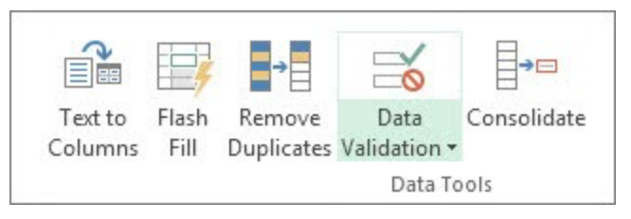
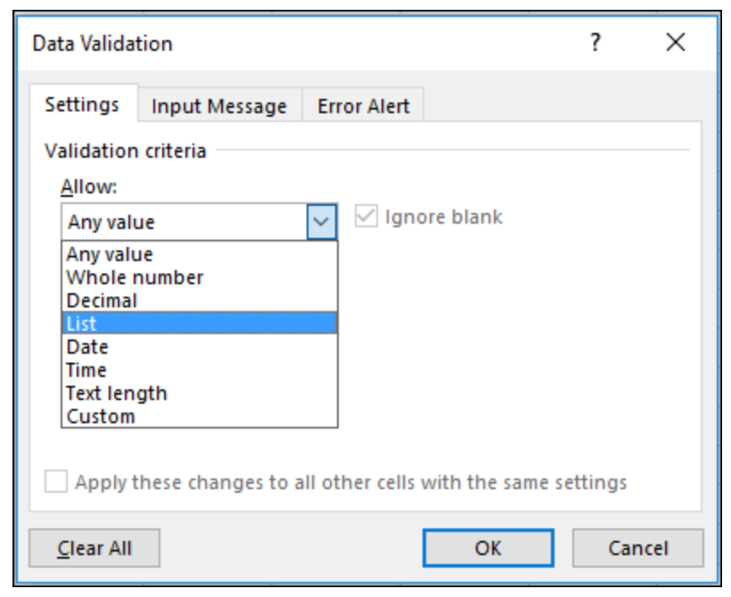
Data validation - restrict the type of data or the values that users enter into a cell
Formatting
One of the most common data validation uses is to create a drop-down list

Slide 37
Contents
TRACKER
Introduction
Text functions
Logical functions
Advanced formatting
Data validation
Conditional formatting

Slide 38
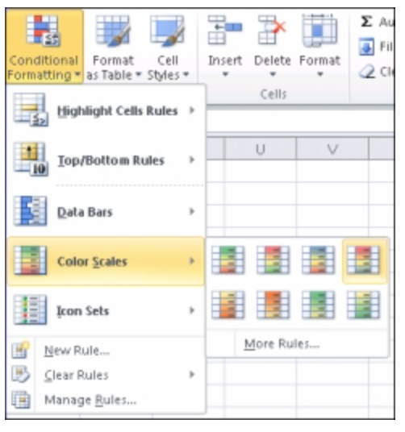
Conditional Formatting - quickly identify variances in a range of values with a quick glance
Formatting

