Slide 1
Designing and Implementing Online Survey Experiments
Doug Ahler
Travers Department of Political Science
UC Berkeley

Slide 2
Overview
Basics and terminology
Using Qualtrics to design surveys
Implementing specific types of survey experiments in Qualtrics
Maximizing treatment effectiveness
Fielding experiments on Mechanical Turk
Analyzing survey experiments
Q & A
Workshoppping individual projects

Slide 3
Features of Survey Experiments
Survey sampling and/or measurement techniques
When we use a randomly selected, population-representative sample, we have a population-based survey experiment.
Random assignment to experimental conditions
Reasoned basis for causal inference
Treatment (T) is designed to manipulate an independent variable of interest (X), theorized to affect dependent variable (Y)

Slide 4
Mechanics of Survey Experiments
Sample
Survey Form T
Survey Form C
Sample from population of interest or draw a convenience sample
Randomly assign participants to experimental conditions
Administer dependent measures and calculate within-group average estimates on Y
Treatment affects independent variable of interest (X)
Form C induces X_{C}
Form T induces X_{T}
Measure Y, obtain Y_{C}
Measure Y, obtain Y_{T}
Analysis: Estimate average treatment effect
ATE = Y_{T} - Y_{C}
−
−
−
−
−

Slide 5
A word on validity
Internal validity: the extent to which a causal inference is warranted, based on the extent to which the design can rule out alternative explanations and minimize bias
External validity: the extent to which results can be generalized to other situations and other people
How to think about student samples vs. MTurk vs. population-based experiments?

Slide 6
Overview
Basics and terminology
Using Qualtrics to design surveys
Implementing specific types of survey experiments in Qualtrics
Maximizing treatment effectiveness
Fielding experiments on Mechanical Turk
Analyzing survey experiments
Q & A
Workshopping individual projects

Slide 7
The Qualtrics Environment: Basics for Survey Experiments
Question blocks and page breaks within blocks
Adding and labeling questions
Survey flow, branching, and ending surveys
Response randomizer
Forcing or requesting responses
Display logic
The all-important randomizer tool

Slide 8
Go to Qualtrics Survey 1

Slide 9
Overview
Basics and terminology
Using Qualtrics to design surveys
Implementing specific types of survey experiments in Qualtrics
Maximizing treatment effectiveness
Fielding experiments on Mechanical Turk
Analyzing survey experiments
Q & A
Workshopping individual projects

Slide 10
“Classic” Survey Experimental Techniques
Traditionally used for improving measurement:
Question wording experiments
Question order experiments
List experiments for sensitive topics
For any of these, the randomizer tool in Qualtrics survey flow is the easiest implementation

Slide 11
Go to Qualtrics Survey 2

Slide 12
Direct and Indirect Treatments
Direct treatments: The manipulation is precisely what it appears to be to the participants
Indirect treatments: Goal is to induce an altered state, mood, thought-process, etc. through a treatment with some other ostensible purpose
A key difference is the degree to which we can be certain that the treatments had the intended effect on X.

Slide 13
Vignette Treatments
Goal: “to evaluate what difference it makes when the object of study or judgment, or the context in which that object appears, is systematically changed in some way” (Mutz 2011)
Simple example: 2 x 2 study (Jessica and Mike, from Mollborn 2005)
Here, it’s easiest to copy and paste the vignette and use the survey flow randomizer
For more complex factorial designs, you need both a large n and randomization of characteristics through embedded data

Slide 14
Go to Qualtrics Survey 3

Slide 15
Overview
Basics and terminology
Using Qualtrics to design surveys
Implementing specific types of survey experiments in Qualtrics
Maximizing treatment effectiveness
Fielding experiments on Mechanical Turk
Analyzing survey experiments
Q & A
Workshopping individual projects

Slide 16
Treatment Impact
Impact: the degree to which the treatment affects X as expected
Problems for impact:
“Low dose”
Time and decay
Participant attention
Suspicion
Use manipulation checks to confirm that T affected X as expected
Factual recall, measurement of property you are attempting to induce, etc.

Slide 17
Go to Qualtrics Survey 4

Slide 18
Overview
Basics and terminology
Using Qualtrics to design surveys
Implementing specific types of survey experiments in Qualtrics
Maximizing treatment effectiveness
Fielding experiments on Mechanical Turk
Analyzing survey experiments
Q & A
Workshopping individual projects

Slide 19
What is Mechanical Turk?
Online web-based platform for recruiting and paying people to perform tasks
Human Intelligence Tasks (HITs) can be used to recruit survey respondents

Slide 20
Looking Under the MTurk Hood
Advantages
Disadvantages
Cheap!
Participants are attentive
More diverse than a traditional convenience sample (e.g., college sophomores)
Classic findings validated
Relatively easy to create panels
Not population-representative
Degree and dimensions of non-representativeness not entirely known
Fear of Turkers becoming “professional subjects”
See Berinsky, Huber, & Lenz (2012, in Political Analysis) for more detail.

Slide 21
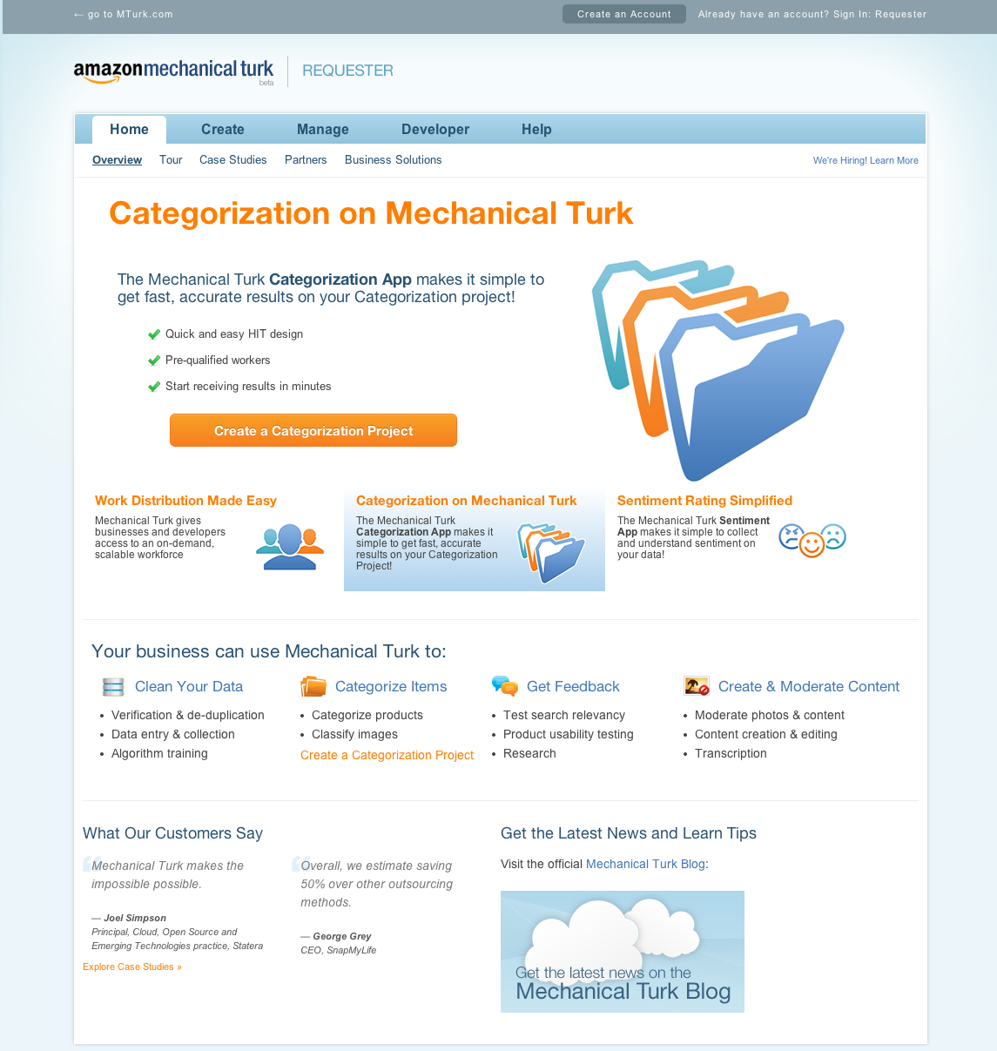
Creating a HIT

Slide 22
Some Best Practices
Allow participants much more time than necessary (~1 hour for a 10-minute survey)
Put actual time of survey in HIT description instead
Time a few non-social-scientist friends taking your survey and give Turkers an accurate description of survey length
Aim to pay Turkers ~$3 per hour
Allow potential respondents to preview your HIT, but use a bit of JavaScript to prevent them from accessing the survey without accepting the HIT

Slide 23
Confirming Participation
Create custom end-of-survey messages in Qualtrics for each potential end-of-survey
The “code-and-input” system is standard for linking survey completion on Qualtrics to payment in MTurk
Using the respondent’s Qualtrics ID + some string as a code simplifies verification and allows you to link Qualtrics and MTurk records

Slide 24
Launching a HIT
Make sure everything in survey flow works (including end-of-survey messages)
Take Qualtrics survey live and receive URL
Plug URL into your HIT on MTurk
Launch your survey by purchasing a new batch of HITs from the “Create” tab on MTurk’s requester site
Monitor and accept HITs as they initially come in, and be on the lookout for e-mails about problems

Slide 25
Good Tools to Know
Bonusing workers and reversing rejected work
Extend HITs to add more respondents

Slide 26
Multi-Wave Studies in MTurk
Why?
Within-subjects designs
Need to collect demographics in separate wave (e.g., to avoid priming)
Test for duration of effects
How?
Get consent for recontact in FIRST wave
Save MTurk IDs and match to Qualtrics respondent IDs
You used Qualtrics IDs for code/input, right?
Create second wave survey in Qualtrics and post as a HIT on MTurk
Recontact workers with Perl script

Slide 27
Recontacting Workers
Code and instructions available from Prof. Gabe Lenz:
https://docs.google.com/document/d/1-TbJWlQ1x75SUo4PAkwSzlKpGWUpRT5k2YOakDeRyXw/preview

Slide 28
A few IRB logistics…
Prior to fielding anything you might present or publish, you need approval from the Committee for the Protection of Human Subjects (CPHS)
To get this approval, you need:
2 CITI certificates:
Group 2 Social and Behavioral Research Investigators and Key Personnel
Social and Behavioral Responsible Conduct of Research
A written protocol, submitted through eprotocol

Slide 29
A few IRB logistics…
If you plan on using deception:
Debrief!
You will likely not qualify for exempt IRB status

Slide 30
Overview
Basics and terminology
Using Qualtrics to design surveys
Implementing specific types of survey experiments in Qualtrics
Maximizing treatment effectiveness
Fielding experiments on Mechanical Turk
Analyzing survey experiments
Q & A
Workshopping individual projects

Slide 31
Getting Data from Qualtrics

Slide 32
Analyzing Survey Experiments
In traditional analyses, key question is: “Is variance in Y between conditions significantly greater than variance in Y within conditions?”
Most common strategies:
t-test for difference-in-means
ANOVA and F-test
Bivariate regression of Y on T
Also consider nonparametric analyses to test sharp null hypothesis of no treatment effect (see Rosenbaum’s Observational Studies, ch. 2)

Slide 33
Multivariate Regression Adjustment
Be cautious with regression models for experimental data. (See Freedman 2008; Mutz 2011; c.f. Green 2009)
Good strategy: If using a multivariate model, only include covariates that are known to have a strong relationship with Y. Avoid the “kitchen sink model.”
Better strategy: Block on these covariates and then estimate heterogeneous treatment effects within blocks

Slide 34
Noncompliance
Subjects assigned to control receive treatment, or subjects assigned to treatment are not treated
In survey experiments, barring a Qualtrics catastrophe, we face the latter problem
Failed manipulation, suspicion, etc. can often be gleaned from manipulation checks
Addressing this problem:
DO NOT DROP PARTICIPANTS! This induces bias. Instead:
Estimate intent-to-treat (ITT) effect
Estimate complier average causal effect (CACE) by instrumenting compliance with assignment

Slide 35
Overview
Basics and terminology
Using Qualtrics to design surveys
Implementing specific types of survey experiments in Qualtrics
Maximizing treatment effectiveness
Fielding experiments on Mechanical Turk
Analyzing survey experiments
Q & A
Workshopping individual projects

Slide 36
Helpful References
Population-Based Survey Experiments (2011) by Diana Mutz
Mostly Harmless Econometrics (2009) by Joshua Angrist and Jorn-Steffen Pischke
Experimental and Quasi-Experimental Designs for Research (1963) by Donald Campbell and Julian Stanley
Cambridge Handbook of Experimental Political Science (2011), eds. Druckman, Green, Kuklinski, and Lupia

Slide 37
Reserve Slides

Slide 38
The Qualtrics Environment: A Few More Helpful Tools
Embedded data
We can use this for a variety of things, including tailoring treatments to individual respondents
Piped text
Look & Feel tab

Slide 39
Example of an Indirect Treatment
From Theodoridis (working paper)
Research question: Does the salience of an individual’s personal self-concept (X) affect the degree to which they display a “rooting interest” (or bias) (Y) in processing political news?
How to manipulate salience of personal self-concept (X)?

Slide 40
Go to Qualtrics Survey 3

Slide 41
Maximizing Effectiveness of T on Y through Within-Subjects Designs
Thus far, we’ve talked about between-group experimental designs:
R X O
R O
Here, the researcher asserts control over who gets the treatment by randomly assigning participants to one of two groups, then measuring Y.

Slide 42
Maximizing Effectiveness of T on Y through Within-Subjects Designs
An alternative is the within-subjects design, in which the researcher measures Y twice and asserts control over when treatment is administered:
O₁ X O₂
Y is measured twice, and we estimate ATE by taking the average of (O₂ – O₁) among all participants.

Slide 43
Within-Subjects Designs
Pros
Cons
Halving the number of experimental groups means doubling your effective-n
Reduces within-group variation on Y to measurement error
Both imply significant power increase – greater ability to detect effect of X on Y
Cost – requires two surveys
May be vulnerable to “history” threat to internal validity
More time-intensive
Participants must consent to recontact, so vulnerable to attrition/nonresponse bias

Slide 44
Blocking
n=200
Z=z_{a}
n=60
Treatment
n=30
Control
n=30
Z=z_{b}
n=140
Treatment
n=70
Sample
Subset the sample on hypothesized moderator Z
Block randomization
Control
n=70
Measure the DV and obtain averages for each block within conditions
Y_{aT}
Y_{aC}
Y_{bT}
Y_{bC}
−
−
−
−

Slide 45
An Example: Butler and Broockman (2011)
Question: Do legislators discriminate racially in responding to correspondence?
Treatment: E-mail from a (fake) white constituent or (fake) black constituent
DV: Response to e-mail (yes/no)?
Blocking variables: party, race of politician

Slide 46
Final Word on Blocking
Blocking is not necessary to expect equivalence on a hypothesized moderator Z between conditions, but it guarantees balance on Z
It maximizes statistical power when looking for heterogeneous treatment effects
It is a design-based approach rather than an ex-post adjustment (e.g., multivariate regression)

Slide 47
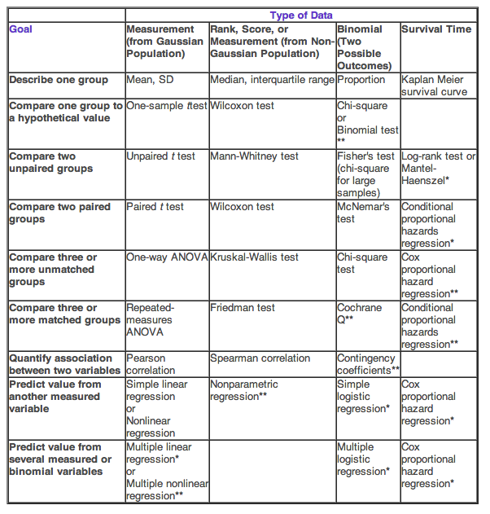
Statistical Tests

