Slide 1
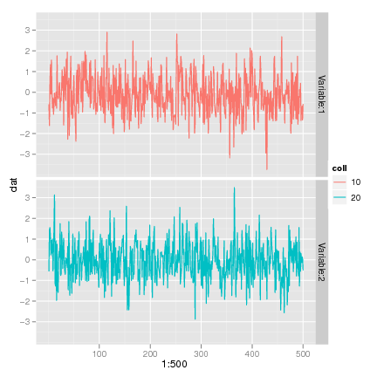
Introduction to R for Absolute Beginners: Part II
Melinda Fricke
Department of Linguistics
University of California, Berkeley
melindafricke@berkeley.edu
D-Lab Workshop Series, Spring 2013

Slide 2
Welcome (back)!
What we covered last time:
creating and manipulating objects
variable assignment =, <-, ->
types of objects
single values vs. vectors vs. data frames
types of data
numerical vs. character vs. factor (categorical)

Slide 3
Welcome (back)!
What we covered last time (cont’d):
functions for manipulating data
c()
as.factor(), as.character(), as.numerical
table(), aggregate()
functions for getting around
ls(), rm()
read.table(), write.table()
dim(), summary(), head(), tail()
subscripting e.g. salary[1,1]
dataframe rows columns

Slide 4
Today
Basic graphing
Downloading and installing packages
Basic statistical tests
… Practice, practice, practice!

Slide 5
Professors’ salaries, revisited
http://linguistics.berkeley.edu/~mfricke/R_Workshop
(S. Weisberg (1985). Applied Linear Regression, Second Edition. New York: John Wiley and Sons. Page 194. Downloaded from http://data.princeton.edu/wws509/datasets/#salary on January 31st, 2013.)
read.table(“salary.txt”, header=T) -> salary

Slide 6
Professors’ salaries
How many rows and columns are in this dataset?
What are the possible values for “rk” (rank)?
How many data points are there for each rank?
How many males vs. females are there at each rank?

Slide 7
Professors’ salaries
How many rows and columns are in this dataset?
dim(salary)
[1] 52 6
What are the possible values for “rk” (rank)?
levels(salary$rk) as.factor(salary$rk) -> salary$rk
[1] “assistant” “associate” “full”
How many data points are there for each rank?
table(salary$rk)
assistant = 18, associate = 14, full = 20
How many males vs. females are there at each rank?
table(salary$rk, salary$sx) female male
assistant 8 10
associate 2 12
full 4 16

Slide 8
Plotting
Create a plot showing the relationship between years since degree (yd) and salary (sl).
plot(y ~ x, data=NameOfDataframe) a basic scatterplot
“as a function of”

Slide 9
Plotting
Create a plot showing the relationship between years since degree (yd) and salary (sl).
plot(sl ~ yd, data=salary)

Slide 10
Plotting
Create a plot showing the relationship between years since degree (yd) and salary (sl).
plot(sl ~ yd, data=salary)
Look at the help file for “plot” and try to add the following to your plot:
a main title
labels for the x and y axes
red dots (instead of the default black dots)

Slide 11
Plotting
Create a plot showing the relationship between years since degree (yd) and salary (sl).
plot(sl ~ yd, data=salary, main=“Professors’ salaries”, xlab=“years since degree”, ylab=“salary ($)”, col=“red”)
a main title
labels for the x and y axes
red dots (instead of the default black dots)

Slide 12
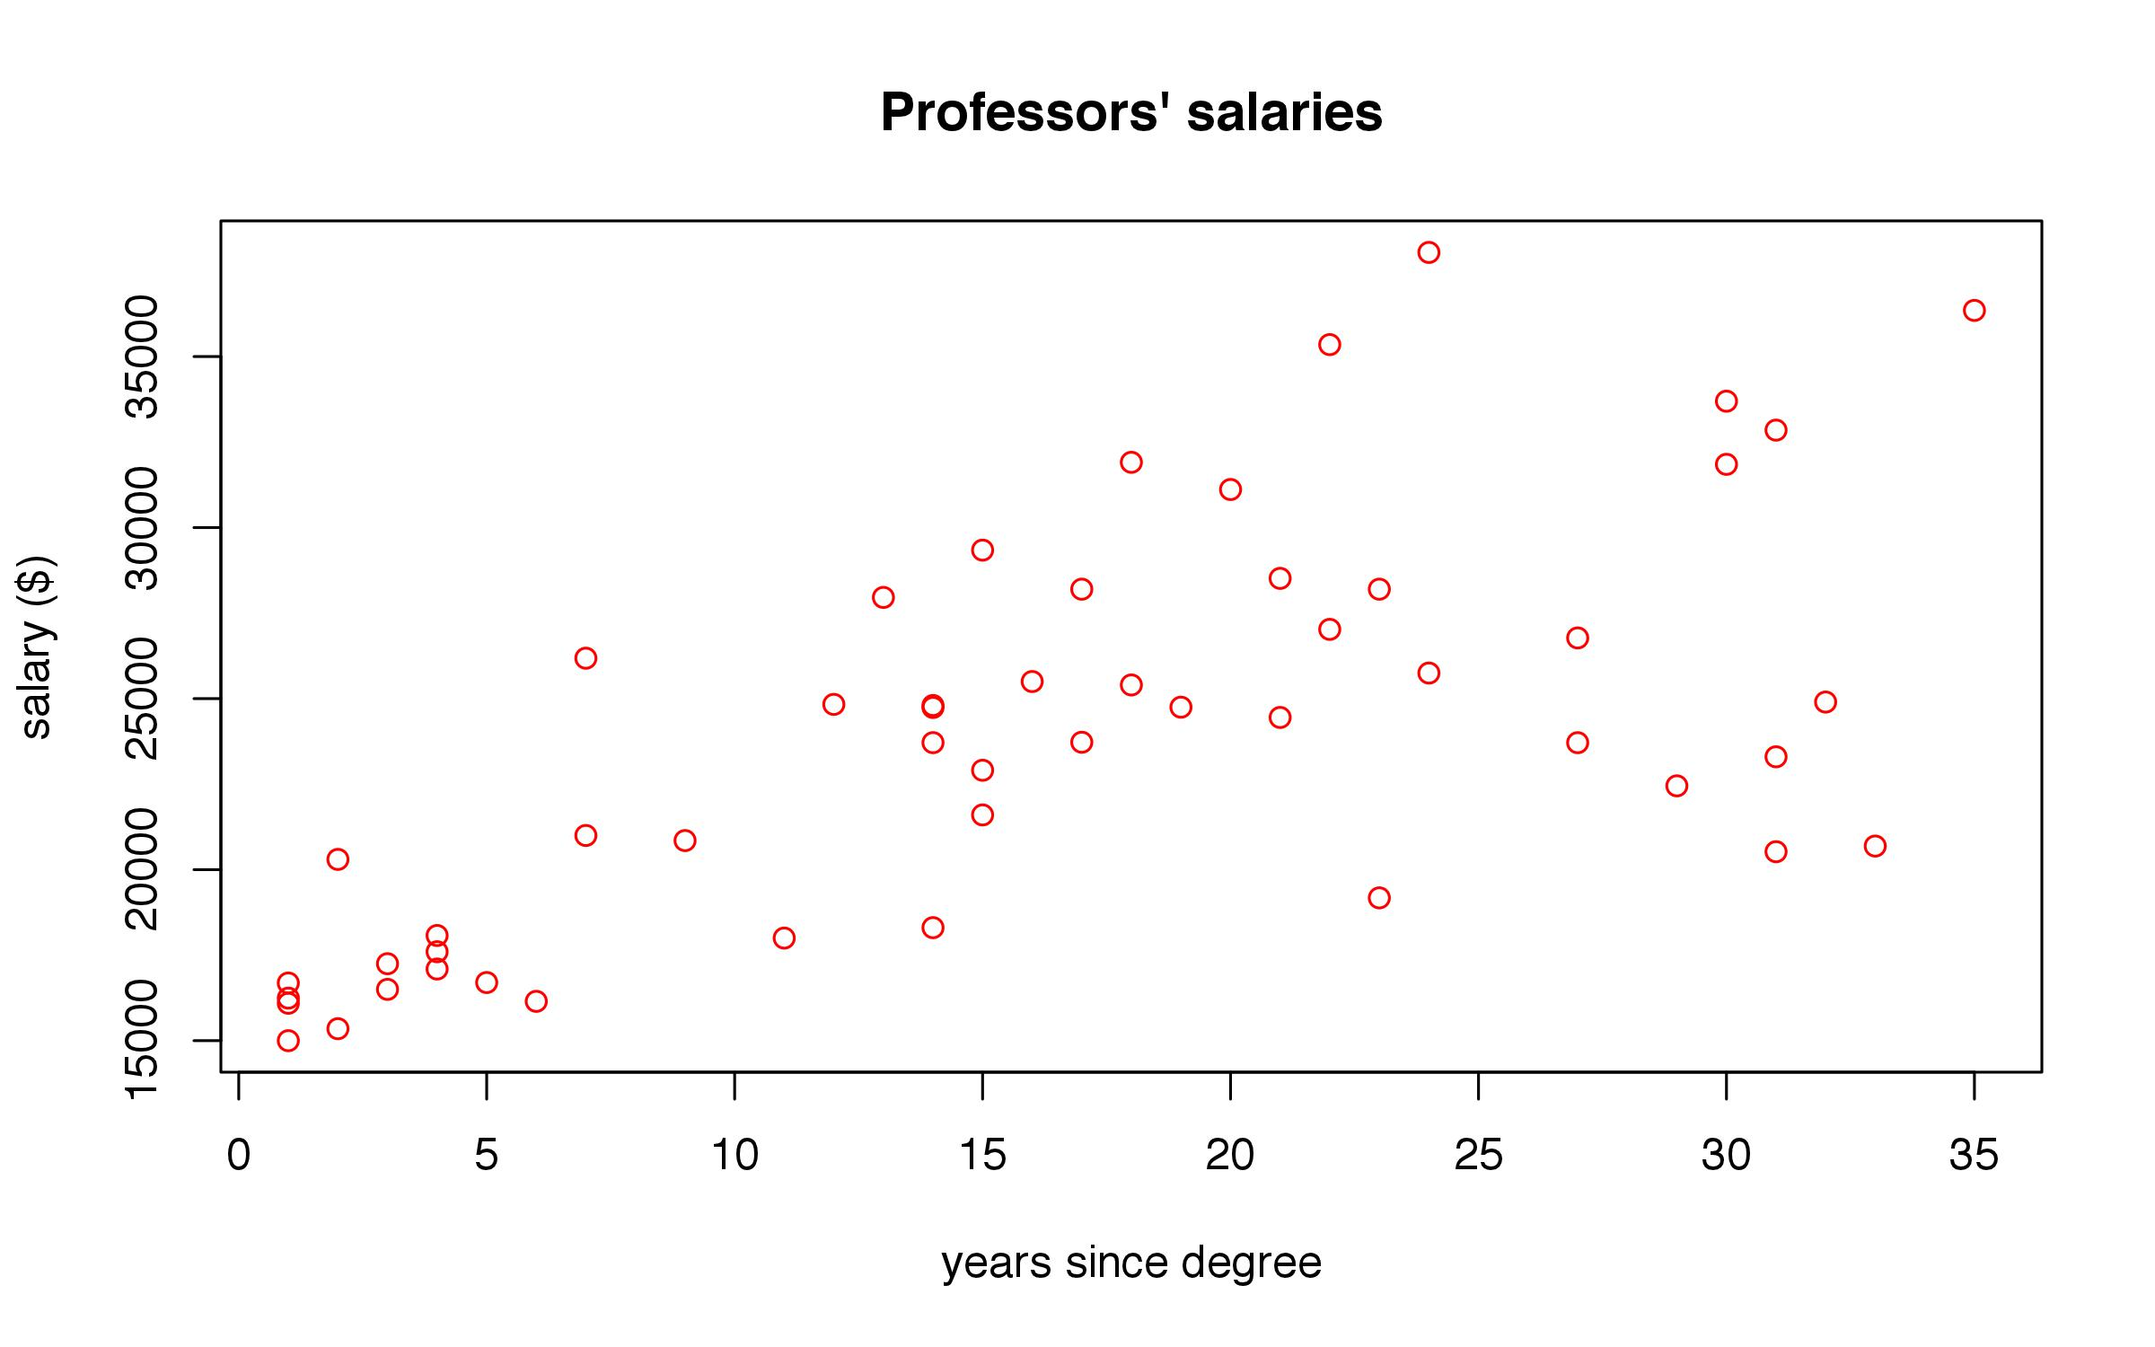
Plotting
Create a plot showing the relationship between years since degree (yd) and salary (sl).
plot(sl ~ yd, data=salary, main=“Professors’ salaries”, xlab=“years since degree”, ylab=“salary ($)”, col=“red”)
a main title
labels for the x and y axes
red dots (instead of the default black dots)

Slide 13
Plotting
Create a plot showing the relationship between years since degree (yd) and salary (sl).
plot(sl ~ yd, data=salary, main=“Professors’ salaries”, xlab=“years since degree”, ylab=“salary ($)”, col=“red”)
more customizing:
ylim = c(0, 40000) change the y range
xlim = c(0, 20) change the x range
pch = 19 specify “plotting character”

Slide 14
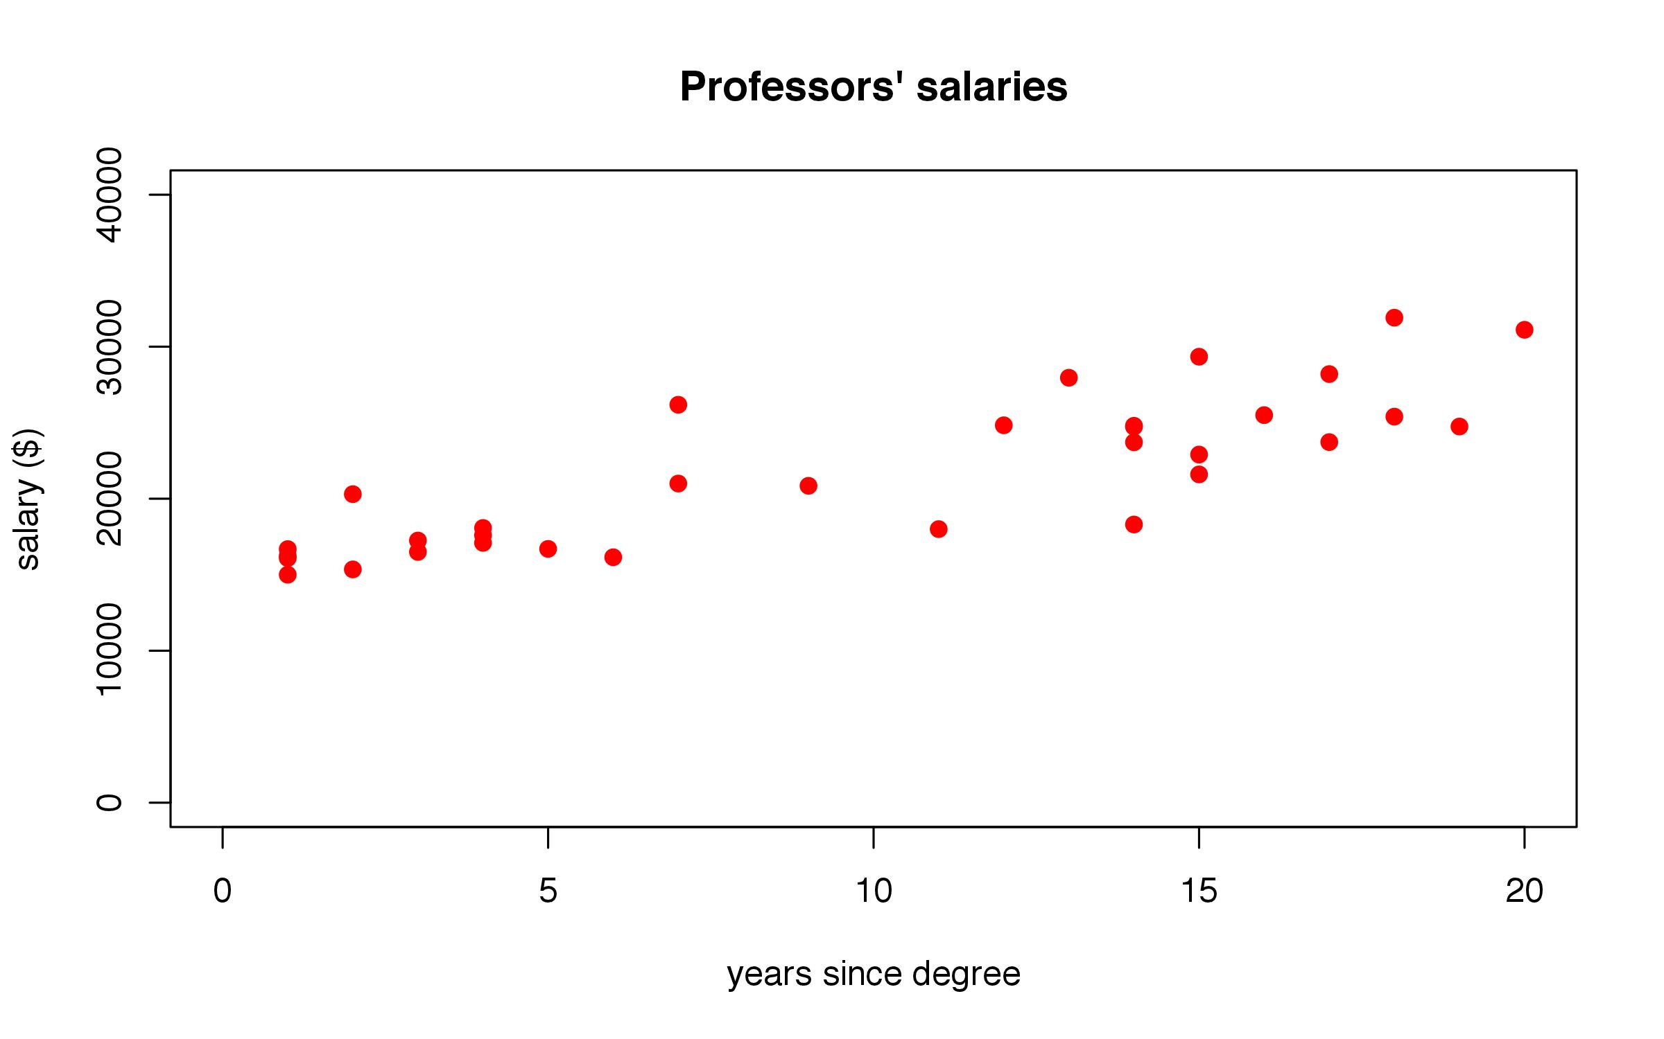
Plotting
Create a plot showing the relationship between years since degree (yd) and salary (sl).
plot(sl ~ yd, data=salary, main=“Professors’ salaries”, xlab=“years since degree”, ylab=“salary ($)”, col=“red”, ylim=c(0, 40000), xlim=c(0, 20), pch=19)
more customizing:
ylim = c(0, 40000) change the y range
xlim = c(0, 20) change the x range
pch = 19 specify “plotting character”

Slide 15
Saving a plot
jpeg(“ProfessorsSalaries.jpeg”, width=8, height=5, units=“in”, res=300)
plot(sl~ yd, data=salary, main=“Professors’ salaries”, xlab=“years since degree”, ylab=“salary ($)”, col=“red”)
dev.off()

Slide 16
More plotting
plot(salary)

Slide 17
More plotting
plot(salary)
boxplot(sl ~ sx + rk, data=salary)

Slide 18
More plotting
plot(salary)
boxplot(sl ~ sx + rk, data=salary)
show me the salary
(= dependent variable)
these variable names can be found in the data frame called “salary”
as a function of both sex and rank

Slide 19
Packages
A package is basically a set of specialized functions.
There are 2 parts to using a package: downloading and installing.
When you download R, it comes with certain packages already included.
library() all downloaded packages
sessionInfo() all installed packages

Slide 20
Packages
To download and install a new package:
In R, go to the “Packages & Data” menu.
Go to the “Package Installer”.
Search for “animation” and click “Get List”.
Select the package and click “Install Selected”.
In the console, type: library(animation).
If nothing happens, that means everything went smoothly!
Notes:
Note: Someone mentioned using SPSS last time. There is a special package for reading in SPSS and Stata (and probably other) data files.

Slide 21
Packages
We’re going to work with some data sets that come installed with R, in the “datasets” package.
library(help=datasets)
head(faithful)
eruptions = duration of each eruption
waiting = # minutes since last eruption

Slide 22
Correlation
Is there a correlation between the duration of a given eruption and the number of minutes since the preceding eruption?
Make a plot that shows the relationship between eruption duration and time since last eruption.
plot(y ~ x, data = dataframe)

Slide 23
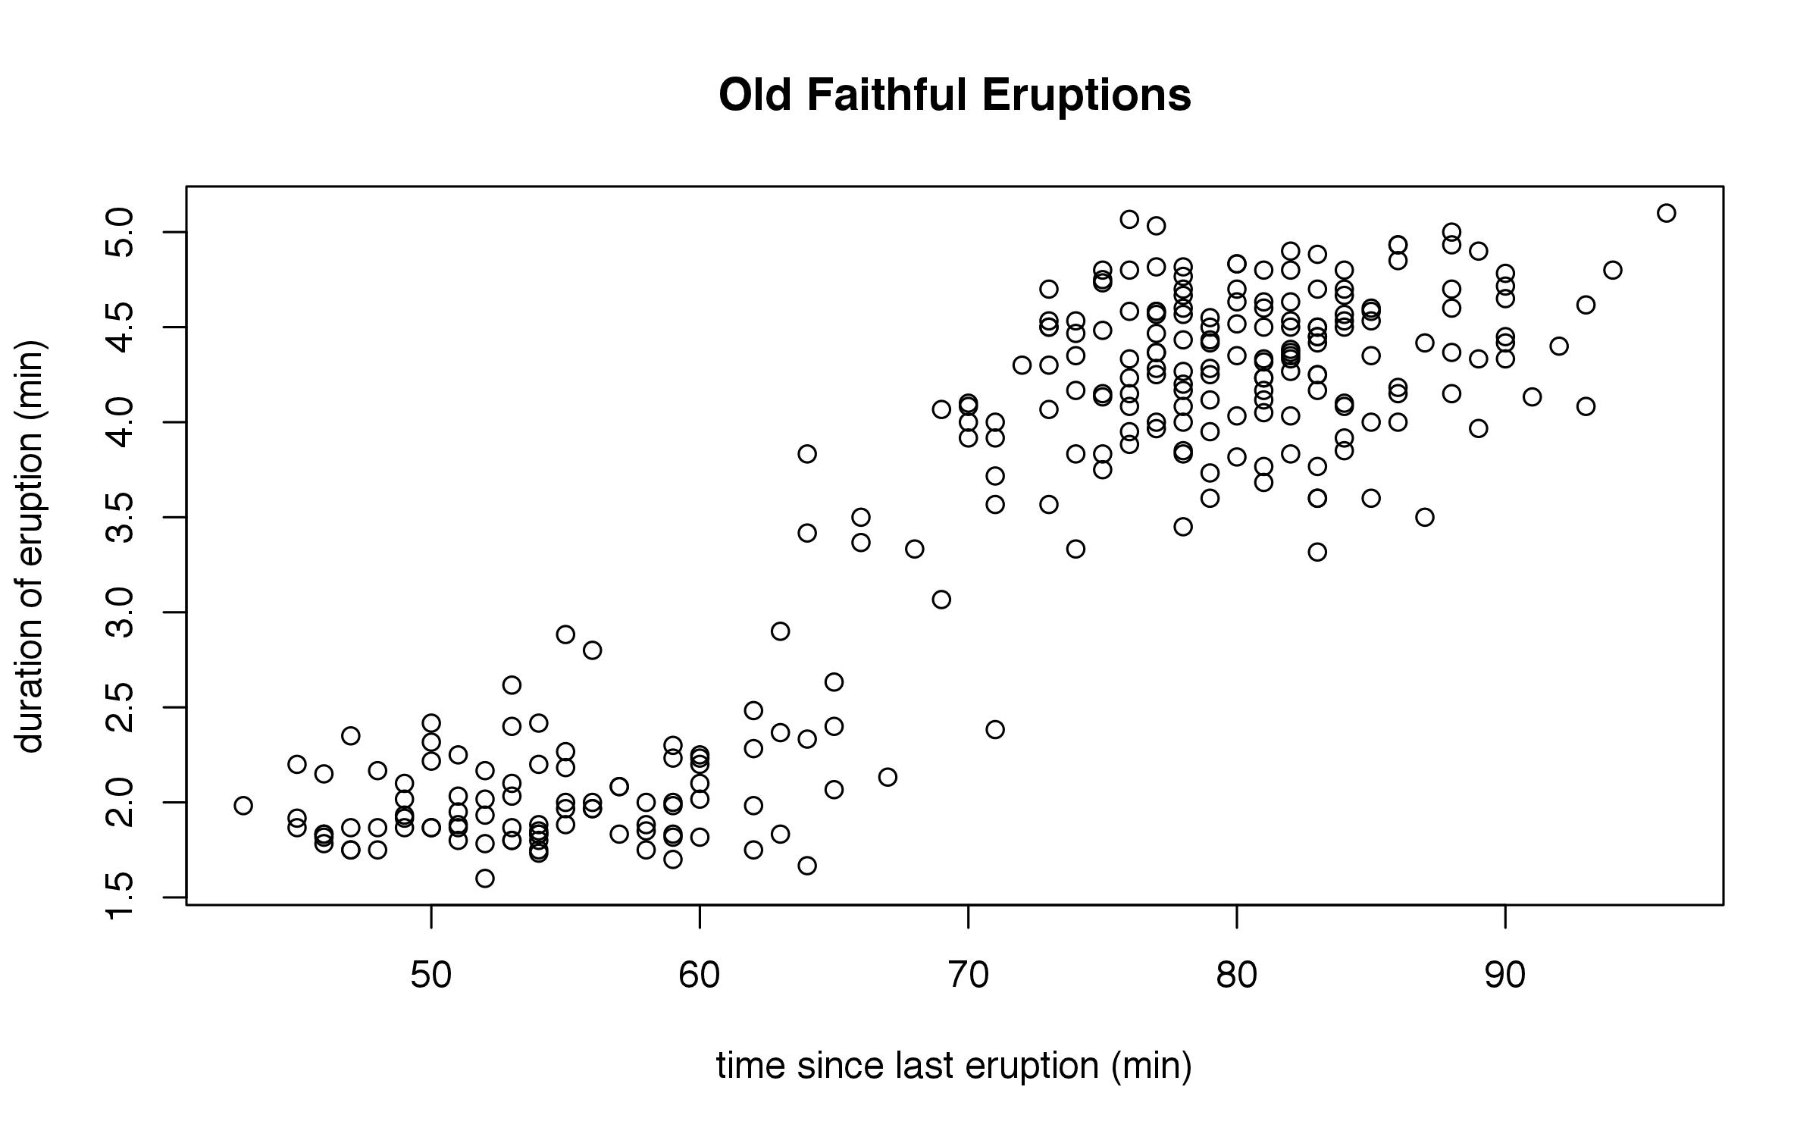
Correlation
plot(eruptions ~ waiting, data = faithful, main = "Old Faithful Eruptions", ylab = "duration of eruption (min)", xlab = "time since last eruption (min)")

Slide 24
Correlation
How can we tell if this correlation is statistically significant?
cor.test() correlation test
cor.test( ~ eruptions + waiting, data=faithful)
cor = 0.9, p < 0.0001

Slide 25
Correlation: simple linear regression
How can we tell if this correlation is statistically significant?
lm() linear model (regression)
lm(eruptions ~ waiting, data = faithful) -> faithful.lm
summary(faithful.lm)

Slide 26
Correlation: simple linear regression
> summary(faithful.lm)
Call:
lm(formula = eruptions ~ waiting, data = faithful)
Residuals:
Min 1Q Median 3Q Max
-1.29917 -0.37689 0.03508 0.34909 1.19329
Coefficients:
Estimate Std. Error t value Pr(>|t|)
(Intercept) -1.874016 0.160143 -11.70 <2e-16 ***
waiting 0.075628 0.002219 34.09 <2e-16 ***
---
Signif. codes: 0 ‘***’ 0.001 ‘**’ 0.01 ‘*’ 0.05 ‘.’ 0.1 ‘ ’ 1
Residual standard error: 0.4965 on 270 degrees of freedom
Multiple R-squared: 0.8115, Adjusted R-squared: 0.8108
F-statistic: 1162 on 1 and 270 DF, p-value: < 2.2e-16
Notes:
What is the effect of waiting time on eruption duration? For every 1 minute of waiting, the eruption lasts 0.075 minutes longer.

Slide 27
Correlation: simple linear regression
plot(eruptions ~ waiting, data = faithful, main = "Old Faithful Eruptions", ylab = "duration of eruption (min)", xlab = "time since last eruption (min)")
lines(abline(faithful.lm))

Slide 28
Correlation: “exploratory plotting”
plot(eruptions ~ waiting, data = faithful, main = "Old Faithful Eruptions", ylab = "duration of eruption (min)", xlab = "time since last eruption (min)")
lines(lowess(faithful$waiting, faithful$eruptions), col=“red”, lwd=4)
x coordinates
y coordinates
“line width”
a function that
draws a smooth line
color of the line
Notes:
We can use other functions to define what types of lines we want to draw.

Slide 29
Correlation: “exploratory plotting”
plot(eruptions ~ waiting, data = faithful, main = "Old Faithful Eruptions", ylab = "duration of eruption (min)", xlab = "time since last eruption (min)")
lines(lowess(faithful$waiting, faithful$eruptions), col=“red”, lwd=4)
x coordinates
y coordinates
“line width”
a function that
draws a smooth line
color of the line

Slide 30
Correlation: “exploratory plotting”
plot(eruptions ~ waiting, data = faithful, main = "Old Faithful Eruptions", ylab = "duration of eruption (min)", xlab = "time since last eruption (min)")
lines(lowess(faithful$waiting, faithful$eruptions), col=“red”, lwd=4)
x coordinates
y coordinates
“line width”
a function that
draws a smooth line
color of the line

Slide 31
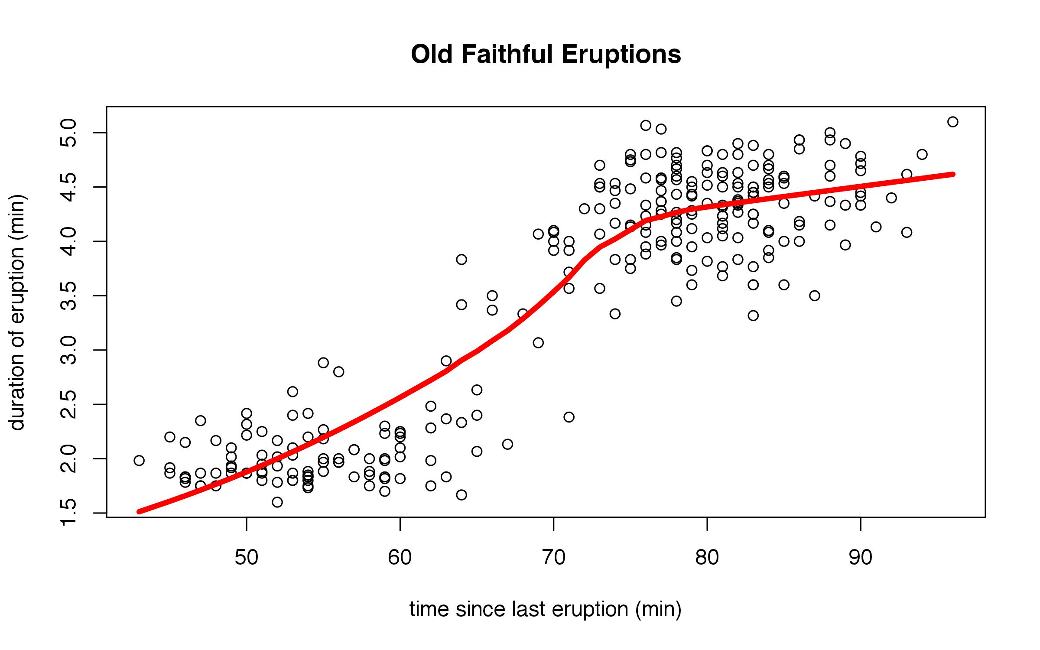
Correlation: “exploratory plotting”
plot(eruptions ~ waiting, data = faithful, main = "Old Faithful Eruptions", ylab = "duration of eruption (min)", xlab = "time since last eruption (min)")
lines(lowess(faithful$waiting, faithful$eruptions), col=“red”, lwd=4)

Slide 32
Practice: correlation
Remember the professors’ salaries dataset?
Is there a correlation between salary and years since degree?
cor.test( ~ x + y, data=yourdata)
lm(y ~ x, data=yourdata)
plot(y ~ x, data=yourdata)

Slide 33
Practice: correlation
Is there a correlation between salary and years since degree?
cor.test( ~ sl + yd, data=salary)
cor = 0.675, p = 4.102e-08

Slide 34
Practice: correlation
Is there a correlation between salary and years since degree?
cor.test( ~ sl + yd, data=salary)
cor = 0.675, p = 4.102e-08
lm(sl ~ yd, data=salary) -> salary.lm
summary(salary.lm)
Coefficients: yd = 390.65, p < 0.0001
Good news! You’ll make $391 more for every year after you get your degree!

Slide 35
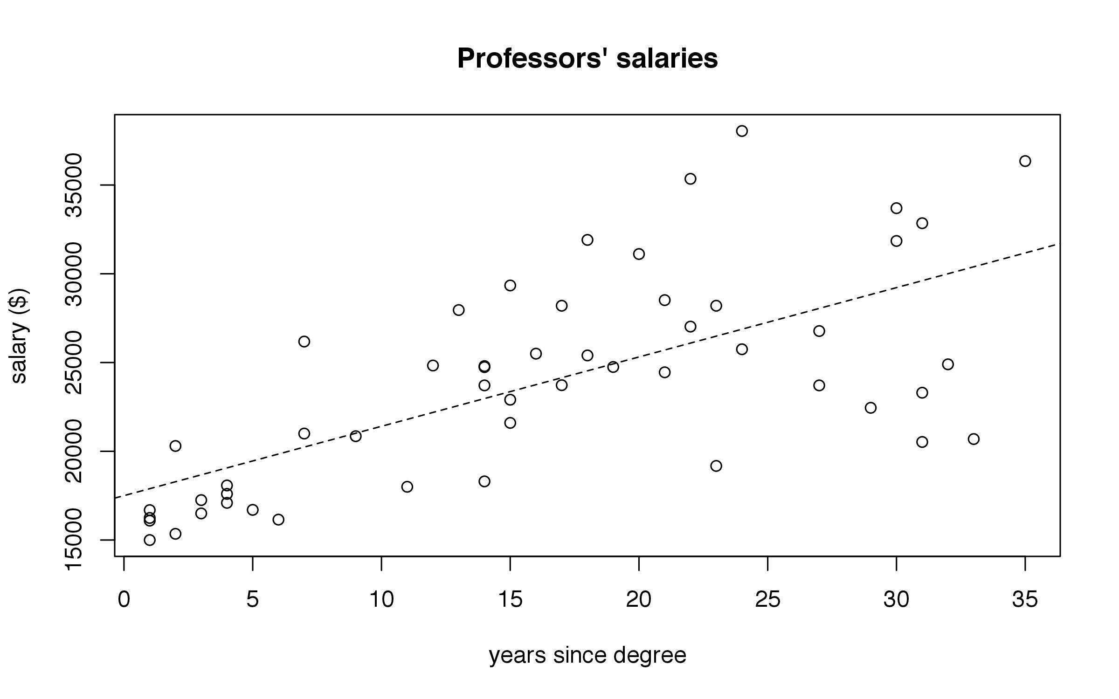
Practice: correlation
Is there a correlation between salary and years since degree?
plot(sl ~ yd, data = salary, main = “Professors’ salaries”, xlab = “years since degree”, ylab = “salary ($)”)
lines(abline(salary.lm), lty=2)

Slide 36
t-tests
A t-test asks the question:
Are these two sample distributions drawn from the same underlying population?
Example: test scores.
Test scores generally form a normal distribution: a few are excellent, and a few are horrible, but the majority are right around the average.
Given two sets of test scores, we want to know if the students from one school performed significantly better than the students at a different school.

Slide 37
t-tests
A few words about normal distributions:
A normal distribution can be described by a mean, and some variation around that mean.
Look at the help file for the function rnorm().
rnorm() generates random numbers from a normal distribution.
Create a distribution of 100 random numbers, with the mean of the distribution centered around 0.

Slide 38
t-tests
rnorm(n, mean, sd)
rnorm(100) try this multiple times

Slide 39
t-tests
rnorm(n, mean, sd)
rnorm(100) try this multiple times
hist(rnorm(100)) now try this multiple times
hist(rnorm(1000, 4.5)) and this!

Slide 40
t-tests
rnorm(n, mean, sd)
rnorm(100) try this multiple times
hist(rnorm(100)) now try this multiple times
hist(rnorm(1000, 4.5)) and this!
Each time we generate a set of random numbers, we are “sampling” from a distribution. The more numbers we generate, the better idea we get of the “underlying” distribution.

Slide 41
t-tests
A t-test asks the question:
Are these two sample distributions drawn from the same underlying population?
Example:
hist(rnorm(10), ylim=c(0,5), xlim=c(-5,5), col=“red”)
hist(rnorm(10), add=T, col=“blue”)
hist(rnorm(1000), ylim=c(0,500), xlim=c(-5,5), col=“red”)
hist(rnorm(1000), add=T, col=“blue”)

Slide 42
t-tests
One more example of the normal distribution:
library(animation)
quincunx()

Slide 43
t-tests
Example: American vs. Japanese cars
Download the .txt file located at
http://linguistics.berkeley.edu/~mfricke/R_Workshop.html, and save it to your working directory.
Read it in to R:
read.table(“Cars-MPG.txt”, header=T) -> cars
Take a minute to inspect the dataframe.

Slide 44
t-tests
hist(cars$American) a basic histogram
hist(cars$Japanese, add=T)
How can we fix this problem?

Slide 45
t-tests
hist(cars$American)
hist(cars$Japanese, add=T)
How can we fix this problem?
xlim=c(0,50)

Slide 46
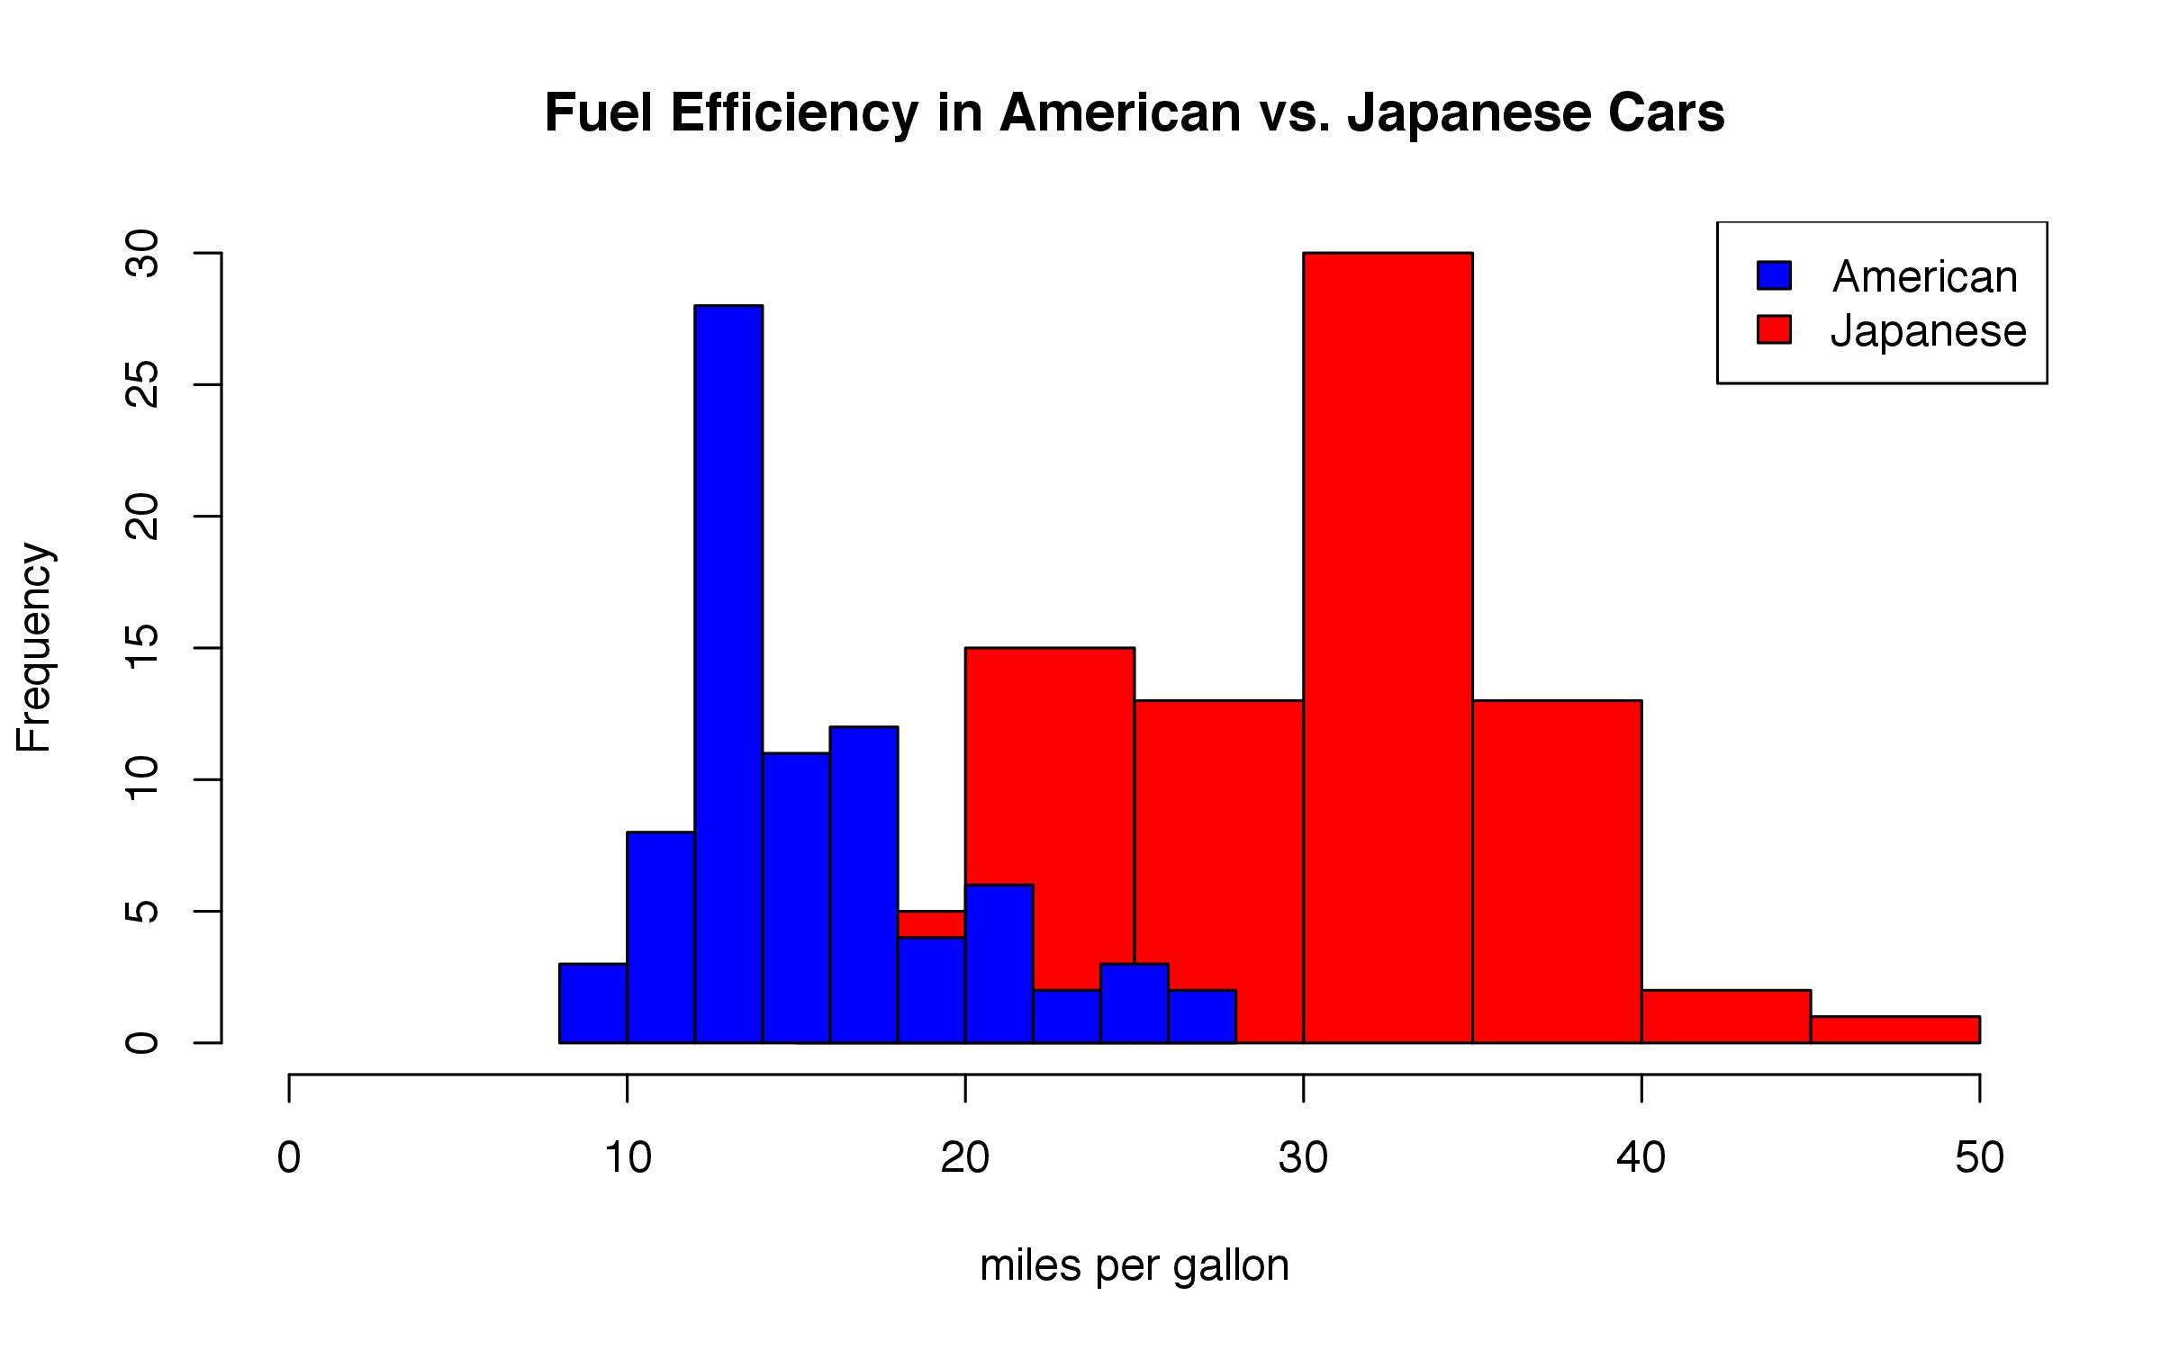
t-tests
hist(cars$Japanese, breaks=10, col="red", main="Fuel Efficiency in American vs. Japanese Cars", xlab="miles per gallon", xlim=c(0,50))
hist(cars$American, breaks=10, col="blue", add=T)
legend("topright", legend=c("American", "Japanese"), fill=c("blue", "red"))

Slide 47
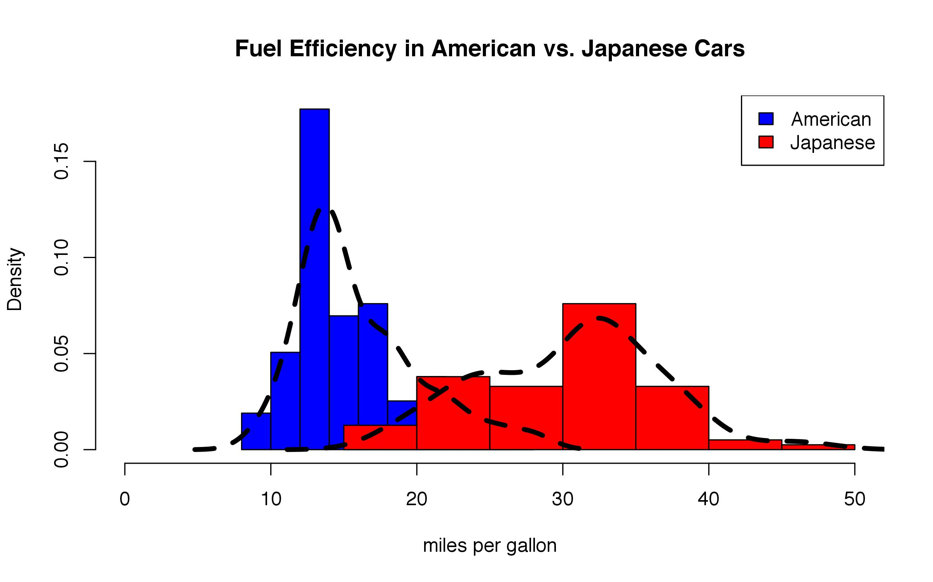
t-tests
hist(cars$American, breaks=10, col="blue", main="Fuel Efficiency in American vs. Japanese Cars", xlab="miles per gallon", xlim=c(0,50), prob=T)
legend("topright", legend=c("American", "Japanese"), fill=c("blue", "red"))
hist(cars$Japanese, breaks=10, col="red", add=T, prob=T)
lines(density(cars$American), lwd=4, lty=2)
lines(density(cars$Japanese), lwd=4, lty=2)
Notes:
The density function gives a smoothed estimate of how many observations fall into each “bin”. If you could have infinitely small bins, this is what the distribution would look like.

Slide 48
t-tests
t.test(cars$American, cars$Japanese)

Slide 49
t-tests
t.test(cars$American, cars$Japanese)
Welch Two Sample t-test
data: cars$American and cars$Japanese
t = -17.3377, df = 138.232, p-value < 2.2e-16
alternative hypothesis: true difference in means is not equal to 0
95 percent confidence interval:
-16.10429 -12.80710
sample estimates:
mean of x mean of y
16.02532 30.48101

Slide 50
ANOVA
An ANOVA (ANalysis Of VAriance) asks the question:
Given more than two sample populations, are any of them drawn from different underlying populations?
In other words: are any of these groups different?

Slide 51
ANOVA
Look at the “chickwts” dataframe.
This is data on chicken weights, according to which type of feed they received.
How many data points do we have?
How many types of feed were there, and what were they?

Slide 52
ANOVA
Look at the “chickwts” dataframe.
This is data on chicken weights, according to which type of feed they received.
How many data points do we have?
dim(chickwts)
[1] 71 2
How many types of feed were there, and what were they?
levels(chickwts$feed)
[1] “casein” “horsebean” “linseed” “meatmeal”
[5] “soybean” “sunflower”
length(levels(chickwts$feed))
[1] 6

Slide 53
ANOVA
Can you make a boxplot showing weight as a function of feed?
boxplot()

Slide 54
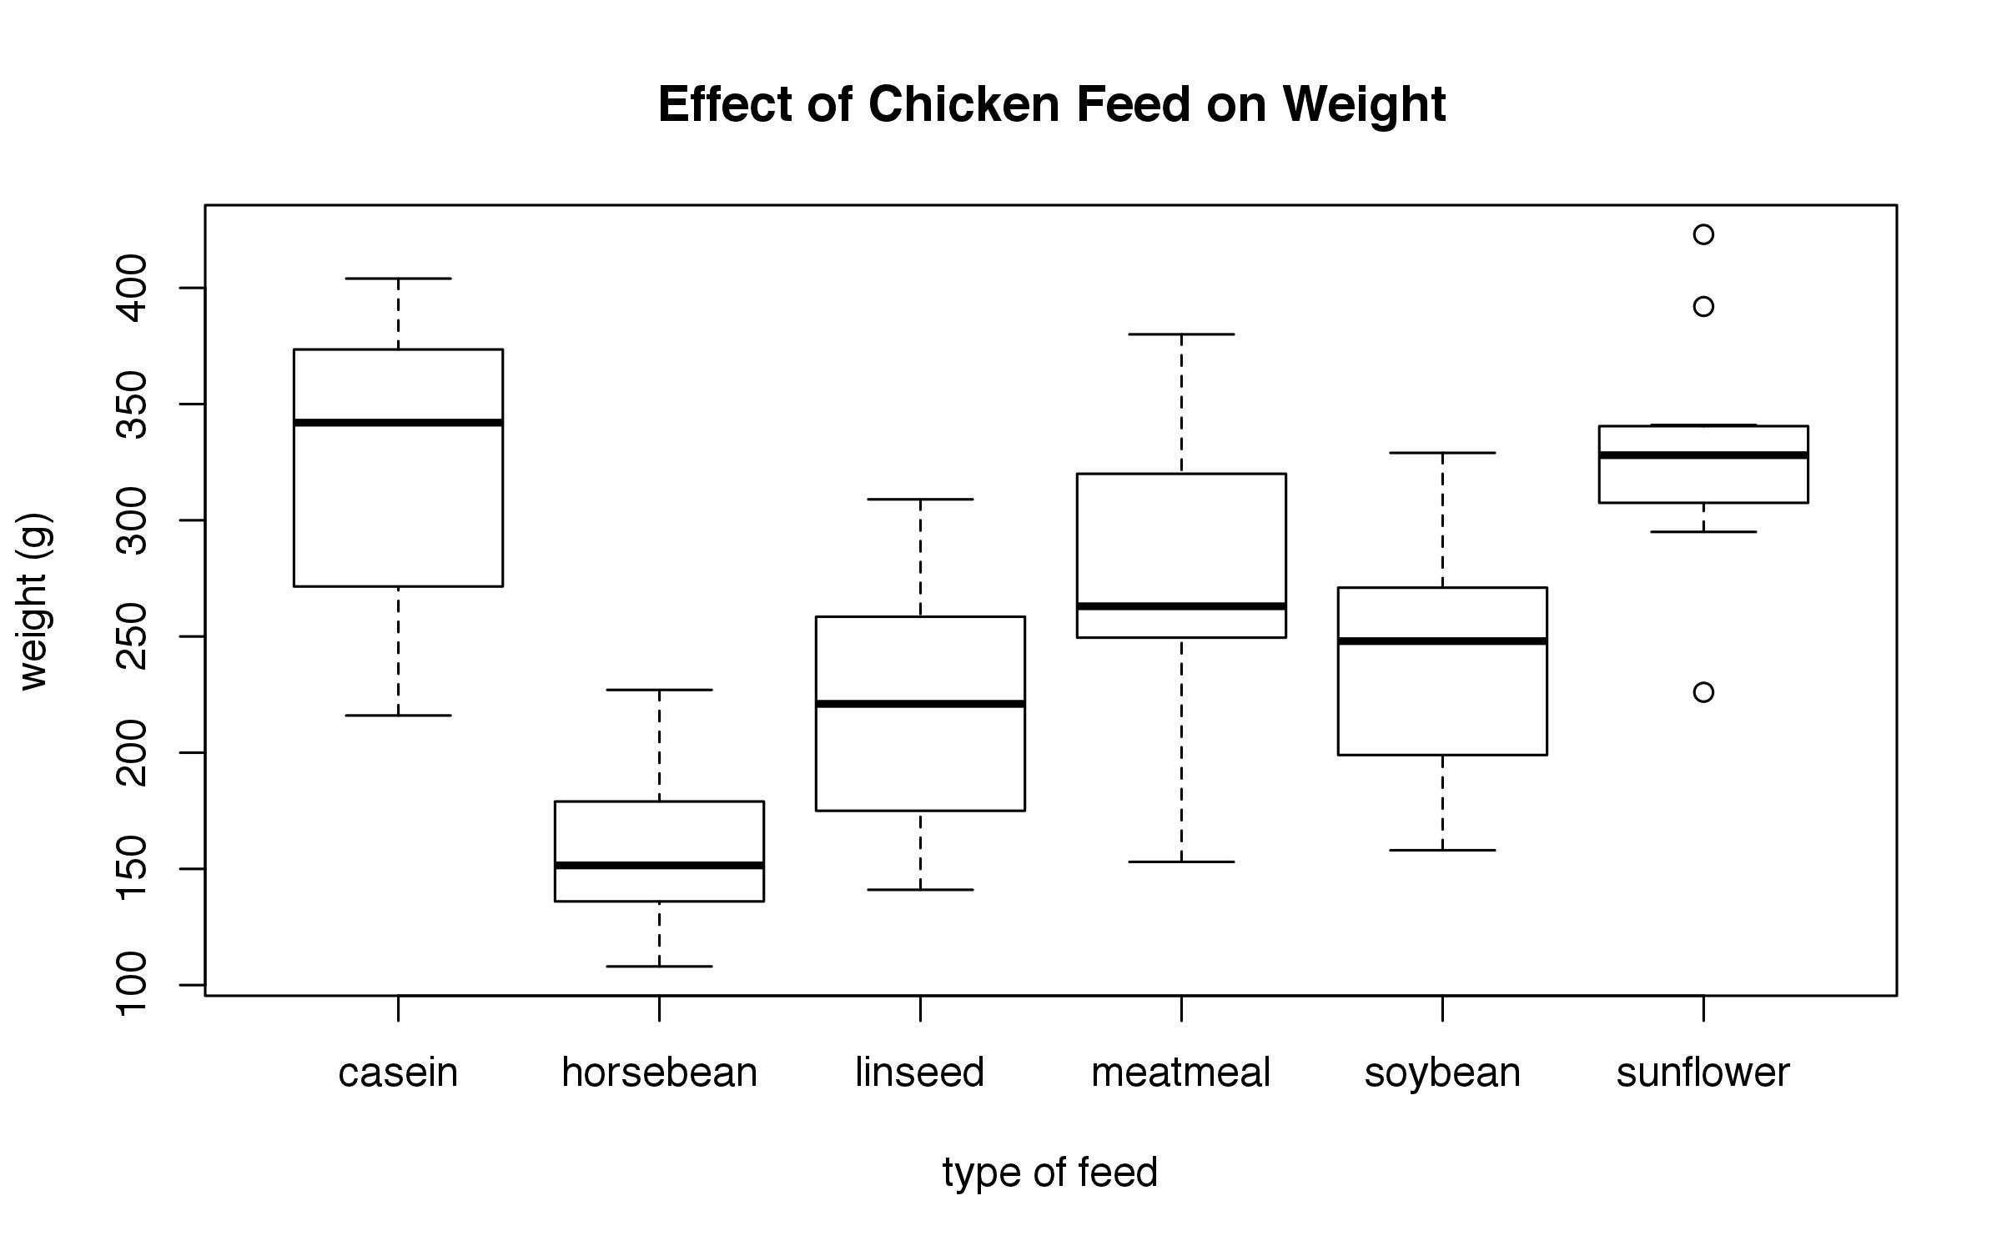
ANOVA
boxplot(weight ~ feed, data = chickwts, main = "Effect of Chicken Feed on Weight", ylab = "weight (g)", xlab = "type of feed")

Slide 55
ANOVA
boxplot(weight ~ feed, data = chickwts, main = "Effect of Chicken Feed on Weight", ylab = "weight (g)", xlab = "type of feed")
anova(lm(weight ~ feed, data = chickwts))

Slide 56
ANOVA follow-up: t-test
An ANOVA only tells you whether ANY of the groups you’re comparing are different from ANY of the others.
If you want to check whether specific groups are different, you need to do a t-test.

Slide 57
ANOVA follow-up: t-test
An ANOVA only tells you whether ANY of the groups you’re comparing are different from ANY of the others.
If you want to check whether specific groups are different, you need to do a t-test.
subset(chickwts, feed==“casein”) -> casein
subset(chickwts, feed==“horsebean”) -> horsebean

Slide 58
ANOVA follow-up: t-test
An ANOVA only tells you whether ANY of the groups you’re comparing are different from ANY of the others.
If you want to check whether specific groups are different, you need to do a t-test.
subset(chickwts, feed==“casein”) -> casein
subset(chickwts, feed==“horsebean”) -> horsebean
t.test(casein$weight, horsebean$weight)
t = 7.34, p = 0.000000721

Slide 59
Practice: ANOVA
Do professors of different ranks make different amounts of money? How can you depict this graphically?

Slide 60
Practice: ANOVA
Do professors of different ranks make different amounts of money? How can you depict this graphically?
anova(lm(sl ~ rk, data = salary))
p = 1.174e-15 (0.000000000000001174)
boxplot(sl ~ rk, data = salary)

Slide 61
Practice: ANOVA
How do male and female salaries compare? Is this relationship consistent across ranks?

Slide 62
Practice: ANOVA
How do male and female salaries compare? Is this relationship consistent across ranks?
anova(lm(sl ~ sx * rk, data=salary))
sx, p = 0.001
rk, p < 0.0001
sx:rk, p = 0.85
Men and women make different amounts, and professors of different ranks make different amounts, but there is no interaction between sex and rank: men and women are equally unequal across all ranks!

Slide 63
Practice: ANOVA
How do male and female salaries compare? Is this relationship consistent across ranks?
anova(lm(sl ~ sx * rk, data=salary))
sx, p = 0.001
rk, p < 0.0001
sx:rk, p = 0.85
Men and women make different amounts, and professors of different ranks make different amounts, but there is no interaction between sex and rank: men and women are equally unequal across all ranks!
‘*’ means “check each of these factors, plus their interaction”

Slide 64
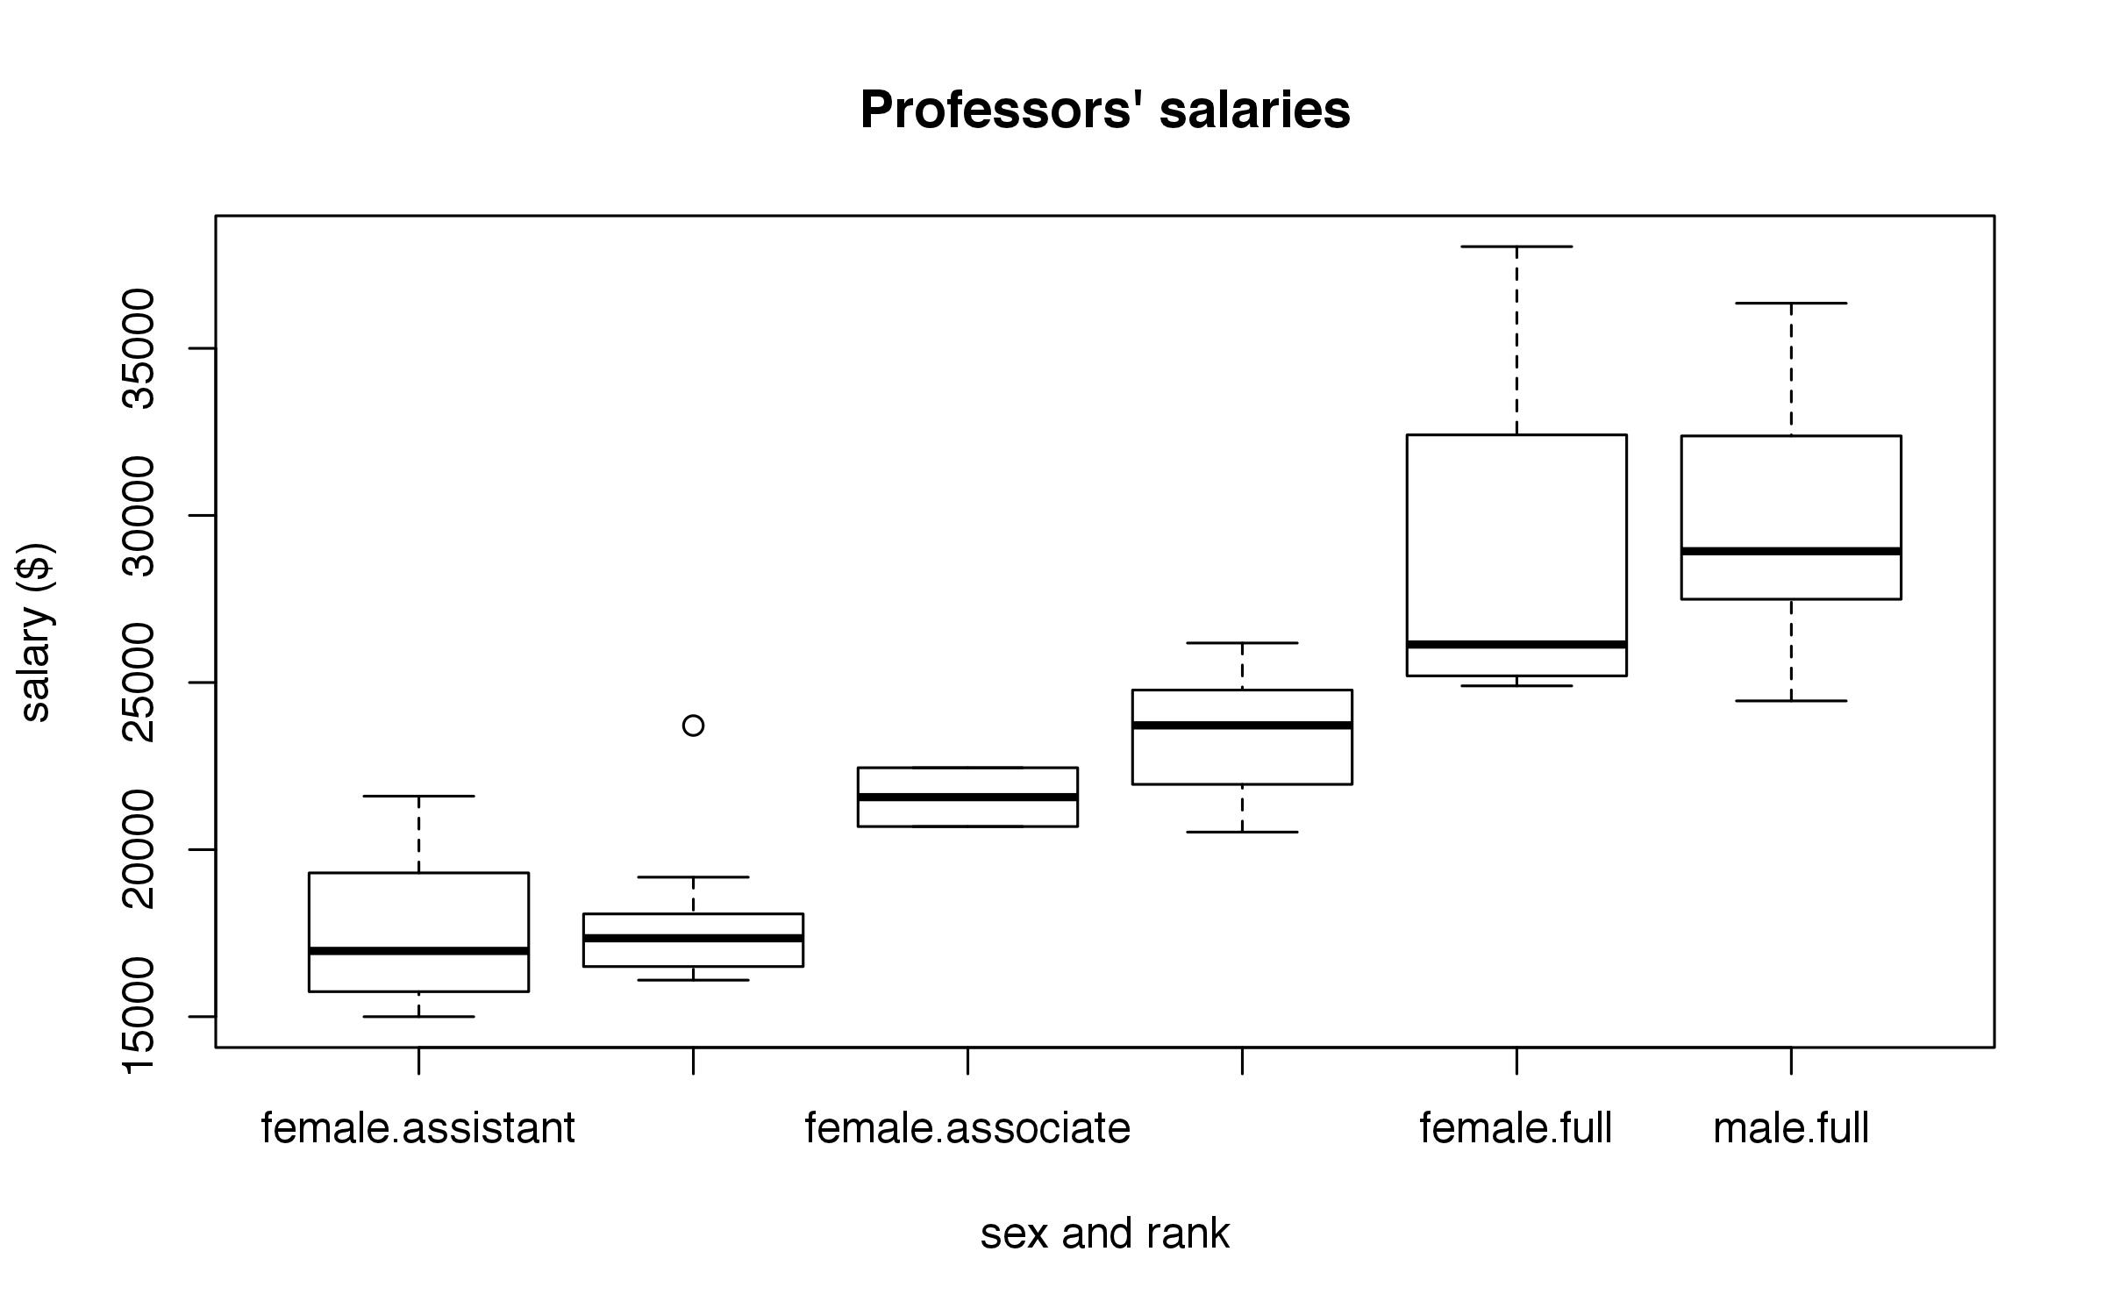
Practice: ANOVA
How do male and female salaries compare? Is this relationship consistent across ranks?
boxplot(sl ~ sx + rk, data = salary, main = “Professors’ salaries”, xlab = “sex and rank”, ylab = “salary ($)”)

Slide 65
chi-squared tests
A chi-squared test asks the question:
If I were sampling multiple times from one underlying population, would this set of counts be surprising?
If the probability of a given outcome is very low, then you probably aren’t sampling from one population.
You’re probably dealing with two different populations.

Slide 66
chi-squared tests: an example
Imagine you are blindfolded, and someone tells you there are two boxes in front of you.

Slide 67
chi-squared tests: an example
Imagine you are blindfolded, and someone tells you there are two boxes in front of you.

Slide 68
chi-squared tests: an example
You are given one box, and you draw 10 balls out of it.
sample 1
red 9
blue 1

Slide 69
chi-squared tests: an example
You are again given a box, and you also draw 10 balls out of it.
sample 1 sample 2
red 9 0
blue 1 10

Slide 70
chi-squared tests: an example
You are again given a box, and you also draw 10 balls out of it.
sample 1 sample 2
red 9 0
blue 1 10
Do you think you were given two different boxes, or did you sample from the same box twice?

Slide 71
chi-squared tests: an example
Let’s do the same thing over again…
sample 1 sample 2
red 5 4
blue 5 6
What if the counts looked like this?

Slide 72
chi-squared tests: an example
Let’s do the same thing over again…
sample 1 sample 2
red 5000 4000
blue 5000 6000
What if the counts looked like this?

Slide 73
chi-squared tests: an example
Let’s do the same thing over again…
sample 1 sample 2
red 5000 4000
blue 5000 6000
What if the counts looked like this?
A chi-squared test asks how surprised we should be at a given outcome, assuming we’re
drawing balls out of the same box.

Slide 74
chi-squared tests: an example
matrix(data = c(5, 5, 6, 4), nrow=2) -> ex1
matrix(data = c(10, 0, 1, 9), nrow=2) -> ex2
matrix(data = c(5000, 5000, 6000, 4000), nrow=2) -> ex3
ex1
chisq.test(ex1)
chisq.test(ex2)
chisq.test(ex3)

Slide 75
chi-squared tests: an example
matrix(data = c(5, 5, 6, 4), nrow=2) -> ex1
matrix(data = c(10, 0, 1, 9), nrow=2) -> ex2
matrix(data = c(5000, 5000, 6000, 4000), nrow=2) -> ex3
ex1
chisq.test(ex1)
X-squared = 0, df = 1, p = 1
chisq.test(ex2)
X-squared = 12.9293, df = 1, p-value = 0.0003235
chisq.test(ex3)
X-squared = 201.6164, df = 1, p-value < 2.2e-16
If we draw from the same box over and over again, the probability of observing a distribution like example 1 goes to 1. Example 1 should not surprise us at all. There is no reason to think we’re drawing from 2 separate boxes.
The probability of drawing from the same box and getting a distribution like example 2, though, is VERY small. So we’re probably not drawing from the same box!

Slide 76
chi-squared tests
A chi-squared test asks the question:
If I were sampling multiple times from one underlying population, would this set of counts be surprising?
If the probability of a given outcome is very low, then you probably aren’t sampling from one population.
You’re probably dealing with two different populations.

Slide 77
What we did today
A common way of entering formulas in R:
(y ~ x, data = dataframe)
plot(y ~ x, data = dataframe)
boxplot(y ~ x, data = dataframe)
lm(y ~ x, data = dataframe)
anova(lm(y ~ x, data = dataframe))

Slide 78
What we did today
Some functions ask for data in a different format, though. Check the help file to see what a function’s arguments are!
cor.test(~ x + y, data = dataframe)
t.test(dataframe$x, dataframe$y)
?cor.test or help(cor.test)

Slide 79
What we did today
There are lots of ways to customize plots!
main = “” main title
xlim = c(x,y) set the range for the x values
ylim = c(x,y) set the range for the y values
xlab = “” label the x axis
ylab = “” label the y axis
col = “blue” set the color for an object
lwd = 2 set the width for a line
lty = 2 define the type of line to use (2 = dashed)
pch = 19 set the plotting character
legend() add a legend to a plot

Slide 80
Thank you!
I hope this was helpful.
Please give me your feedback so I can improve the workshop for future iterations.
Also be sure to check out the other D-Lab R offerings!

